Slide 1
ElderCare of Alachua County
The Mission of ElderCare of Alachua County is to be an advocate for the elderly and provide services that will build capacity, maximize independence, and enrich the quality of life for the seniors in Alachua County and north central Florida.

Slide 2
Alachua County Senior Recreation Center
Notes:
COVERAGE
QUALIFICATIONS
MD TO FOLLOW

Slide 3
Alachua County Senior Recreation Center
Funding of the center
Qualifications:
Age 60
Live in Alachua County
Membership is free
Simple application
Provided over 500 programs
Fitness Center which includes a trainer M-F from 8-12
$5 a month charge
Monthly Social Events

Slide 4
Alachua County Senior Recreation Center
Senior Center Video

Slide 5
Alachua County Senior Recreation Center Membership (cumulative)

Slide 6
Alachua County Senior Recreation Center
Looking at the latest survey we developed additional programs based on results
The first of the themed days
Tuesdays –Orthopedic Day
9:30am-11:30am Parkinson's Exercise Program
10:00am-11:15am Yoga
11:30am-12:30pm Chair Yoga
11:30am-12:30pm Dance for Lifelong Health
1:15pm-2:30pm Parkinson's Exercise Class
1:00pm-5:00pm Have speakers from UF Health OSMI

Slide 7
Meals on Wheels Program
Who qualifies: Seniors 60 and over
How to enroll/utilize programs:
Call 352-265-9040
Assessment is done over the phone, priority score assigned and when slots are opened a home visit is done and services are set up and start!
Coverage area: Alachua County
Depending on Program may have a co-pay
Notes:
COVERAGE
QUALIFICATIONS
MD TO FOLLOW

Slide 8
Alachua County Senior Recreation Center
Faces of Hunger

Slide 9
Meals on Wheels Program
Program details:
Congregate Meals- currently 6 sites around Alachua County
Hot/Cold Meals, Programs, and Socialization
Home Delivered Meals
Hot/Cold Meal, Well being check
Currently serve over 300 clients
Wait List is around 900 and growing-
Private pay option for those that can afford
$40 a week for hot meals
$42.50 a week for frozen meals
Notes:
COVERAGE
QUALIFICATIONS
MD TO FOLLOW

Slide 10
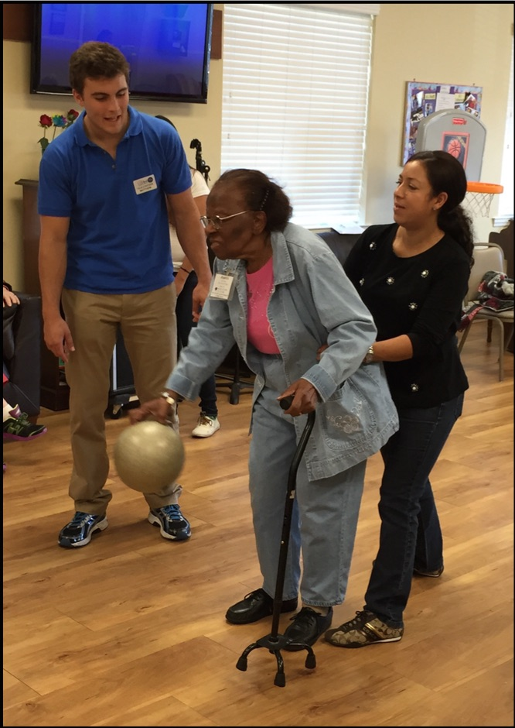
Al’z Place
What is Al’z Place:
Al’z Place provides care for people age 18+ with Alzheimer’s disease or severe memory impairment. The adult program is available five days per week, Eight hours per day. Therapeutic activities include physical exercise; active and quiet games; reminiscence; validation therapy; and other failure-free activities. Lunch and two snacks per day are provided.
Caregiver support/support groups
Notes:
COVERAGE
QUALIFICATIONS
MD TO FOLLOW

Slide 11
Al’z Place
Who qualifies:
Reside in Alachua County
Be 18 years of age or older
Have a primary or secondary medical diagnosis of dementia, including but not limited to Alzheimer's disease
Must be able to participate in activities
How do I get started:
Call Al’z Place at 352-375-3000
Assessment is done over the phone, priority score assigned and when slots are opened a home visit is done.
Order from MD
Ongoing coordination with the MD by the nurse by the nurse on staff at Al’z Place
Trial visit scheduled to see how the senior will do
Notes:
COVERAGE
QUALIFICATIONS
MD TO FOLLOW

Slide 12
Alachua County Senior Recreation Center
Al’z Place

Slide 13
Independence with Low Vision
Who qualifies:
Age 18 and over, live in Alachua County, and have a visual impairment that affects both eyes
Coverage Area: Alachua County
How do you get started:
Contact the Eldercare office at 352-265-9040, ask for the Independence with Low Vision Program
Complete the application
Submit your eye report

Slide 14
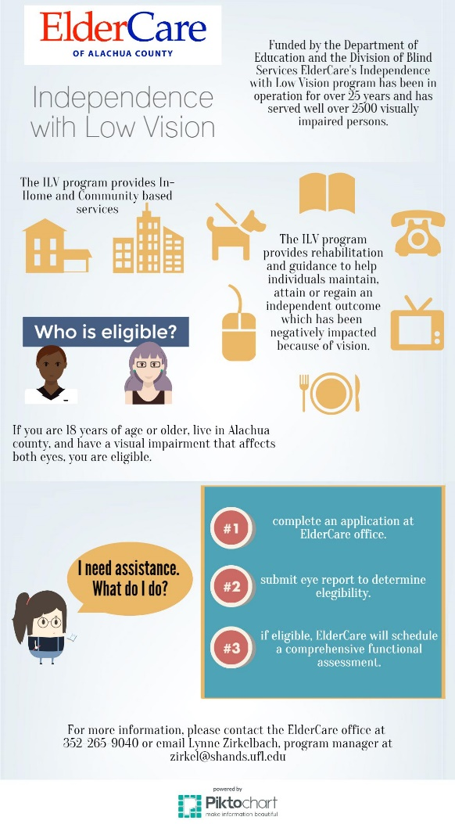

Slide 15
Senior Transportation Program
Partnership with the City of Gainesville, Gainesville Area Chamber of Commerce, ElderCare of Alachua County, Uber
Seed money from the COG
2 Neighborhoods
On demand transportation
Will expand to other senior communities
Co-Pays apply
Loaner phones- Wells Fargo

