Slide 1
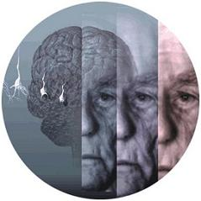
Dementias in the elderly
So dam Kim, MD Assistant Professor of Medicine Geriatric Medicine

Slide 2
True or False?
Difficulty with retrieval of already learned information is a normal consequence of aging
A careful history and neurological exam is sufficient for detecting cognitive impairment
The united states Preventive services Tash Force (USPSTF) does not support cognitive screening
Notes:
T-F-T

Slide 3
DSM V : Major Neurocognitive disorder Mild Neurocognitive disorder
“Major Neurocognitive Disorder denotes a state of cognitive decline in 1 or more domains which include attention, executive function, working memory, language, perceptual motor or social cognition that is persistent and interferes with previously achieved levels of social or occupational function.”
The American Psychiatric Association's Diagnostic
and Statistical Manual, 5th edition (DSM-V) 2013

Slide 4
Dementia refers to cognitive impairment severe enough to interfere with the ability to independently perform activities of daily living

Slide 5
Prevalance
Age range | Affected %*
65-74 years | 5%
75-84 years | 15-25%
85 and older | 35-50%
*US population
Have high suspicion
Consider screening test
The United States Preventive Services Task Force (USPSTF) does not support cognitive screening
Notes:
11/2016 there was study that prevalence of dementia has fallen sharply in recent years, most likely as a result of Americans' rising educational levels and better heart health, which are both closely related to brain health.

Slide 6
Beyond memory…
Emotional disturbances
Depression, Anxiety, Agitation
Sleep disturbance (can include Sleep apnea)
Malnutrition and Dehydration
Weight Loss
Constipation
Deconditioning and Falls
Alzheimer’s disease patients are more prone to osteoporosis, falls and fractures than non-demented subjects, with poorer outcomes following fracture
Poor self management of chronic illness
Diabetes
CHF
Notes:
High fall rate.
heart failure patients with cognitive impairment had a risk of all-cause death and heart failure readmission 7.5 times greater than those without cognitive impairment.

Slide 7
Cognitive test
MMSE
Mini-cog
MoCA
SLUMS
Neuropsychological test
And more…
Notes:
Can be difficulty to detect without formal screening.
MMSE made to detect hospital delirium. Age and education bias and heavily weighted on language. Misses frontal lobe dementias and some early stage vascular dementia, Proprietary (1dollar per exam administration)
Clock drawing – quick, minimal language requirement, doesn’t need specialized testing material. Less dependence on education and language. Identifies deficits in Visual-spatial / planning / abstraction. Need fine motor skills fine motor skills and vision.
MOCA was designed to detect MCI and with high education level. Covers a lot of cognitive domain.
If can remember with cues, likely not AD.
MoCA is noteworthy for being more sensitive and therefore able to pick up on things the MMSE might miss. It has been validated in patients who may not be currently demented but are at the risk of progressing and getting worse
Factors to be considered
Age / Education / Culture
Anxiety
Baseline function
Sensory function
Normal brain aging “ I am not as ‘smart’ as I used to be

Slide 8
Dementia
Alzheimer’s disease dementia
Frontotemporal dementia
Lewy body dementia
Vascular dementia
Notes:
AD : gradual progression, memory, language, visual-spatial disturbanes, Indifference, delusions, agitation
FTD : personality change, early social skill deteriorates, executive dysfunction, hyperorality, relative preservation of visual-spatial skills until late stage.
LBD : Visual hallucination (which pt may aware of it), delusions, fluctuating mental status(sometimes looks like delirium), sensitivity to antipsychotic medications, Pakinsonism (tremor, orthostasis, REM behavior), gait instability.
Vascular : Abrupt onset, stepwise deterioration, prominent
Differences Between FTD and Other Dementias
FTD differs markedly in several ways when compared to other dementias, especially Alzheimer’s disease:
FTD is characterized by cerebral atrophy in the frontal and anterior temporal lobes of the brain, while Alzheimer’s affects the hippocampal, posterior temporal, and parietal regions.
The neurofibrillary tangles, senile plaques, and Lewy bodies present in the brains of Alzheimer’s and other dementia patients are absent. (Pick bodies are also usually absent.)
Alzheimer’s patients experience severe memory loss. While FTD patients exhibit memory disturbances, they remain oriented to time and place and recall information about the present and past.
FTD patients, even in late stages of the disease, retain visuo-spatial orientation, and they negotiate and locate their surroundings accurately.
Intellectual failure in FTD is distinctly different from that of Alzheimer’s patients. Results of intelligence tests are normal in those with FTD until the point in the disease when disinterest results in lower scores.
Life expectancy is slightly longer for FTD.
aphasia, motor sign.
Why is it important to think about subtype?
Treatment option and expectation can be different.
Different pathology.

Slide 9
Case 1: Mrs. Jones
76 y/o female admitted due to fall at home that had caused trauma over the R orbital area and R hip.
PMHx : Insulin dependent DM with neuropathy - last A1c 8.5, HTN, A.Fib on Apixaban
Family History: Mother : CAD, HTN , forgetful at age 70’s Father : DM , HTN , CVD
Social History: Lives alone at home, no walking aid instruments, No ETOH or Smoking
ROS : Frequent falls, progressive visual and hearing impairment, Forgetful and outbursts of anger at times, as per daughter 1 episode of wandering around the community. Has problems naming objects and remembering people’s names.
Notes:
Risk factor for fall.
Previous fall.
Pph neuropathy
Has DM and HTN
What do you want to ask more?
When this started? How is the function?

Slide 10
Case 1: Mrs. Jones
Physical Exam: Vitals: BP : 160/92, HR: 48 RR :16 T:97.0 F
Head: Edema and ecchymosis in R orbit
Eyes: PERRLA, EOMI, Sclera anicteric
ENT: MMM
CV: Irreg/irreg
Resp: CTA, good air entry
GI: +Bowel sounds, soft, nontender, nondistended
GU: no foley catheter
Neuro: Motor intact, CAM (Neg), Mini Cog (Pos), MoCA = 18/30
Skin: Senile purpura
Lymph: No Cervical lymphadenopathy
Medications :
Lantus 30u QHS, Novolog 6u TID AC
Atenolol 20 mg BID, Lisinopril 10 mg QD, Eliquis
Gabapentin 300 mg BID, Donepezil 10 mg QHS
Ginko Biloba 1 Tab QD, Garlic 1 Tab QD, MVI 1 Tab QD
Ca 400 mg QD, Vit D 600u QD

Slide 11
Mrs. Jones’ EKG

Slide 12
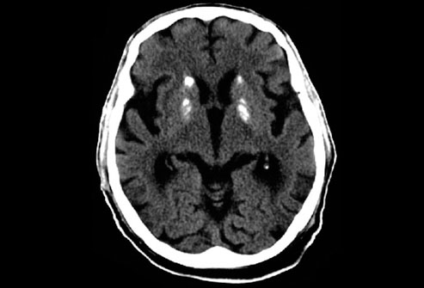
Mrs. Jonse’s Head CT

Slide 13
What is the likely Diagnosis ?

Slide 14
What is the likely Diagnosis ? Alzheimer’s Disease Syncope due to Bradycardia Fall with R hip fracture
Notes:
What to do?

Slide 15
AD : Epidemiology
5 million patients in US
15 millions by 2050
Cost : $ 20 Billion / year
Notes:
Probably more expensive than heart disease and cancer. 75-85% of spending is from nursing home. Home health.

Slide 16
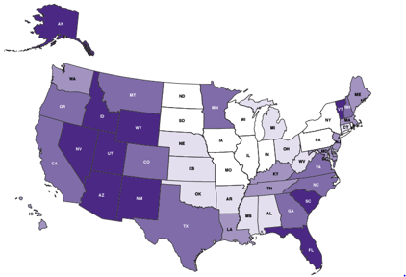

Slide 17
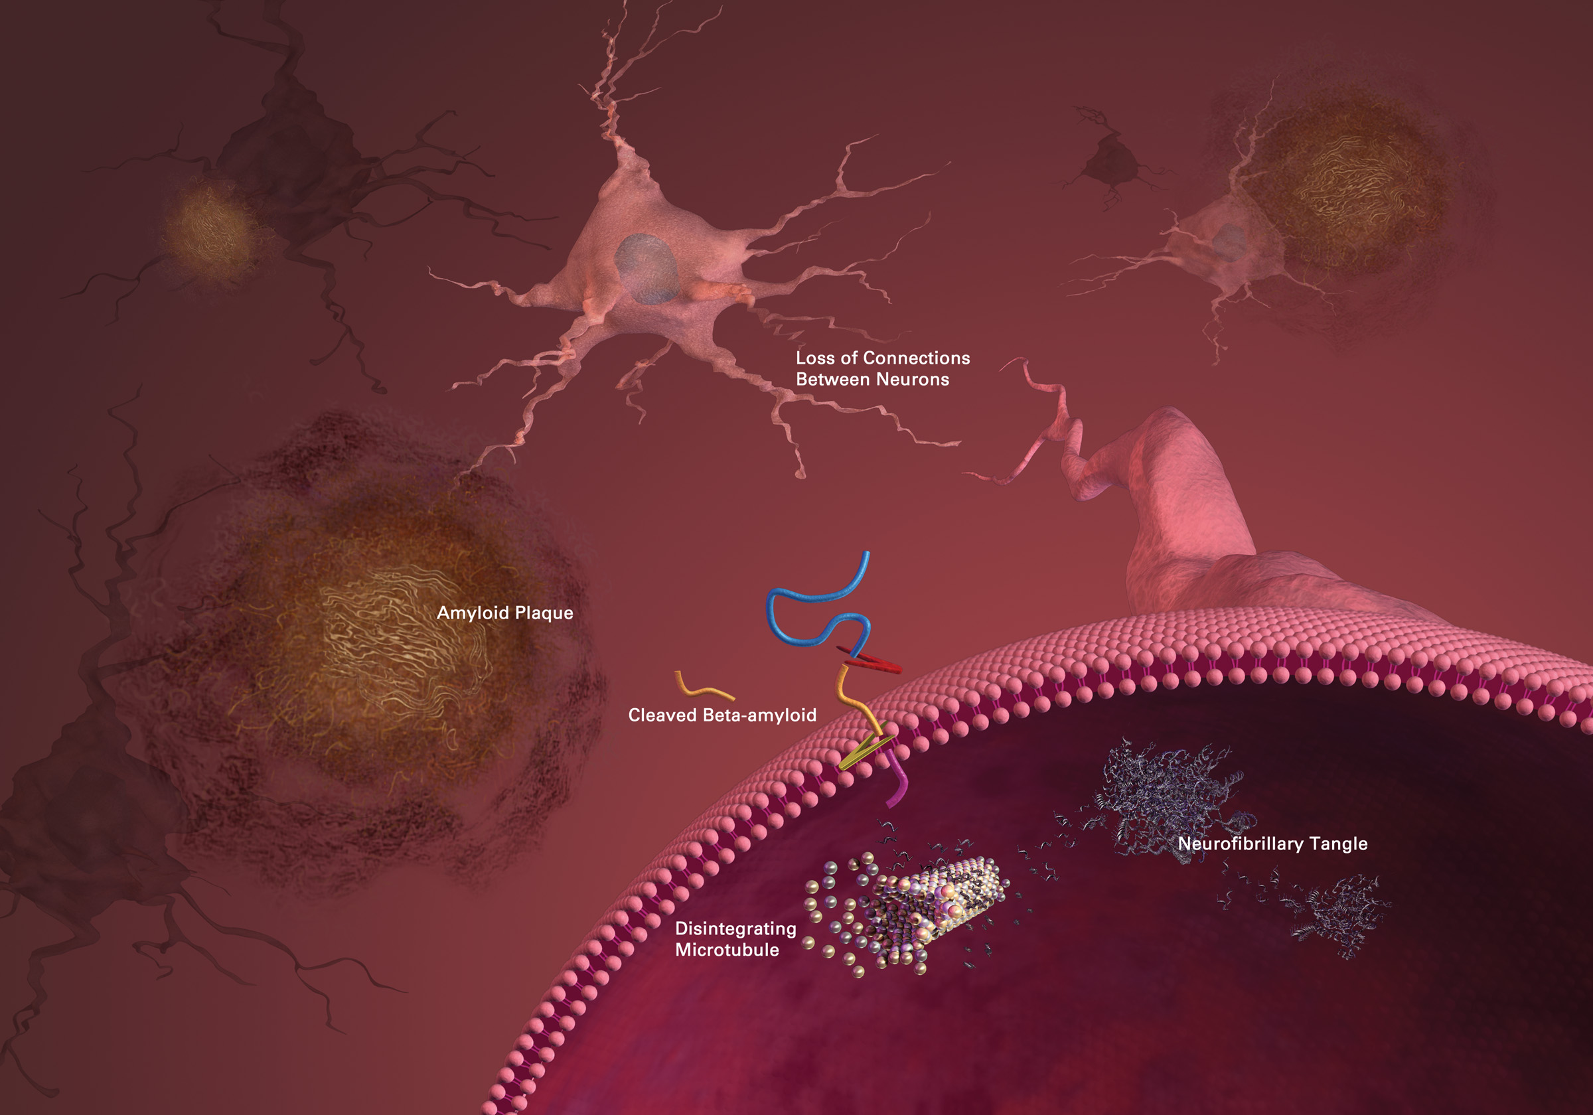
AD : Pathophysiology

Slide 18
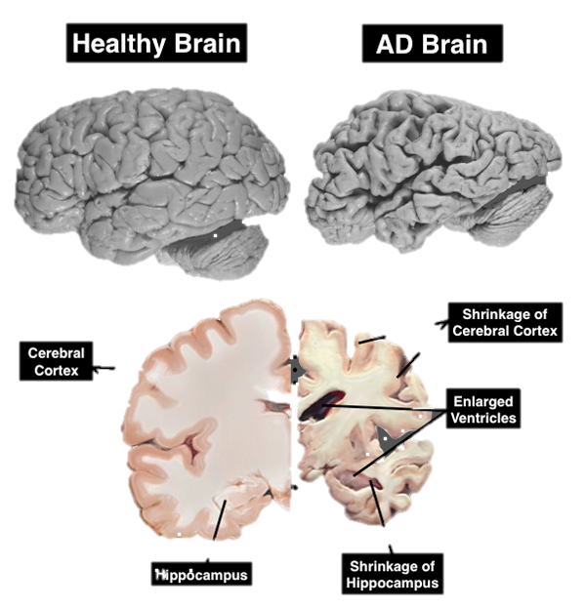
AD : Progression and Clinical features

Slide 19
AD

Slide 20
AD : Management
Non pharmacologic : - Routine activities - Avoid conflicts - Constant reorientation - Prevent delirium
“Remember the atypical presentation of the disease in the elderly and even more in the demented patient”

Slide 21
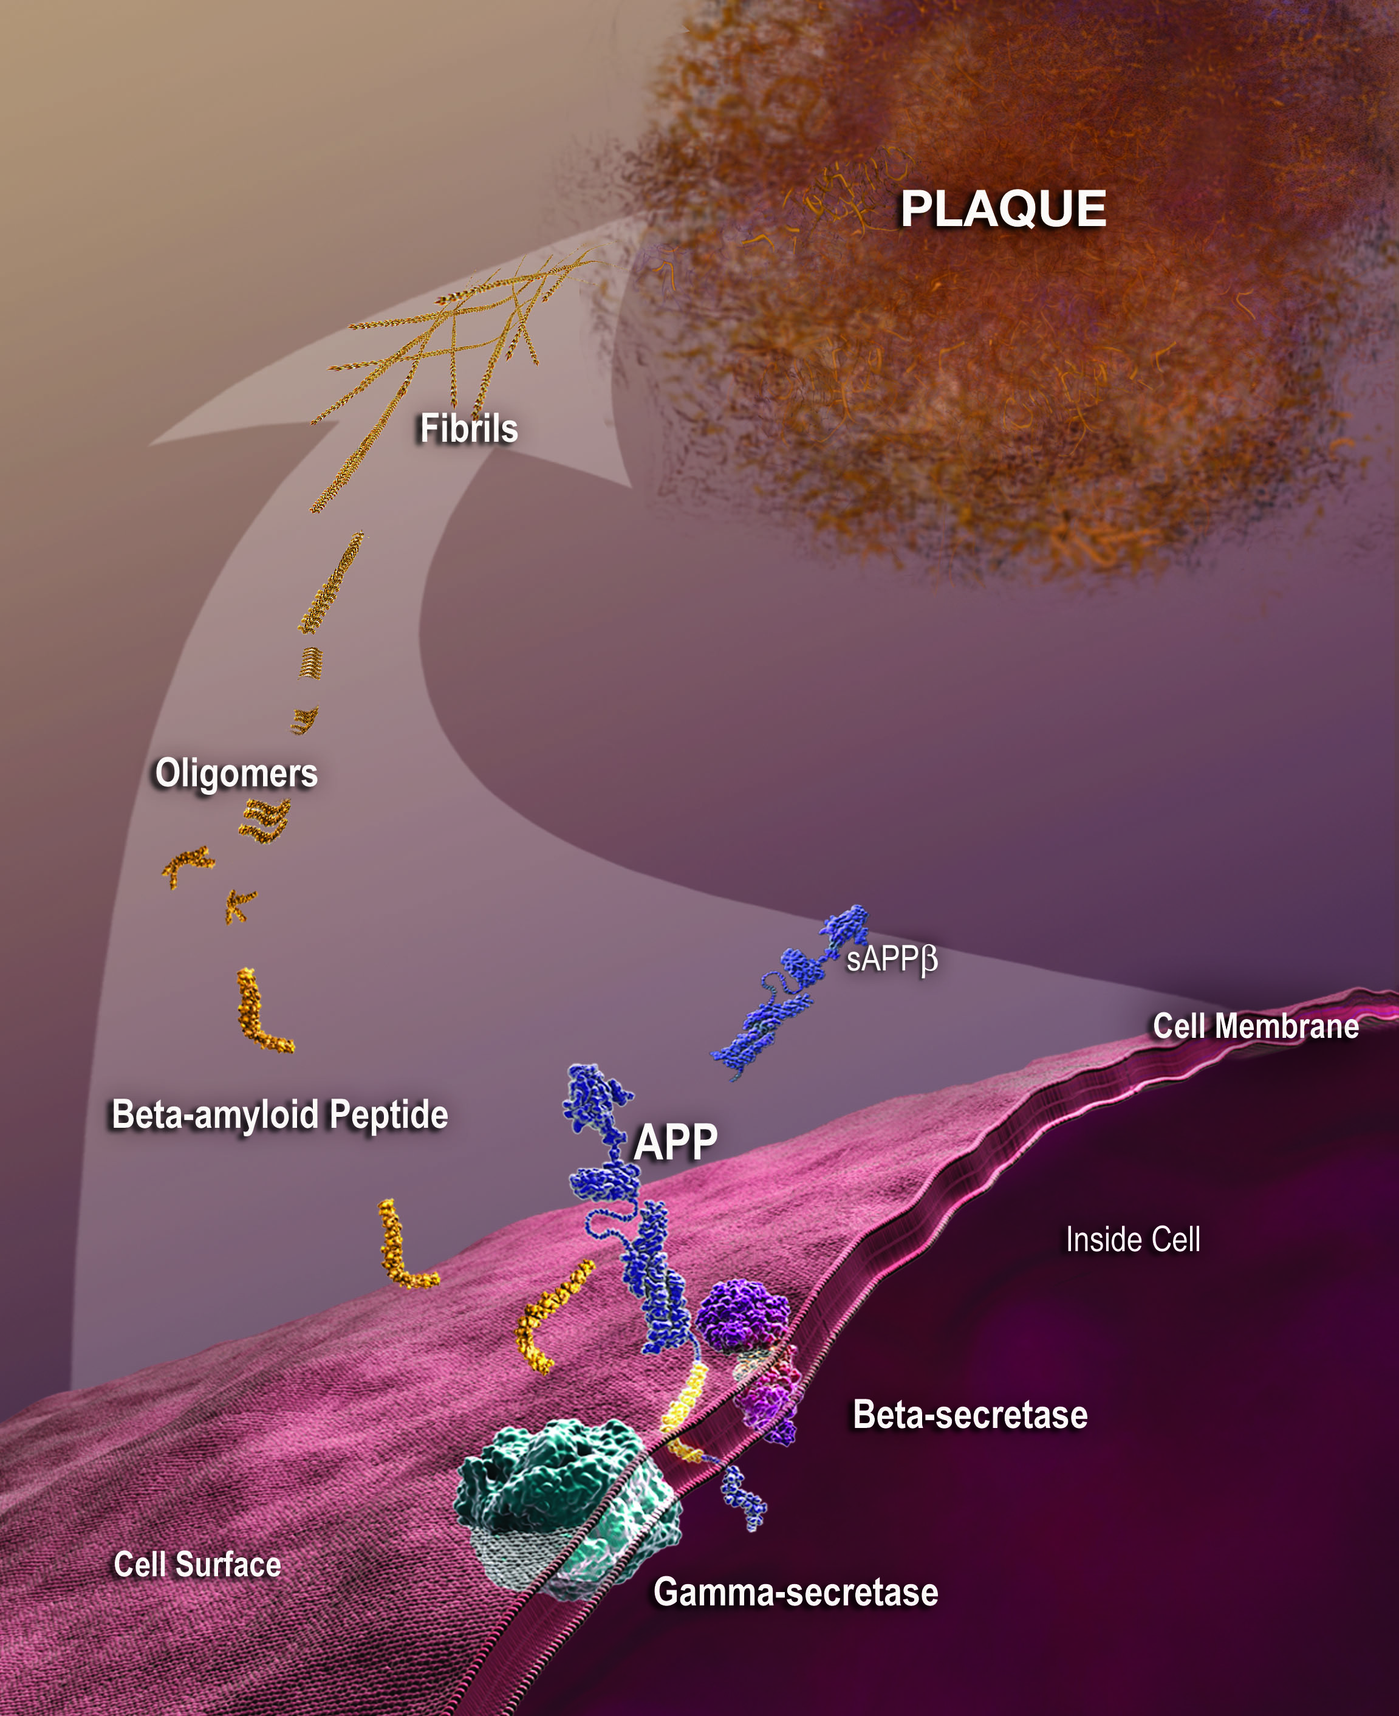
AD : Management
Pharmacologic : - Cholinesterase Inhibitors : Donepezil Galantamine Rivastigmine
- Memantine (NaMenDA) - Experimental Drugs : Eli Lily : Solanezumab Biogen : Aducanumab
Eisai and Biogen : BAN2401
Notes:
Namenda is NMDA receptor antagonist. N-methyl-D-aspartate receptor (also known as the NMDA receptor or NMDAR), is a glutamate receptor and ion channel protein found in nerve cells
: Hypothesis – reduce excitatory amino acid ( glutamate ) toxicity.
Symptomatic treatment.
Namenda was evaluated for additive effects with cholinesterase inhibitors.
Disease modifying treatment.
Anti amyloid agents. ; solanezumab.
Can draw the graph.

Slide 22
Case 1 continued
The same patient underwent ORIF. After 1 day the patient turned with agitated delirium.
What is the indicated management ? A) Start Haldol 1 mg IM q 8h
B) Start Seroquel 25 mg PO q 8h C) Continue Acetaminophen 650 mg PO q 6h prn D) Continue Hydromorphone 0.2 mg IV q 4 h prn E) Schedule Acetaminophen 650mg PO q 6 h and start Oxycodone 2.5 mg PO q 4h or prior to PT or bath.
What does it mean PRN in dementia patients ?

Slide 23
Case 1 continues
What does it mean PRN in dementia patients ?
P atient
R eceives
N othing
Frequent assessment of pain in the elderly patients specially in cases of trauma.
Avoid delirium induced by pain by scheduled pain medications
Start low and go slow to avoid delirium induced by polypharmacy

Slide 24
Case 2
85 y/o male who as per his son since the last year has been presenting progressive with difficulty walking, frequent falls, apathy. He has had several admissions in the past due to frequent UTI’s. He is once again admitted for another episode of UTI (ESBL) managed with Cefepime – Vancomycin. During the admission has been complicated with hyperactive delirium not improved with non-pharmacologic measures.
PMHx : HTN, OA , Frequent UTIs, Prostate cancer , chronic foley, progressive deterioration of cognitive function
Social Hx: Progressively more dependent for all activities , uses a walker lives with his family at home, No ETOH or Smoking
ROS : Screams at night, poor sleep, vivid dreams and hallucinations described as monkeys and spiders in the room

Slide 25
Case 2
PE : - Vitals : BP 145/90, HR : 65, RR: 18 , T : 37 - HEENT : normal ; - CV : RRR; - Chest : CTA; - Abd : NT, BS+ ; - GU : Foley + ; - Neuro : CAM +, agitated, Cog Wheel +, poor verbal
Medications : - Norvasc 10 mg , Metoprolol 50 mg BID - Tamsulosin 0.4 mg PO q night - Oxycodone 2.5 mg PO q 4 h prn
Labs : WBC :11, N: 81% Na 131, TSH : 4.1 , FT4: 2 CT Brain : Brain atrophy, no acute pathology

Slide 26
What is the likely Diagnosis ?

Slide 27
What is the likely Diagnosis ? Lewy Body Disease with Hyperactive Delirium secondary to UTI

Slide 28
LBD
Cognitive impairment is progressive and fluctuating

Slide 29
Management LBD
Non pharmacologic
Behavioral : Donepezil, Memantine
Neurologic : Carbi-Levodopa (especially in PD)
Notes:
Larger cholinergic deficit in DLB. -> AchEi can help cognition and behavior.
Memantine showed benefits in global function and neuropsychiatric symptoms not in cognition.
If motore symptoms -> try sinemet.
Also somnolence common, agitated and psychotic behavior .Modafinil.

Slide 30
LBD with Delirium
Treat the cause : I WATCH DEATH !!!!
Infectious (encephalitis, meningitis, UTI, pneumonia)
Withdrawal (alcohol, barbiturates, benzodiazepines)
Acute metabolic disorder (electrolyte imbalance, hepatic or renal failure)
Trauma (head injury, postoperative)
CNS pathology (stroke, hemorrhage, tumour, seizure disorder, Parkinson’s)
Hypoxia (anemia, cardiac failure, pulmonary embolus)
Deficiencies (vitamin B 12 , folic acid, thiamine)
Endocrinopathies (thyroid, glucose, parathyroid, adrenal)
Acute vascular (shock, vasculitis, hypertensive encephalopathy)
Toxins, substance use, medication (alcohol, anesthetics, anticholinergics, narcotics)
Heavy metals (arsenic, lead, mercury)
Notes:
Infectious (encephalitis, meningitis, UTI, pneumonia)
Withdrawal (alcohol, barbiturates, benzodiazepines)
Acute metabolic disorder (electrolyte imbalance, hepatic or renal failure)
Trauma (head injury, postoperative)
CNS pathology (stroke, hemorrhage, tumour, seizure disorder, Parkinson’s)
Hypoxia (anemia, cardiac failure, pulmonary embolus)
Deficiencies (vitamin B 12 , folic acid, thiamine)
Endocrinopathies (thyroid, glucose, parathyroid, adrenal)
Acute vascular (shock, vasculitis, hypertensive encephalopathy)
Toxins, substance use, medication (alcohol, anesthetics, anticholinergics, narcotics)
Heavy metals (arsenic, lead, mercury)

Slide 31
LBD with Delirium
Treat the cause : I WATCH DEATH !!!!
Avoid anticholinergic medications
and dopamine agonists for LBD
QUETIAPINE (SEROQUEL)
Notes:
Infectious (encephalitis, meningitis, UTI, pneumonia)
Withdrawal (alcohol, barbiturates, benzodiazepines)
Acute metabolic disorder (electrolyte imbalance, hepatic or renal failure)
Trauma (head injury, postoperative)
CNS pathology (stroke, hemorrhage, tumour, seizure disorder, Parkinson’s)
Hypoxia (anemia, cardiac failure, pulmonary embolus)
Deficiencies (vitamin B 12 , folic acid, thiamine)
Endocrinopathies (thyroid, glucose, parathyroid, adrenal)
Acute vascular (shock, vasculitis, hypertensive encephalopathy)
Toxins, substance use, medication (alcohol, anesthetics, anticholinergics, narcotics)
Heavy metals (arsenic, lead, mercury)

Slide 32
Case 3
81 y/o male who as per his son has been getting progressively more abulic, forgetful and turning aggressive with his family.
PMHx : Insulin Dependent DM, HTN, Depression , HLD, prior CVA with R mild hemiplegia
Social Hx : Partially dependent for all activities , uses a walker , former smoker until age 70.
ROS : Occasional hallucinations , paranoid delusions

Slide 33
Case 3
PE : - Vitals : BP 165/89 , HR : 78 , RR: 18 - HEENT : normal , PERLA - Neck : Supple, no JVD - Chest : CTA - CV: S1- S2, RRR - Abd : NT , BS+ - Neuro : No focal , muscular strength 3/5 in all 4 extremities
Labs : CBC, BMP, TSH , FT4 ; all normal EKG : NSR CT brain as follows

Slide 34
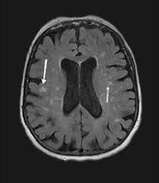

Slide 35
What is the likely Diagnosis ?

Slide 36
What is the likely Diagnosis ? Vascular Dementia

Slide 37
Vascular Dementia
2nd most common : 20-30% of cases
Mixed with AD
Risk factors for vascular dementia CVD ( HTN, DM, HLD) Atherosclerosis (CAD , PAD)

Slide 38
Vascular Dementia

Slide 39
Management Vascular Dementia
Prevention
Treat HTN : ACEi, CCB, BB DM : A1c goal < 7 , < 8 in old old HLD: Statins
R/O Depression : GDS SSRI’s : Cause HypoNa Good!!!! : Citalopram (cause QT prolongation) Excelent !!!! Mirtzapine
Behavioral : Donepezil, Antipsychotics
Cognitive enhancers
Erkinjuntti T, Kurz A, Gauthier S, Bullock R, Lilienfeld S, Damaraju CV Efficacy of galantamine in probable vascular dementia and Alzheim -er’s disease combined with cerebrovascular disease: a randomised
trial. Lancet 2002; 359:1283–1290

Slide 40
Other Non-Alzheimer Dementias
Neurological Degeneration : NPH, Progressive supranuclear palsy, Corticobasal Degeneration, Multiple System Atrophy, Primary progressive aphasia
PSA related Dementias : ETOH related Dementia, THC related dementia, Cocaine – Heroin dementia
Nutritional Deficiencies : B12, Folate, Thiamine
Infectious related Dementias : HIV , Tertiary Syphilis, Prion Diseases (Kuru, CJD)
Rapid progressive Dementias : CJD, Hashimoto, Antibody-mediated limbic encephalitis, Paraneoplastic limbic encephalitis

Slide 41
Take home points
Dementia is NOT a normal condition of the aging
Dementia is a long progressive process of cognitive decline EXCEPT: CJD, Delirium , Depression (Pseudodementia)
Every patient with cognitive decline should be worked up with : CBC, CMP, TSH, B12, Folate
Occasionally with : RPR, Imaging, HIV serology testing, lupus anticoagulant, antiphospholipid antibody, ANA, ANCA.
Most available medicine for dementia is Symptomatic treatment and has side effect.
Avoid antipsychotic use for behavioral issue as much as you can.

