Slide 1
Fantastic Plastics in Postwar America:
Earl Tupper, Brownie Wise & Materials Marketing
Marsha Bryant
Professor of English, U. Florida

Slide 2
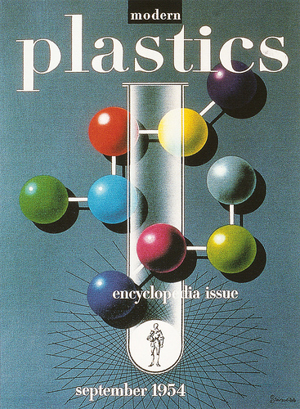
How do plastics present problems and advantages on the consumer market?
How did a polyethylene product become a museum object and a household icon in postwar America?

Slide 3
PLASTIC (Greek: plassein)
to mold
to feign

Slide 4
British Punk Star Poly Styrene

Slide 5
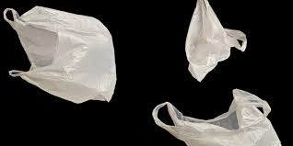
Plastic Bags, Punk & Pop!
Poly Styrene, “Plastic Bag”
My mind is like a plastic bag
that corresponds to all those ads
it soaks up all the rubbish
that is fed in through by ear
I eat Kleenex for breakfast
and I use soft, hygienic Weetabix
To dry my tears.
(1977)
Katy Perry, “Firework”
Do you ever feel like a plastic bag
drifting through the wind,
wanting to start again?
(2010)

Slide 6
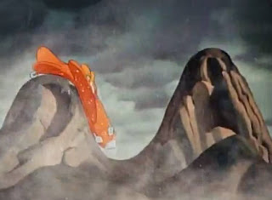
The Problem of Plastics & the Market
“the plastic experience”
disintegrates, cracks, combusts, smells
fake, artificial, a ‘trick’
cheap, gaudy
Donald Duck’s airplane (1944, “The Plastics Invent0r”)

Slide 7
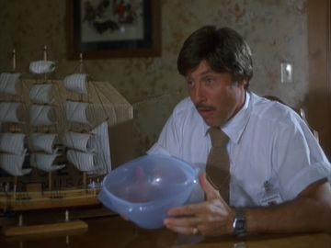
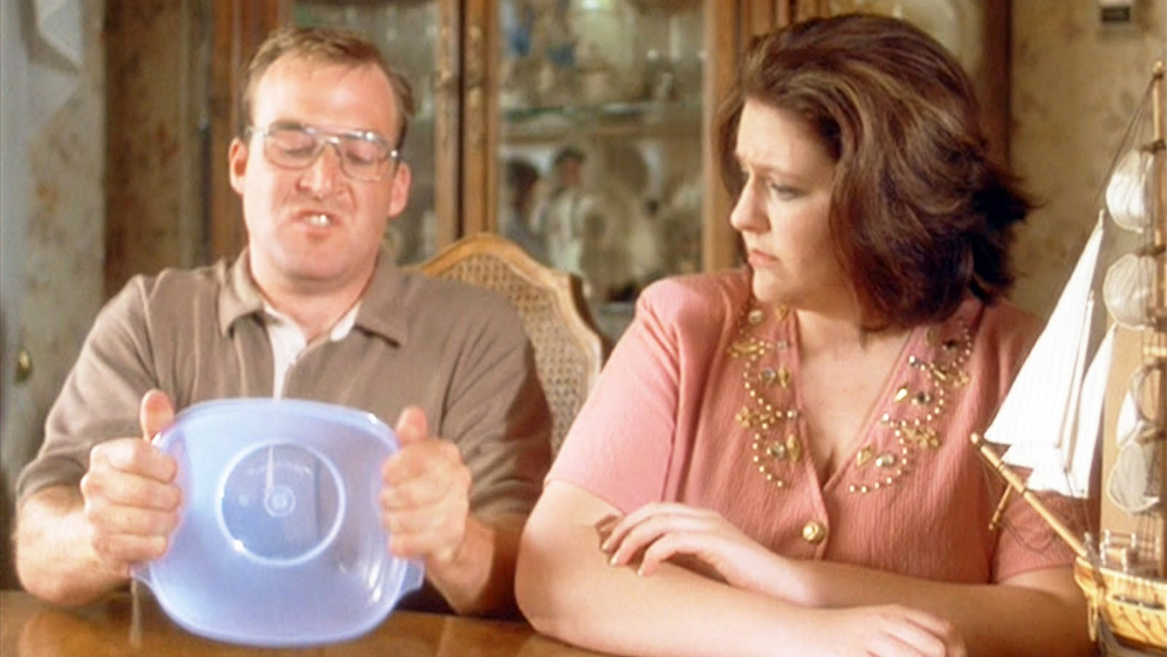
Just how tough is Tupperware? Ask Uncle Rico!
Go on, give it a tear!
Napoleon
Dynamite
2004

Slide 8
Everyday Alchemy
“So, more than a substance, plastic is the very idea of its infinite transformation. . . it is less a thing than the trace of a movement.”
“Plastic is, all told, a spectacle to be deciphered: the very spectacle of its end-products. At the sight of each terminal form (suitcase, brush, car-body, toy, fabric, tube, basin or paper), the mind does not cease from considering the original matter as an enigma.”
“It is the first magical substance which consents to be prosaic.”
--Roland Barthes, “Plastics,” Mythologies (1957)

Slide 9
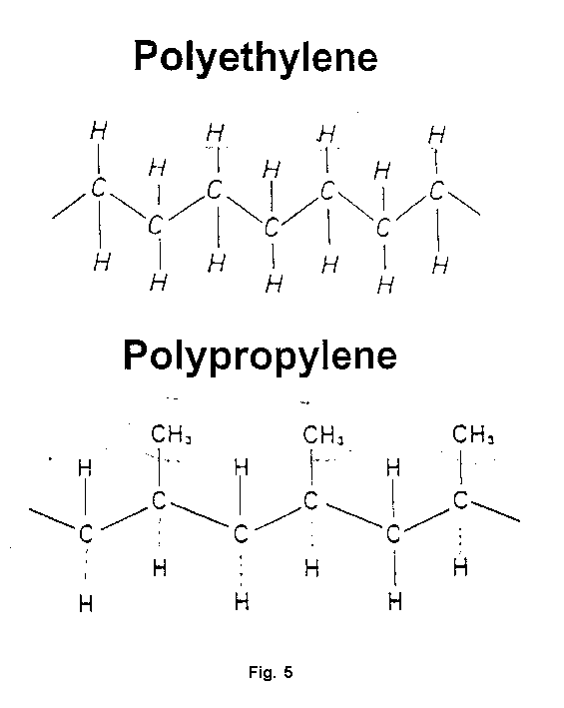
Tupperware
The composition of Tupperware is either low density polyethylene (LDPE) or polypropylene (PP)
http://www.isss.de/conferences/Mallorca1999/forum1.html

Slide 10
Low Density Polyethylene
LDPE is defined by a density range of 0.910–0.940 g/cm³
LDPE has a high degree of short and long chain branching
This means the chains do not pack into the crystal structure as well as for example the very long chain high density polyethylene.
This results in a lower tensile strength and increased ductility.
LDPE is used for both rigid containers and plastic film applications such as plastic bags and film wrap.
In 2009 the global LDPE market was $22.2 billion
Wikipedia

Slide 11
Polypropylene
The density of polypropylene varies from 0.855-0.946g/cm3.
Most commercial polypropylene is isotactic (the methyl groups are all on the same side).
It has an intermediate level of crystallinity between low-density polyethylene (LDPE) and high-density polyethylene (HDPE).
Polypropylene is normally tough and flexible.
Polypropylene is reasonably economical, and can be made translucent.
Applications include clothing, carpeting, medical devices, rope, car batteries, wastebaskets, and pharmacy prescription bottles .
In 2009 the global PP market was ~$61billion.

Slide 12
Poly-T: Material of the Future
Properties
Production & uses
Developed in Great Britain in the early 1930s
U.S. Production begins in 1943
Industrial: insulation, washers, gaskets, linings, packing
Domestic: storage, serving, tableware
Nontoxic
Odorless
Flexible
Lightweight
Chemical resistant
Durable
Colorful

Slide 13
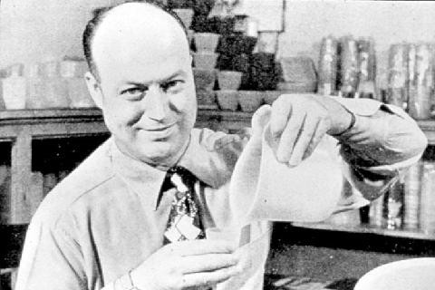
Earl Tupper, Inventor & CEO of Tupperware

Slide 14
Tupper’s Curriculum for Innovation
Manual labor (farming, railroads, tree surgery)
Technology
Literary classics
Writing: journal, notebook, etc.
Popular Magazines (incl. American Home, Popular Mechanics, Literary Guild)
Advertising (correspondence school)
Business trends, trade shows
New York World’s Fair
Industry: Sample Maker for Doyle Factory/DuPont
Consulting with women (wife, extended family, neighbors, coworkers)

Slide 15
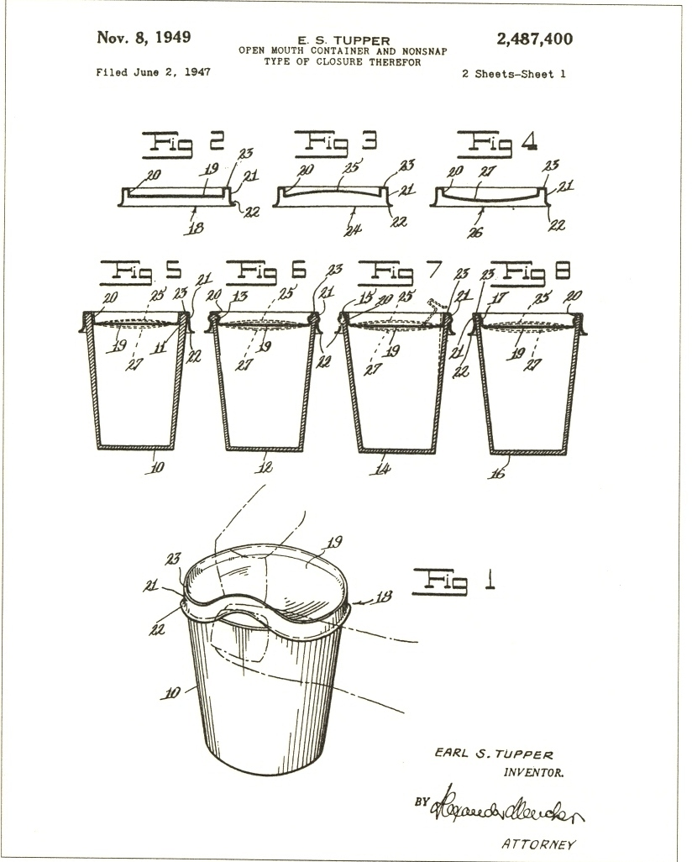
Drawings for Tupper’s 1947 patent application for his “nonsnap” lid

Slide 16
The Beauty of Utility
Tupperware Bowl, 1945. From MoMA exhibit “What Was Good Design? 1944-56”
“Above all else, the bowls have a profile as good as a piece of sculpture.”
– Elizabeth Gordon, House Beautiful (1947)

Slide 17
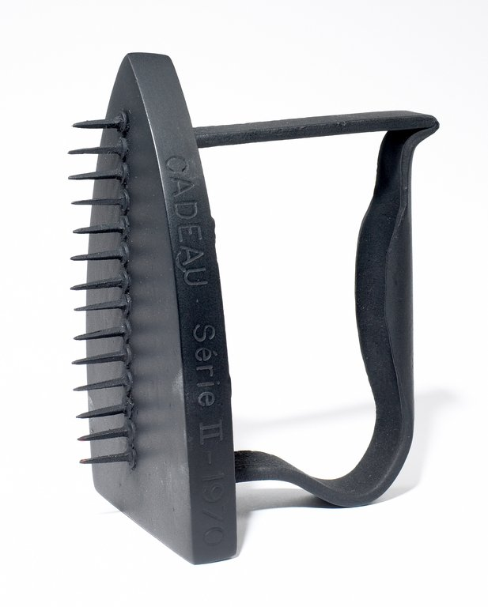
Modernist Aesthetics 101
Form over function
Clean lines & geometric designs
Transcend the banal & everyday
Autonomy
Authenticity
Restraint
May Ray
“The Gift”
1921

Slide 18
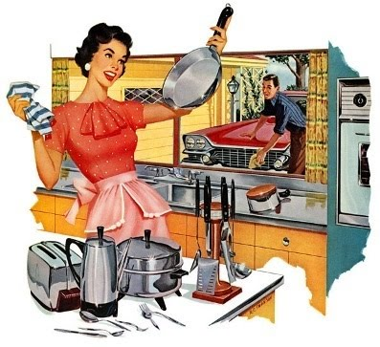
Gleam & Glamour in the American Dream Kitchen

Slide 19
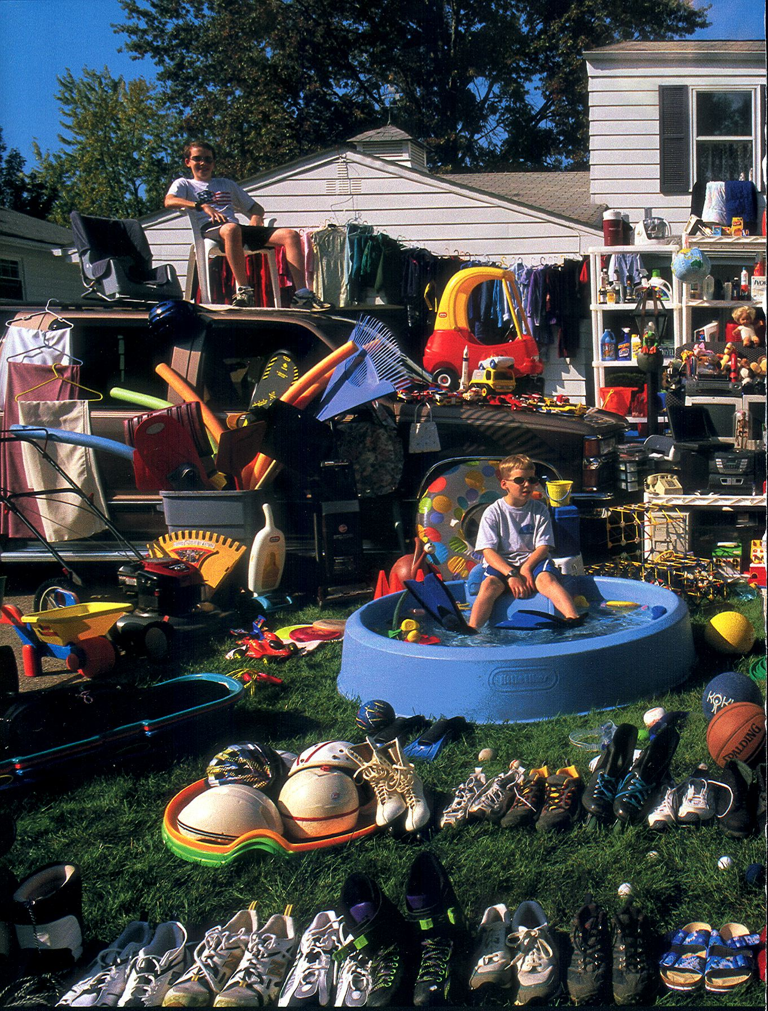
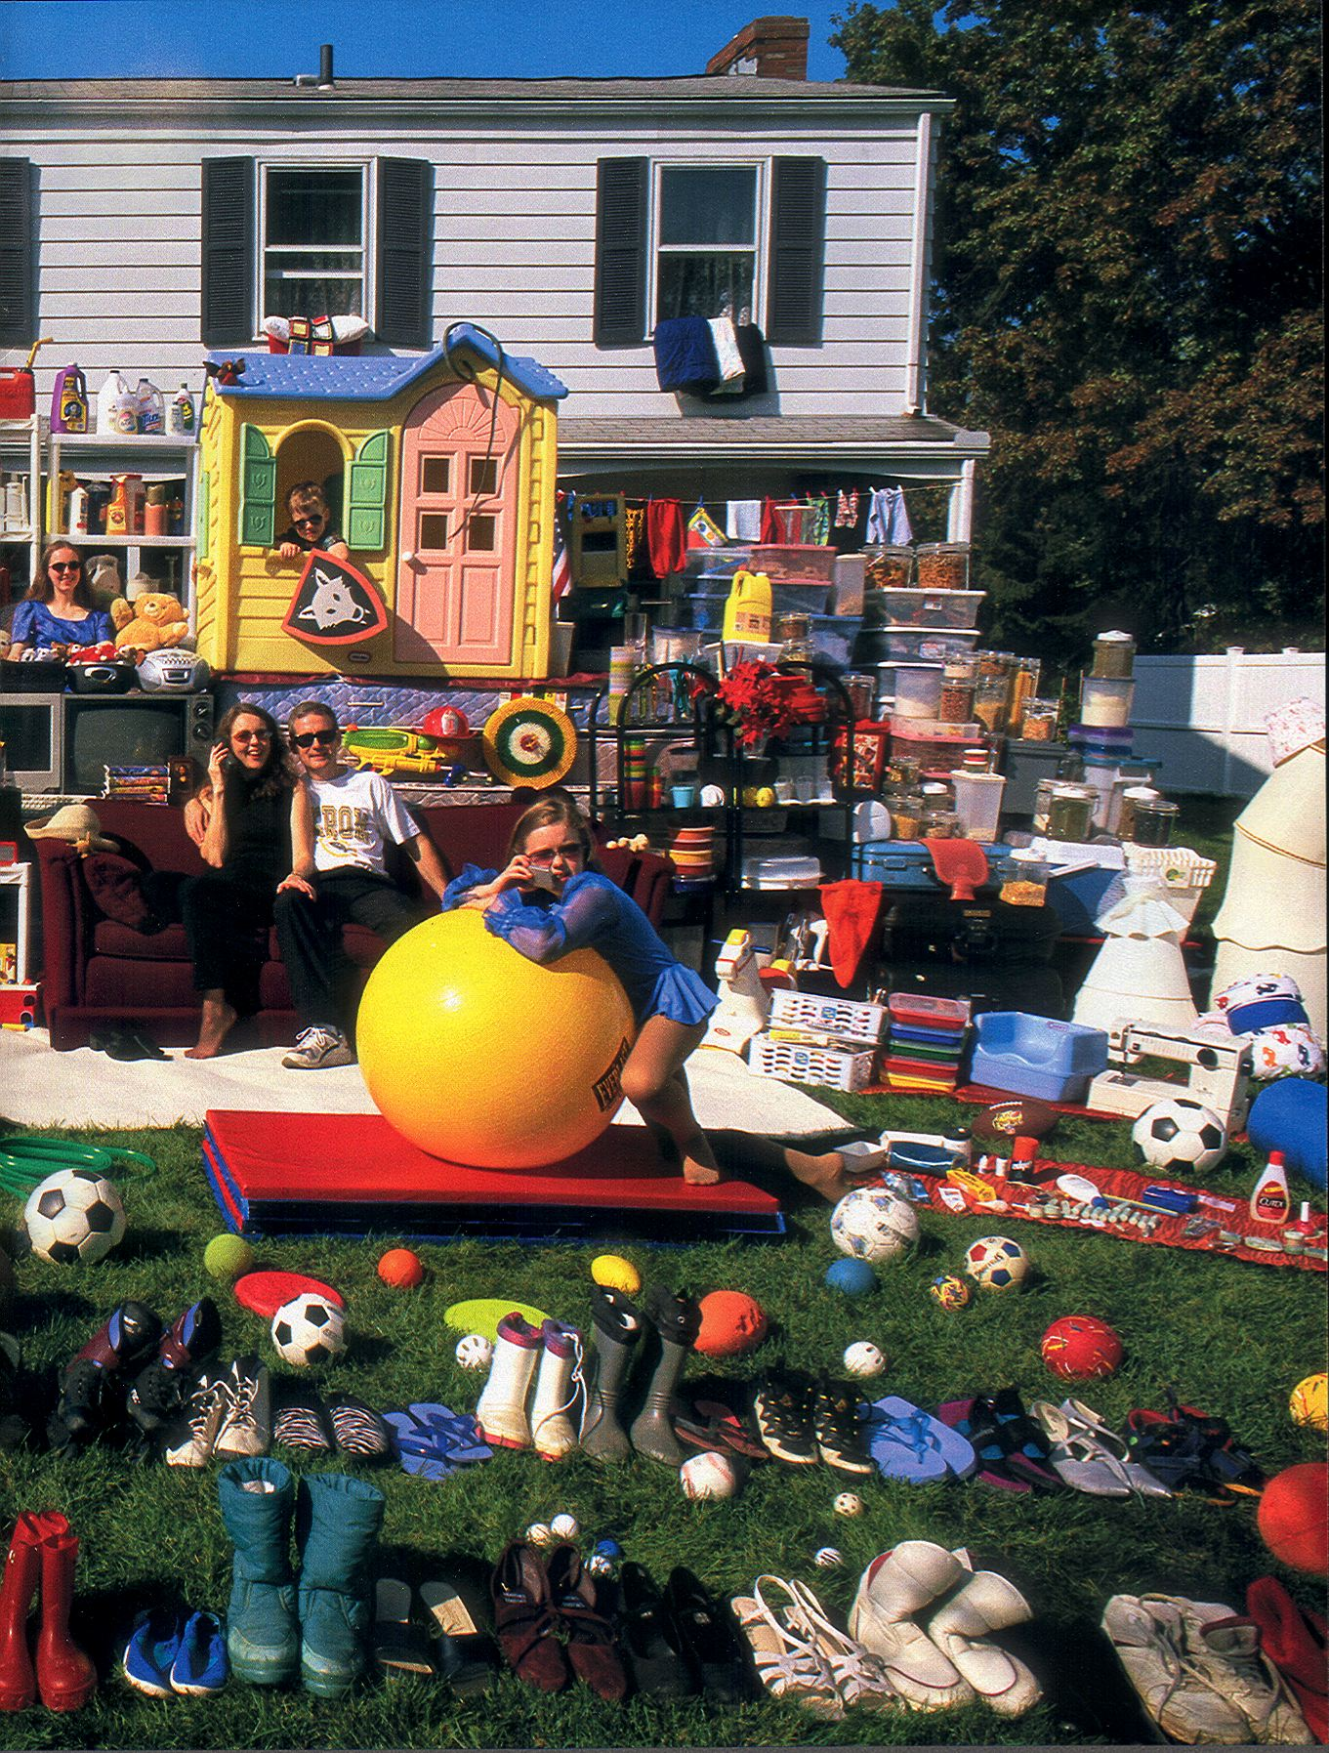
Why are polymers important?
Polymers are all around us!
National Geographic, June 2004, Photographer: Sarah Leen
Notes:
NOTES:
Polymers have become the material of choice for many products based on their low cost and light weight.
Consider the example of parts used to fabricate automobiles. In the past primarily metals were used. Now, many components are made from plastics.
The picture on this slide was taken by National Geographic to illustrate everything that this family owns which is made out of plastic.
Plastics are everyone around us in our daily lives.

Slide 20
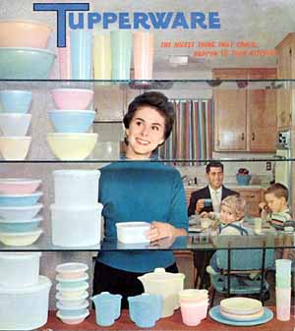
The Nicest Thing That Could Happen to Your Kitchen
Tupperware Catalogue, 1958

Slide 21
Brownie Wise & the Tupperware Party

Slide 22
American Advertising Milestones
Gerard Lambert, Selling the Need
(1920s, Listerine)
Rosser Reeves, Unique Selling Proposition
(1950s, Anacin)
David Ogilvy, Image and Science
(1950s & 60s, Hathaway, Dove Soap)

Slide 23
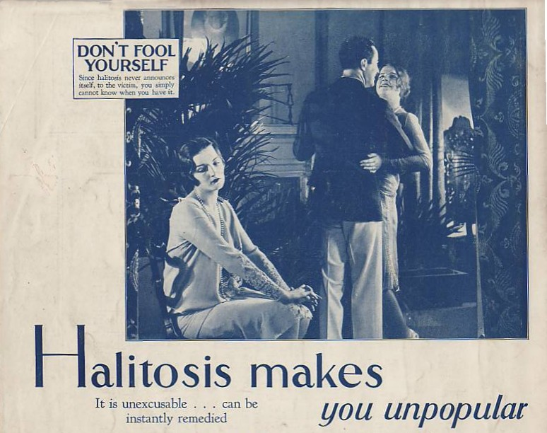
Selling the Need: Lambert, “whisper copy,” and Listerine, 1928
Notes:
Wisk “Ring Around the Collar” campaign (1970S)

Slide 24
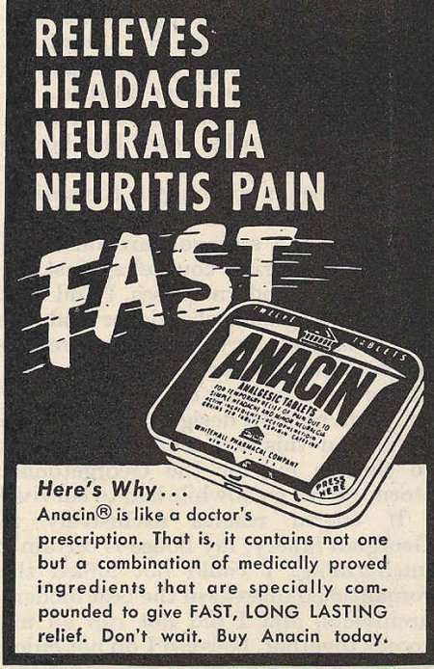
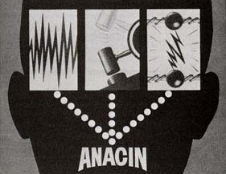
Another Hard Sell
Reeves’s USP for Anacin:
fast, Fast, FAST!
Notes:
M&Ms: Melts in your mouth, not in your hand. FedEx: Absolutely, positively overnight.

Slide 25
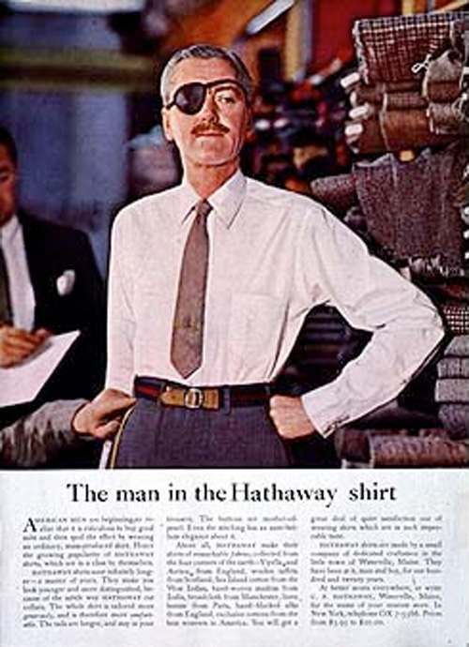
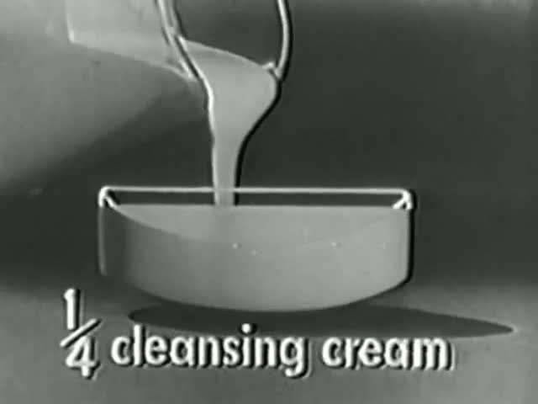
Ogilvy’s Iconic Campaigns: Hathaway and Dove Soap
“Every advertisement is part of the investment in the personality of the brand.”
– David Ogilvy, 1955
*Market Research *Big Idea
Notes:
Modern Equivalent to Man in the Hathaway shirt: Dos Equis “Most Interesting Man in the World”; repackaged through the Old Spice guy “Smells like a Man, Man” campaign; Science: Olay’s Regenerist products with biopeptides and B3 Complex work “at the cellular level”

Slide 26
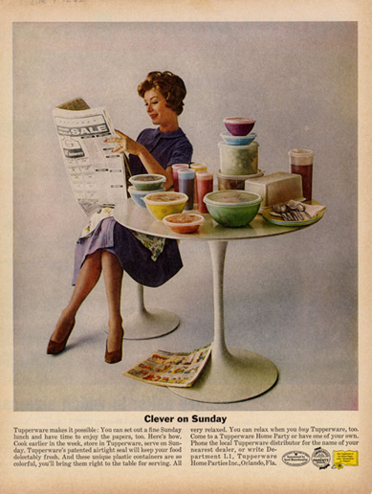
1950s/60s

Slide 27
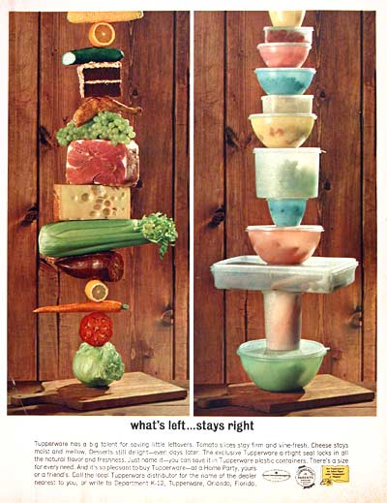
1950s/60s

Slide 28
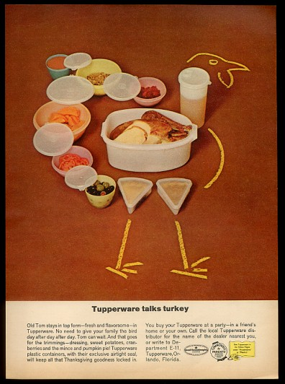
1962

Slide 29
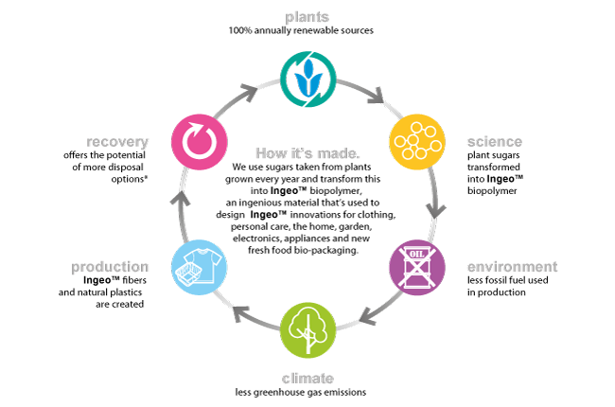
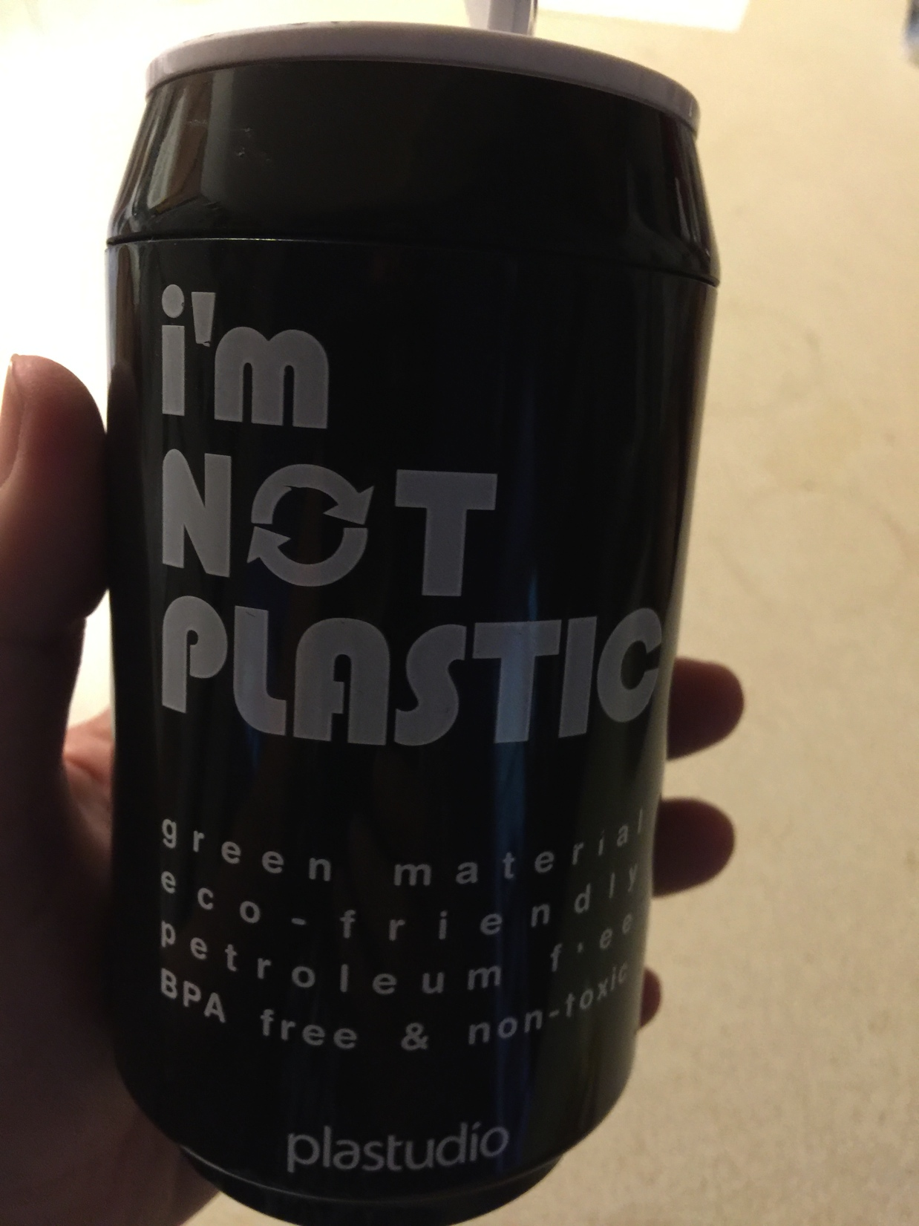
Florida college student’s Eco Can, by Plastudio (Taiwan)

Slide 30
Bisphenol Pale Ale: Should You Be Worried About the BPA in Your Beer Can?
Beeradvocate #125 (June 2017)

Slide 31
Sources
Roland Barthes, Mythologies. 1957.
Alison J. Clark, Tupperware: The Promise of Plastic in 1950s America. 1999.
Roland Marchand. Advertising the American Dream: Making Way for Modernity. 1985.
Elaine Tyler May. Homeward Bound: American Families in the Cold War Era. 1988.
Tammy Dean McGee. Vintage Tupperware Collection.
Museum of Modern Art website.
Napoleon Dynamite. Dir. Jared Hess. 2004.
National Geographic June 2004. Photographer: Sarah Leen
Once Upon a Honeymoon. Promotional film, AT&T/Bell. 1956.
PG&E advertisement, “Live Better Electrically.” 1957.
Juliann Sivulka. Soap, Sex, and Cigarettes: A Cultural History of Advertising. 1998.
Tupperware Commercial, 1961.
Tupperware! (PBS), Written, produced, directed by Laurie Kahn-Leavitt. 2004.
Bob Kealing, Tupperware Unsealed: Brownie Wise, Earl Tupper, and the Home Party Pioneers. 2008.
Wikipedia

