Slide 1
Dirt

Slide 2
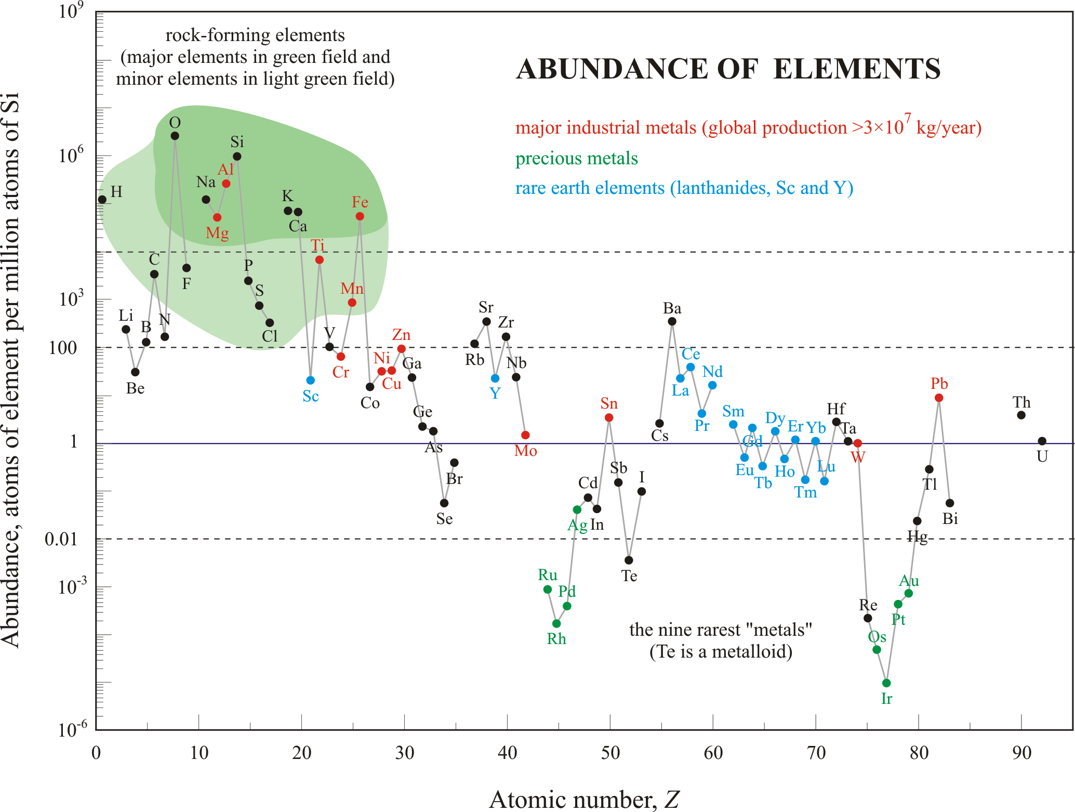
clay
Clay is a naturally occurring material composed primarily of fine-grained minerals, which show plasticity through a variable range of water content, and which can be hardened when dried and/or fired.
Composition: Al, Si and O plus water (and other elements sometimes)
Why use clay? To begin with it’s made of the most abundant elements
www.geology.ar.gov

Slide 3
clay
Properties
Plasticity (manipulate at room temperature)
First material to be easily manipulated into complex shapes
Cohesion
Maintains shape
High strength in compression (after drying, baking)
Poor strength in tension
Opaque
Insulating
Can be Chemically transformed
Upon heating to above 1000°C
Remove water
But also induce formation of a chemical bond
Shrinks upon firing
Called a ceramic after firing

Slide 4
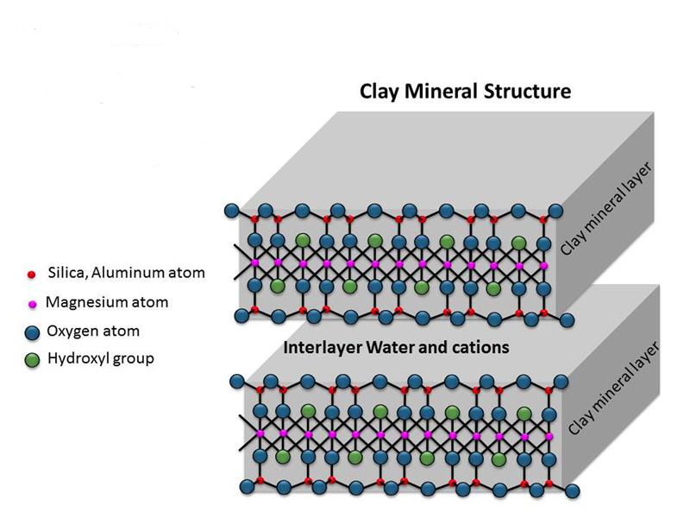
Clay structure
Properties:
With water layers can slide past each other, which leads to
→ plasticity
Upon drying the clay it will harden but no chemical reaction is induced, which leads to → sundried bricks
Upon firing (>1000°C) can induce chemical bonding of the layers
(formation of Si-O-Si bonds), which leads to → Ceramics
Silica, Aluminum atom
Aluminum or Magnesium
Oxygen atom
Hydroxyl group

Slide 5
Clay structure
Properties:
With water layers can slide past each other, which leads to
→ plasticity
Upon drying the clay it will harden but no chemical reaction is induced, which leads to → sundried bricks
Upon firing (>1000°C) can induce chemical bonding of the layers
(formation of Si-O-Si bonds), which leads to → Ceramics
SEM Image of Kaolinite 1350X

Slide 6
Where does Clay come from?
Form from weathering of rocks
Weak acids dissolve silicate bearing rocks
Clays defined by size <2µm (<0.0002cm in diameter)
Doesn’t naturally settle
Silt is larger
Primary clays found at site of formation, secondary clays washed downstream
Clays have many different types
Depends on the minerals in the soil
Lots of clay formed after glaciation
Examples: Kaolinite and Smectite

Slide 7
Types of Clay
Kaolinite (1 part Al₂O₃ and 2 parts SiO₂ and 2 H₂O)
1:1 (1 tetrahedra layer then 1 octahedra layer)
Also called china Clay
Low shrink-swell capacity
Heat below 550°C and its reversible drying
Heat above 1000°C and you make stoneware dishes
Used in porcelain, toothpaste, cosmetics, paint, organic farming, Kaopectate, Quick-clot combat gauze.

Slide 8
Types of Clay
Smectite Clay
Montmorillonite most common form
2:1 (2 tetrahedra:1 octahedra) (1T:1O:1T)
Opposite of Kaolinite it has a large shrink-swell capacity
Used in oil drilling, cores of dams, liners in landfills, cat litter, can cause micelles to assemble into vesicles, look like cell membranes. It also helps nucleotides assemble into RNA which will end up inside the vesicles. These are the building blocks of early lifeforms.

Slide 9
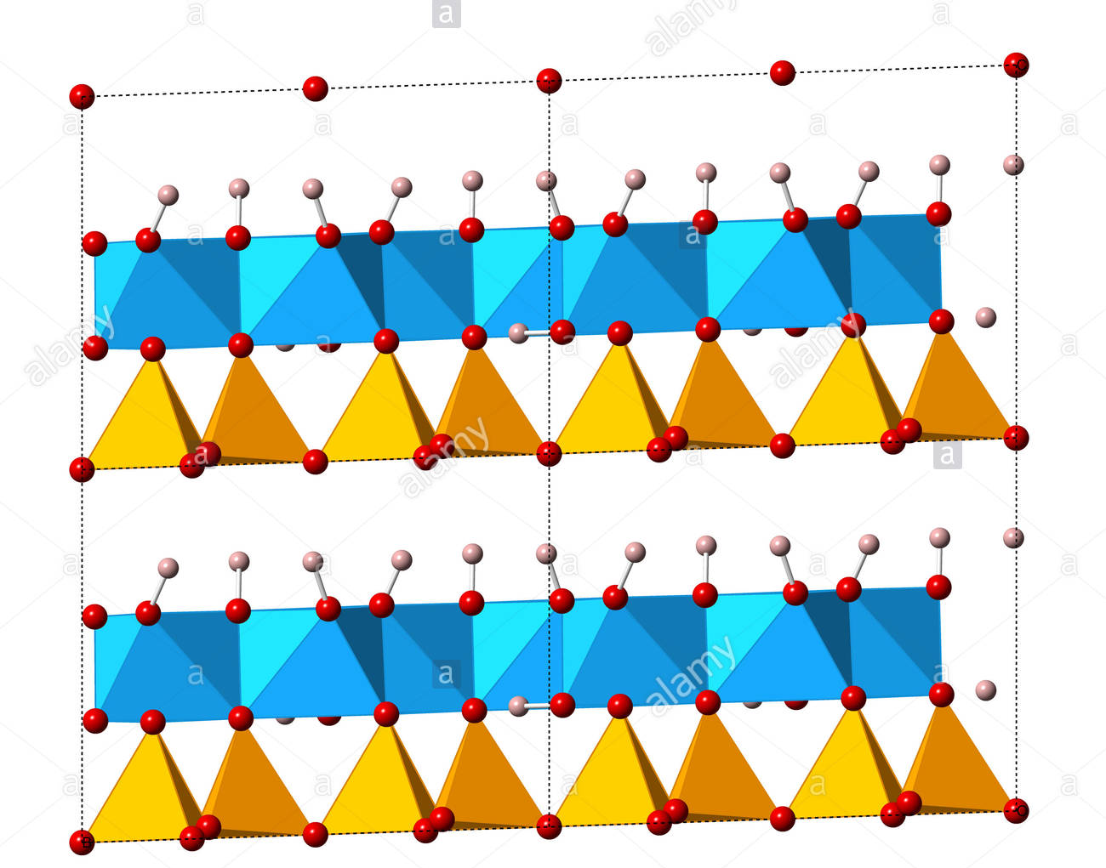
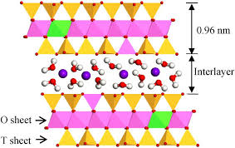
Clay structure
Kaolinite
Montmorillonite

Slide 10
Clay structure
So which is this?
Tetrahedra
Octahedra
Tetrahedra
Silica, Aluminum atom
Aluminum or Magnesium
Oxygen atom
Hydroxyl group
Montmorillonite

Slide 11
Early History of Clay
Paleolithic (2.5M to 15,000 years ago)
26,000 years ago Central Europe
Clay figurines (Venus)
Many were broken (performance art?)
Mesolithic (15,000-11,000 years ago)
Japanese pottery

Slide 12
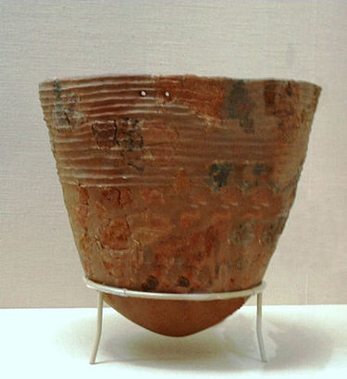
Earliest Clay Pottery
Jomon People of Japan
16,000 years ago
Hunter gatherers who carried clay pots for cooking
Incipient Jōmon Pottery (14,000–8000 BC) Tokyo National Museum, Japan.
http://en.wikipedia.org/wiki/J%C5%8Dmon_period#Earliest_pottery

Slide 13
Early History of Clay
Paleolithic (2.5M to 15,000 years ago)
26,000 years ago Central Europe
Clay figurines (Venus)
Many were broken (performance art?)
Mesolithic (15,000-11,000 years ago)
Japanese pottery
Neolithic (~10,000 to 5000 years ago) (8000-3000BC)
10,000BC Natufians (Israel/ Jerico) clay bricks

Slide 14
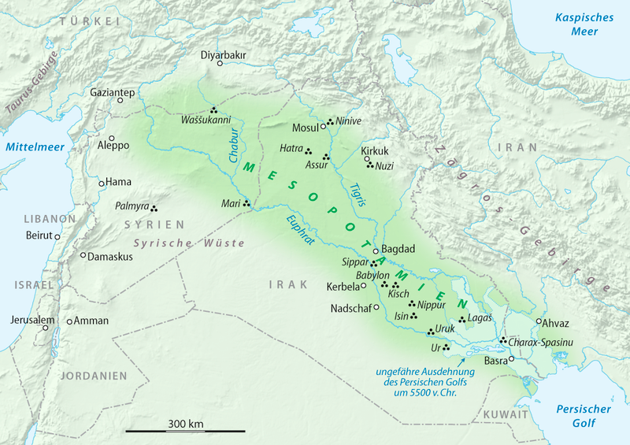
Mesopotamia
Jericho
10,000BC
Notes:
Fix placement of pins for Catal Huyuk, Jericho, and Sumar; It looks off to me -Van

Slide 15
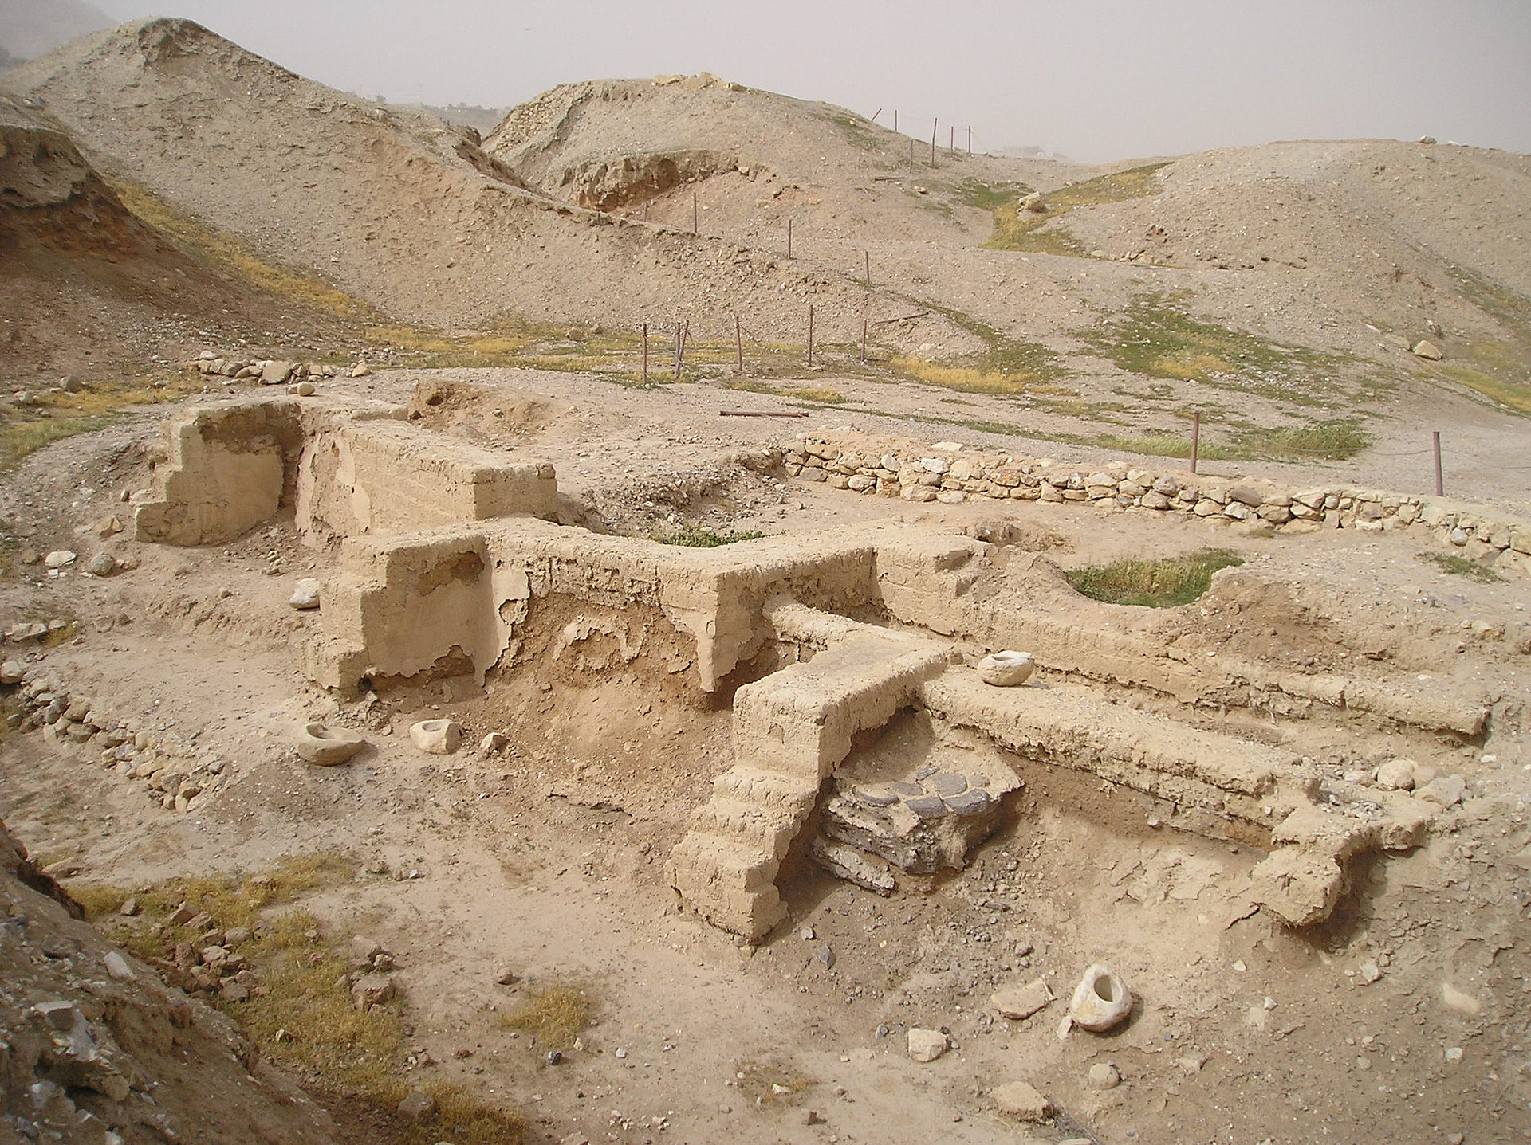
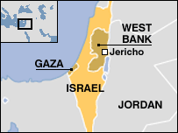
Jericho
One of the oldest inhabited city in the world
Built 12,000 years ago
Sun baked bricks, still hunting and gathering
By 10,000 year ago, Crops cultivated and stored in clay
http://en.wikipedia.org/wiki/Jericho#Ancient_period

Slide 16
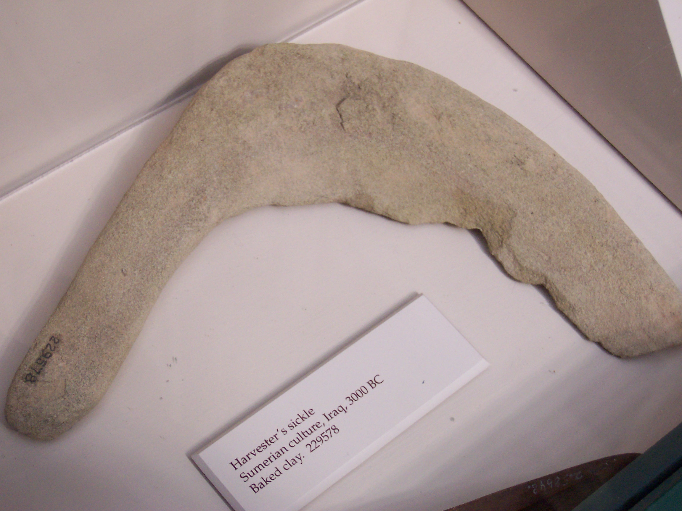
Clay Sickle
Sumarian
3000BC
For harvesting Wheat
http://commons.wikimedia.org/wiki/File:ClaySumerianSickle.jpg

Slide 17
Early History of Clay
Paleolithic (2.5M to 15,000 years ago)
26,000 years ago Central Europe
Clay figurines (Venus)
Many were broken (performance art?)
Mesolithic (15,000-11,000 years ago)
Japanese pottery
Neolithic (~10,000 to 5000 years ago) (8000-3000BC)
10,000BC Natufians (Israel/ Jerico) clay bricks
7000-5000BC Catal Huyuk clay society
6000BC rise of Mesopotamia/ Sumarians
5000-4000BC potters wheel
4000BC Cuneiform clay tablets/ writing
Track trade, land ownership, centralized government

Slide 18
Mesopotamia
Catal Huyuk
7000BC -5000BC
Sumar
5000BC-2000BC
Jericho
10,000BC
Notes:
Fix placement of pins for Catal Huyuk, Jericho, and Sumar; It looks off to me -Van

Slide 19
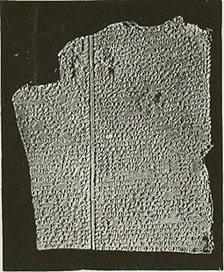
Cuneiform
Epic of Gilgamesh
Oldest written story
2700BC
Discovered in 1853
12 tablets
Account of the adventures of the king of Ur who lived in ancient Mesopotamia as he discovers why he can’t be immortal among other things
http://static.newworldencyclopedia.org/thumb/2/26/GilgameshTablet.jpg/250px-GilgameshTablet.jpg

Slide 20
Ancient Uses
Building Materials

Slide 21
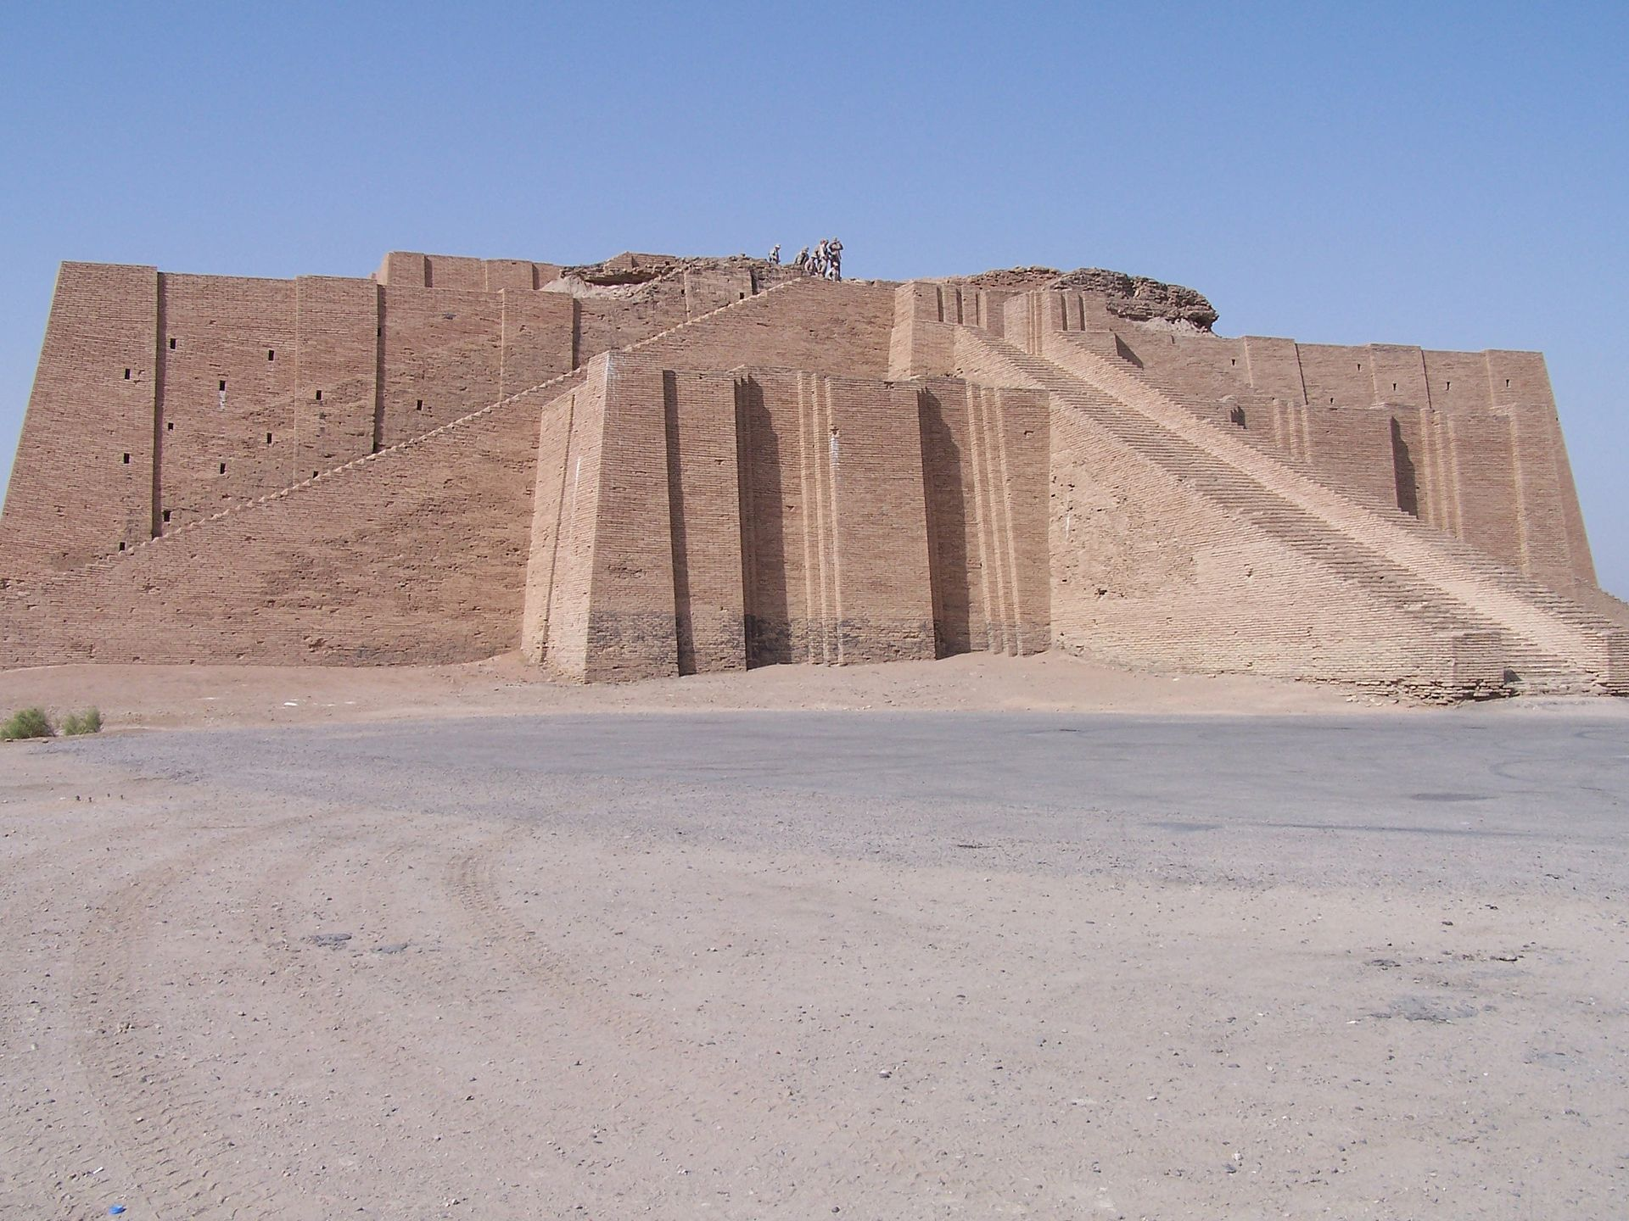
Clay for construction
Great Ziggurat of Ur (modern Iraq) (2000BC)
Built of clay and mud

Slide 22
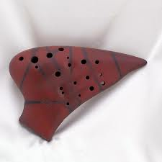
Ancient Uses
Building Materials
Writing materials
Cooking materials
Storage materials
Sling Ammunition
Medical
Armenian bole
(early version of Milk of Magnesia for upset stomach)
Musical Instruments
Ocarina
https://s-media-cache-ak0.pinimg.com/236x/42/12/96/421296210e9c55b6fbae0c5dab43bf8f.jpg

Slide 23
Ocarina?
How about more recent music?
Anyone recognize this song?
Ocarina Solo

Slide 24
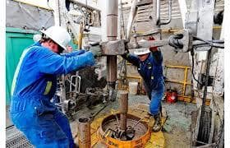
Modern Uses
Clay
Pottery
Building materials (Italy)
Odor absorbents (cat litter)
Oil drilling wells
http://manek.tradeindia.com/bentonite-all-grade-.html

Slide 25
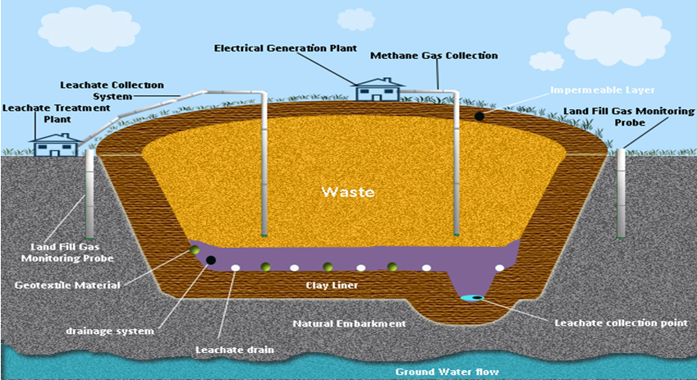
Modern Uses
Clay
Pottery
Building materials (Italy)
Odor absorbents (cat litter)
Oil drilling wells
Land fill liner
http://pubs.sciepub.com/env/3/3/2/

Slide 26
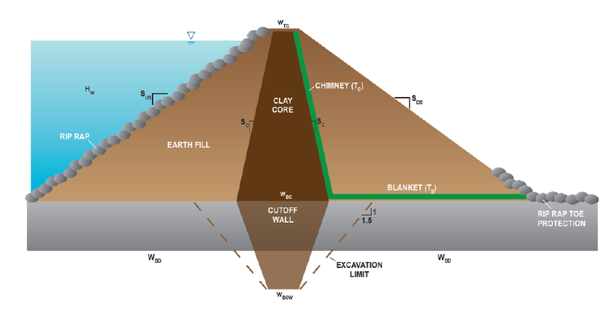
Modern Uses
Clay
Pottery
Building materials (Italy)
Odor absorbents (cat litter)
Oil drilling wells
Land Fill Liner
Dams
http://pubs.sciepub.com/env/3/3/2/

Slide 27
Modern Uses of Clay
????

Slide 28
Modern Uses of Clay
Pottery
Building materials (Italy)
Odor absorbents (cat litter)
Oil drilling wells
Land Fill Liner
Dams
Gasoline production uses clay-based catalysts
Paper making
Hazardous waste clean-up
Cement Production (1700’s used ground up Septarian Nodules which are clay and calcium carbonate to create a form of concrete)
Chemical Filtering

Slide 29
Extraterrestrial Clay?
Clay has been discovered on Mars
Why is that important?

Slide 30
Modern Uses Continued
Movies
https://www.youtube.com/watch?v=jVdlxwX6A7g

