Slide 1
Iron and Steel
Magnet and Steel, Walter Egan

Slide 2
Properties of Iron and Steel
Hard
Opaque
Malleable
Metallic
Electrical Conductor
Thermal Conductor
Magnetic
Strong

Slide 3
Iron and Steel
The transition from the Bronze Age to the Iron Age was ushered in by two developments:
Growing scarcity of copper and/or tin
Increased processing temperatures
Iron and Steel Characteristics?
What is the difference?

Slide 4
Iron vs Steel
Bronze was an Alloy of Cu
Arsenic or Tin most common alloying impurity
Steel is an Alloy of Iron
Carbon is the most common alloying impurity
Iron and Carbon is probably the most useful combination in the history of Society
Terms you should know
Forging – beating or hammering a material into shape
Casting – Pouring a liquid into a mold

Slide 5
Forms of iron
Who has heard these terms?
Wrought Iron
Steel
Cast Iron
What is the Difference?
The Amount of Carbon

Slide 6
Forms
Low Carbon 0-0.2%
Wrought Iron
Pure, Ductile, typically about as strong as Bronze
High melting point (>1500°C)
Medium Carbon 0.2-2.1%
Steel
Very strong, hard, forgable,
1000X harder than pure Fe
High melting point (>1400°C)
High Carbon 2.3-4.3%
Cast Iron or Pig Iron
Low Melting Point, Brittle, Not Forgable
Can only be Cast

Slide 7
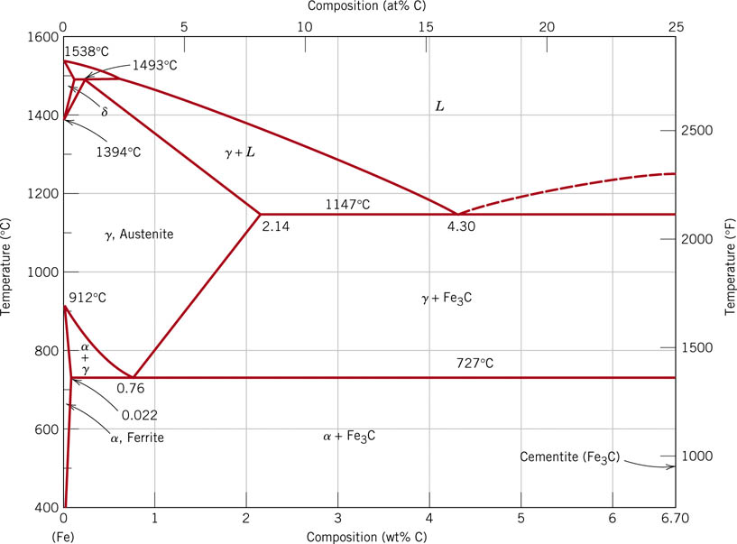
The Iron-Iron Carbide Phase Diagram
Wrought
Iron
Steel
Cast Iron
http://d2vlcm61l7u1fs.cloudfront.net/media%2F5fa%2F5fabc8f5-c63b-4e9b-b65c-d05ad2626ae5%2FphpSvCYaJ.png
Notes:
f24_09_pg290.jpg

Slide 8
Why is Steel Strong?
Two Important phases of iron- α - Ferrite (BCC) γ- Austenite (FCC)
How much carbon can you dissolve in the Iron?
Ferrite very little (<0.02%)
Austenite Lots (up to 2.1%)
Why is that important?
When you heat Steel to 1000°C what phase do you have?
Austenite with lots of Carbon
When you cool it what does the carbon do?
It can precipitate into Carbide particles. Strains crystal makes dislocation motion difficult (hardens)
Wrought Iron
Steel
Cast Iron
Austenite
Ferrite
http://d2vlcm61l7u1fs.cloudfront.net/media%2F5fa%2F5fabc8f5-c63b-4e9b-b65c-d05ad2626ae5%2FphpSvCYaJ.png
Notes:
f24_09_pg290.jpg

Slide 9
Forms of iron
Wrought Iron (Paper Clip)
Very little carbon (<0.2%)
Difficult to slow the dislocations since carbon is dissolved
Soft, malleable, easily wrought
Steel (Bobby Pin)
Medium carbon (0.2-2.3%)
Can dissolve carbon in Austenite but it wants to precipitate upon cooling
Properties depend on how fast you cool
Strain from Carbides greatly strengthens the steel
Must control both the amount of carbon and the tempering
Cast Iron
High Carbon (2.3-4.3%)
Forms lots of carbide phase
Make the material brittle (too much of a good thing)

Slide 10
Why is the Heat treatment important?
For Steel if you heat it to 1000°C you make Austenite
Slow Cool (annealing)
For both Bobby pin (high C) and Paper Clip (low C)
Annealing removes dislocations
Give it time for the Carbon to form particles
Makes material softer
Slightly stronger than Bronze
Fast Cool or Quench
For Bobby Pin
Transform to Martensite
Excess Carbon strains martensite (brittle)
For Paper Clip
Transform to Martensite but less excess carbon (less brittle)
Tempering
Heat again to move carbon around and restore ductility

Slide 11
Why is Steel Strong?
Iron
Steel
Cast Iron
Two Important phases of iron- α - Ferrite (BCC) γ- Austenite (FCC)
How much carbon can you dissolve in the Iron?
Ferrite very little (<0.02%)
Austenite Lots (up to 2.1%)
Carbon makes Paper clips harder and bobby pins brittle when quenched
Stuck in interstitial positions
Austenite
Paper
clip
Bobby
pin
http://d2vlcm61l7u1fs.cloudfront.net/media%2F5fa%2F5fabc8f5-c63b-4e9b-b65c-d05ad2626ae5%2FphpSvCYaJ.png
Notes:
f24_09_pg290.jpg

Slide 12
So how do you make Iron?
Start with
Iron Oxide (either Fe₂O₃ or Fe₃O₄), (mineral form is Taconite)
Limestone (CaCO₃, Oyster Shells) and
Carbon (Charcoal)
Layer these and light on fire and use bellows to get hot
2C +O₂=> 2CO (our favorite reducer)
Fe₂O₃ +3CO => 2 Fe +3CO₂ (reduction makes Iron)
Now have to get rid of sand (impurity that comes with iron ore)
CaCO₃ => CaO +CO₂ (make lime)
CaO + SiO₂ => CaSiO₃ (glass slag)

Slide 13
Methods of Making and Manipulating Iron
Bloomery Furnace
Makes wrought iron (Low Carbon)
Blast Furnace
Makes Cast Iron (High Carbon)
Finery Forge
Converts Cast iron to Wrought Iron
Carburization
Converts wrought iron to steel
Bessimer Furnace
Converts Cast Iron to Steel (medium carbon)

Slide 14
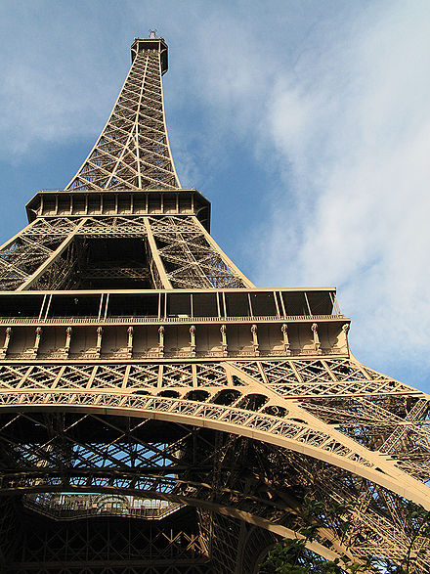
Wrought Iron: Early Bloomeries
Bloom Iron/Wrought Iron
Make a Bloom by heating the mixture we just described
Beat on the bloom with a hammer to separate the iron from the silicate slag
Left with pure wrought (low carbon) iron
Bloom Iron Video

Slide 15
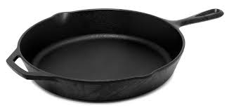
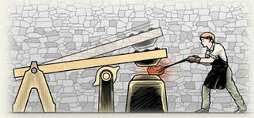
Blast Furnace
Blast Furnace
Same ingredients (Iron Ore, Charcoal and Limestone)
Heat hotter and collect liquid iron from bottom
Cast Iron is also called Pig Iron
Chinese skipped Bloomery stage and just made cast iron from ancient blast furnaces
Not seen in Europe until 1500’s
Finery Forge
Now you have too much carbon
Use Finery Forge to remelt pig iron,
oxidize carbon and silicon
Make bloom and beat it, create wrought iron

Slide 16
Bloom vs Blast
Steel
Cast Iron
Wrought Iron
Melting Point
Austenite
Cast Iron
Melting Point
In Bloomary you can’t get to the melting point of wrought iron: must beat it out
In Blast Furnace you can get to the melting point of cast iron: make pig iron

Slide 17
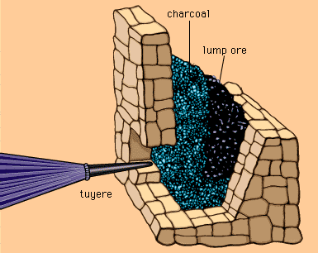
Blast Furnace
Early Blast Furnace
http://media-3.web.britannica.com/eb-media/39/1539-004-7C917766.jpg
www.britanica.com
Notes:
What did you think of the books?
What is your opinion of the respective writing styles? Organizations?
What did you learn from reading two accounts of the same period? Did you notice differences in emphasis?

Slide 18
Finery Forge
Finery Forge
With Cast Iron you have too much carbon
Use Finery Forge to remelt pig (cast) iron,
oxidize carbon and silicon
Make bloom
Beat it with water powered hammers
Create wrought iron

Slide 19
Converting Wrought Iron to Steel
Can make wrought iron by either beating a bloom or using a finery forge. Not enough carbon for steel
How do you make steel?
Carborization
Need to add carbon to make steel
Melting point too high until 1700’s
Heat Iron in Carbon rich air – Carborization
Carbon diffuses into the iron making outer layer of steel
Skilled craftsmen

Slide 20
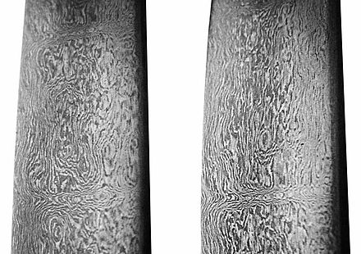
History of Iron and Steel
3500BC Beads in Ancient Egypt for iron
From Meteor (nickel content)
First Iron Production 3000BC Syria and Mesopotamia
Hittites mass produced Iron 1500-1200BC
Bloom Iron in small batch process
Use water power to beat blooms
China starts Iron age later around 700BC
Used the first blast furnaces to make cast iron
Also used Finery forges to make wrought iron 300BC
Wootz Steel 600BC
Southern India, great combination of natural minerals
Produced fine dispersion of carbides, Damascus Swords

Slide 21
History Continued
By 1400’s needs increased
Church bells, cannons etc
Blast furnace developed (Cast Iron)
By 1500’s Japan is making the strongest Steel in the world
Samuri Sword take a week just make the iron
Use Magnetite (black sand Fe₂O₃) and charcoal
Broad range of carbon, separate it by feel and sound
Make the center from low carbon ductile steel
Then add high carbon hard/brittle steel to outside
Create a composite and the best steel for several hundred years

Slide 22
History Continued
1588 Queen Elizabeth limits use of Timber
By 1700’s have a timber famine (charcoal)
Why not use Coal?
Too much Sulfur weakens steel along grain boundaries
Coke the coal,
Drives off impurities (thanks to beer)
1709 Darby England
Low sulfur coke
Cast iron becomes cheap
Start of Industrial revolution
Over 200 years
income increases 10X
Population increases 6X
Machine based economy
Free market, rule of law, no trade barriers

Slide 23
History continued
Puddling
Invented in 1784
Stir Molten Pig (Cast) iron in oxidizing atmosphere
Observe it “come to nature”
Gather in a puddling ball
Replaced by the Bessemer Furnace 1855
Blow Air through the melt
Rapidly remove carbon and silicon
Initially didn’t work tough to remove just the right amount
Instead decided to remove it all and add carbon back
Steel very fast (in 20 minutes) and efficient
Bessemer Furnace Video

Slide 24
Forms
Low Carbon 0-0.2%
Wrought Iron
Pure, Ductile, typically about as strong as Bronze
High melting point (>1500°C)
Product of Bloomery
Medium Carbon 0.2-2.1%
Steel
Very strong, hard, forgable,
1000X harder than pure Fe
High melting point (>1400°C)
Created by the Bessemer Process
High Carbon 2.3-4.3%
Cast Iron or Pig Iron
Low Melting Point, Brittle, Not Forgable
Can only be Cast
Product of Blast Furnace

Slide 25
Methods of Making and Manipulating Iron
Bloomery Furnace
Makes wrought iron (low carbon)
Carburization
Converts wrought iron to steel
Blast Furnace
Makes Cast Iron (High Carbon)
Finery Forge
Converts Cast iron to Wrought Iron
Bessimer Furnace
Converts Cast Iron to Steel (medium carbon)

Slide 26
Today
Today we use 1950’s Process
Basic Oxygen Process (BOP)
Inject pure Oxygen
Add alloying agents and carbon after removing carbon
US Steel Video

