Slide 1

Course Objectives:
Introduce students to:
  How new materials impact society both historically and in the present day
  How social and cultural forces shape the development and use of materials and technologies from the past to present
Course Instructors:
Prof. Kevin Jones Materials Science and Engineering
Prof. Sophia K. Acord Sociology
8 other Faculty from Liberal Arts and Sciences
Course Goal:
Educational, Enlightening and Fun
Notes:
Why?
Materials are enabling – let us make things happen
Eras of history designated by materials – stone, bronze, iron,

Slide 2
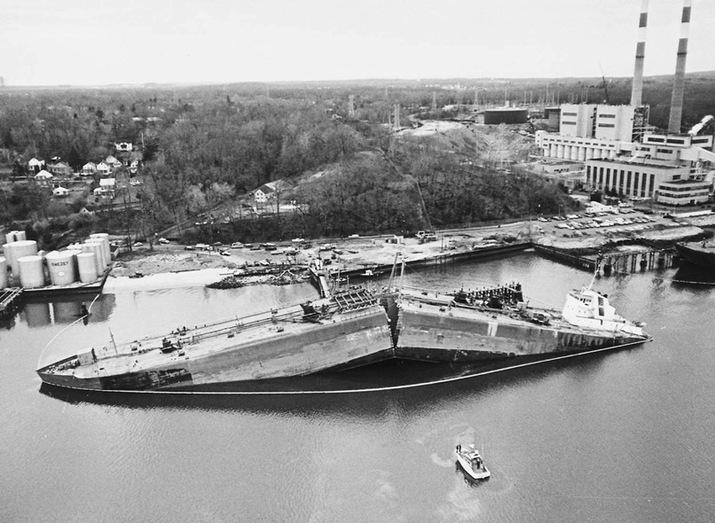
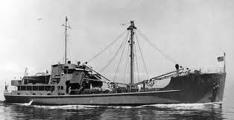

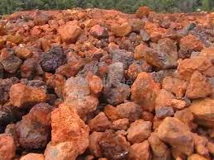
https://commons.wikimedia.org/wiki/File:Design_381_Army_FS.jpg
http://image.slidesharecdn.com/fracturemechanics-140305055250-phpapp02/95/introduction-to-fracture-mechanics-17-638.jpg?cb=1393998806
http://images.clipartpanda.com/cold-weather-clip-art-freezing-cold.jpg
http://2.wlimg.com/product_images/bc-full/dir_97/2893840/iron-ore-1002508.jpg

Slide 3
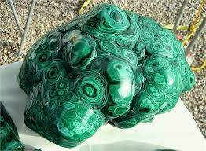
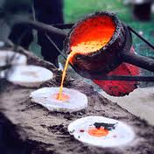
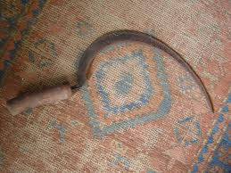

http://api.ning.com/files/YBAVQp1Kcln84RiRU7kGTt32CLTQtCUqV2DfeZdqQ-4ZoxKbGkcBeV0ZDFH3NeM7UIK2jbZyWYrkKPVG2hAstmMttwFDieZE/6malachiteafricanart3230.jpg
https://s-media-cache-ak0.pinimg.com/236x/b5/8e/8d/b58e8d3e2e1f388dd1db8397a3680f74.jpg
http://www.nzmuseums.co.nz/account/3000/object/23463
http://www.lgim.net/home/180011471/180011471/Images/wheat_field_28.jpg

Slide 4

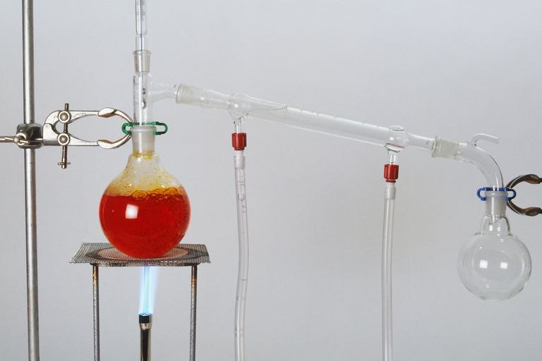


https://www.travelblog.org/pix/Wallpaper/tb_mui_ne_sand_dunes.jpg
https://www.thoughtco.com/what-is-distillation-601964
http://phoneam.com/wp-content/uploads/sites/93/2013/04/Fiber-Optics-Cables.jpg
http://www.trenologi.com/wp-content/uploads/2014/09/Internet-Connection-Maps-01-620x400.jpg

Slide 5
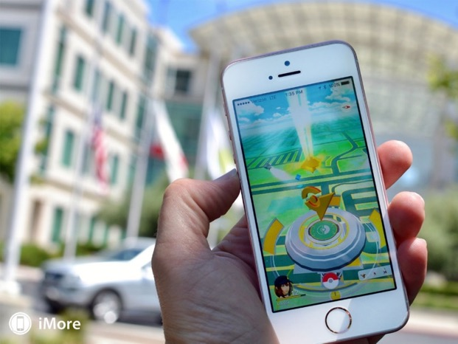

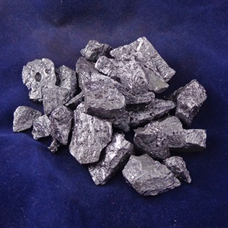
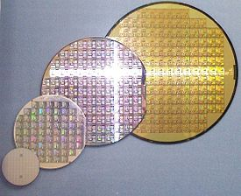
http://www.imore.com/pokemon-go
https://carlyroberts15.wordpress.com/2014/03/13/think-you-can-trust-the-person-youre-dating-try-spending-a-day-with-their-cell-phone/
https://www.belmontmetals.com/product/98-5-silicon-lumps/?attribute_forms=1%2522%2Bx%2B12%2BMesh%2BMetal%2BLumps&gclid=CjwKCAjw1_PqBRBIEiwA71rmtZFvUVZilUTlUVyBYLyhKcGWY62rnXEkctMdp8vkD5qMYHcNXWY6tRoCVCEQAvD_BwE
https://en.wikipedia.org/wiki/Wafer_(electronics)

Slide 6
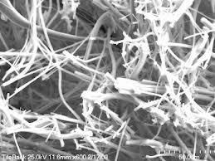
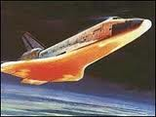

http://wolfweb.unr.edu/~mojtaba/index_files/image12681.gif
http://dbs2000ad.com/brojon.org/TERROR%20IN%20ORBIT%20PART%201_files/reentry.jpg
http://photos1.blogger.com/blogger/6085/786/1600/Manly%20Injuries%20-%20Shuttle.jpg

Slide 7

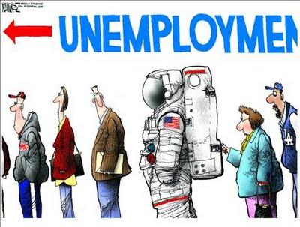
https://http://spacecoast-florida.com
http://beforeitsnews.com/opinion-conservative/2011/07/unemployment-nasa-style-808860.html

Slide 8
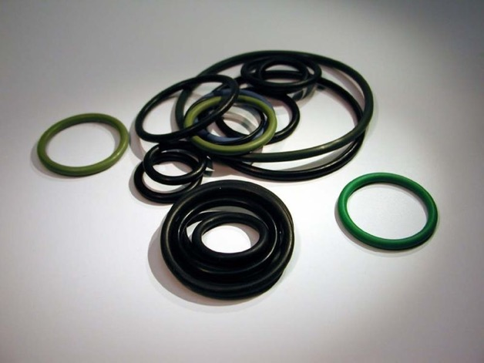

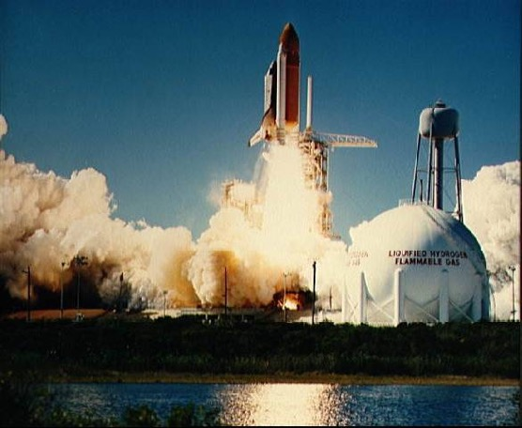
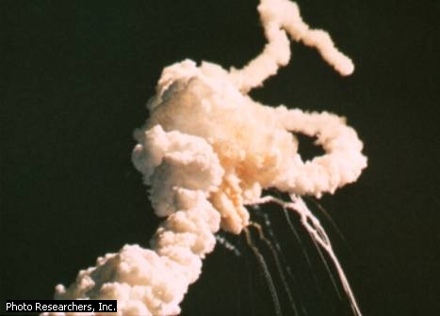
http://www.osengines.com/parts/images/25515000.jpg
http://upload.wikimedia.org/wikipedia/commons/thumb/c/c1/Oring_gr.jpg/320px-Oring_gr.jpg
http://www.earthlyissues.com/images/litofff.jpg
http://trendistic.com/wp-content/uploads/15981-thumb.jpg

Slide 9
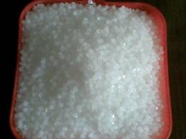

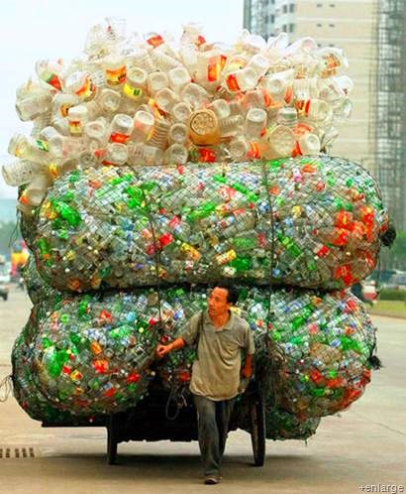
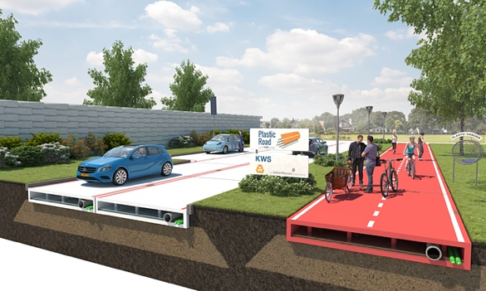
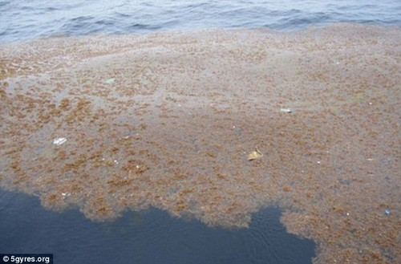
Plastic Road Proposed
Great Plastic Patch in the Atlantic Ocean
http://i00.i.aliimg.com/photo/v0/171507508/Recycled_LDPE_granules_LDPE_film_grade_for.jpg
http://www.trulysimple.com/wp-content/uploads/2011/12/water-bottle.jpg
https://s-media-cache-ak0.pinimg.com/236x/b9/74/89/b97489a3f9761827fa9984122d9bdf7e.jpg
http://materia.nl/article/sustainable-plastic-road-future/?utm_source=Materia&utm_campaign=66d90a5b50-Plastic+Roads+and+More+Unbelievable+Materials&utm_medium=email&utm_term=0_8794d00bd4-66d90a5b50-302945573
http://www.on-select.com/p/p/pacific-garbage-patch-aerial-view/3/

Slide 10
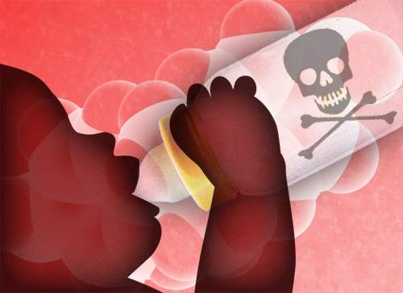

http://reusablebags.typepad.com/newsroom/bpa_phthalates/
https://skepticalswedishscientists.wordpress.com/scientific-method/

Slide 11
Anatomy of a Weekly Module :
Materials
Overview
HSS Case Study
IMOS
Video
Flipped Classroom Activity
Notes:
This is maybe a little repetitive of the last slide; see which you like more.
The point that you can make is that the HSS Case Study can be quite flexible. It can be a study of one particular application of a material (like coins), or a broad investigation of how a class of materials has revolutionized our world (like writing materials). No matter what you choose to do, there is a social lesson that will help you to think about the future.

Slide 12

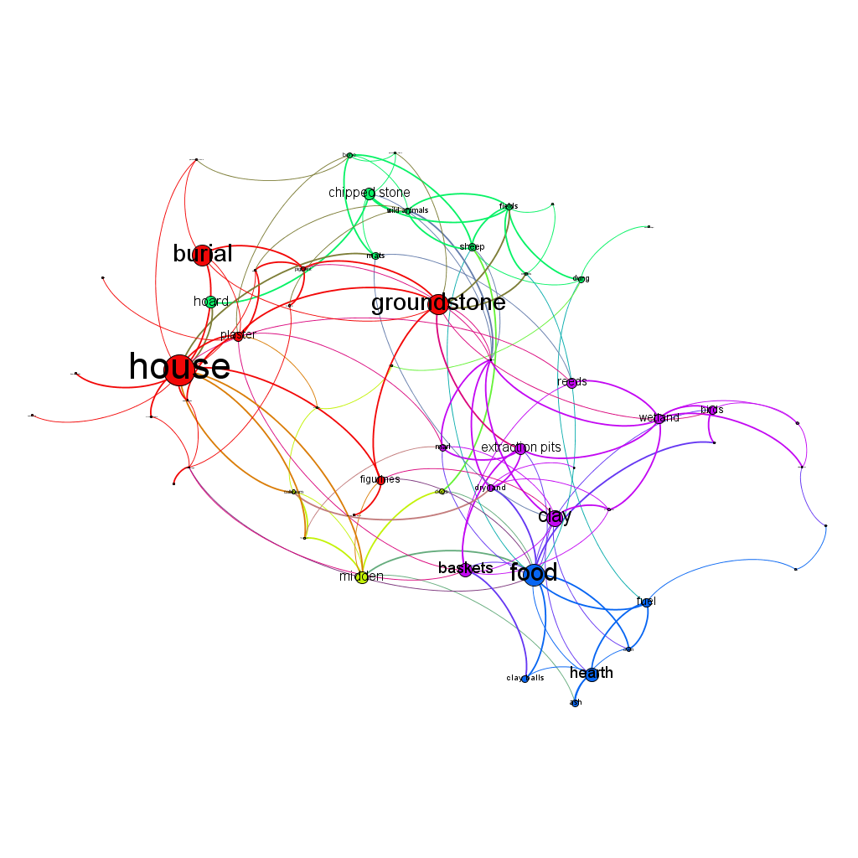
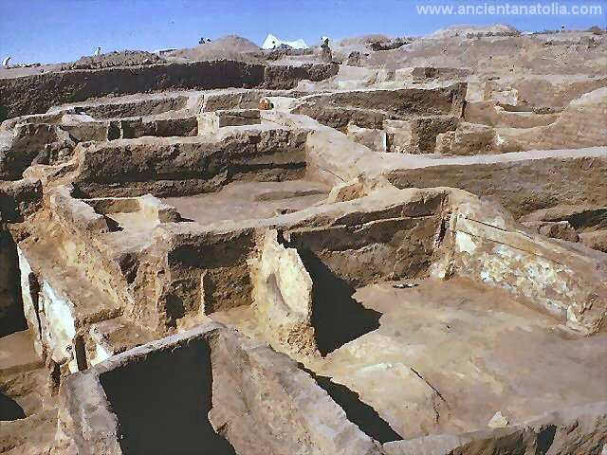
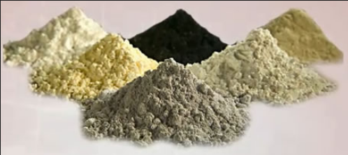
Clay and Entanglement
(Susan Gillespie, anthropology)
http://electricarchaeologist.files.wordpress.com/2013/03/tanglegram.png
http://www.ancientanatolia.com/Pictures/Images01/catalhoyuk.jpg
Notes:
Anthropology/Archaeology: Understand change over time: change occurs as populations grow, things fall apart, etc. (time is unique variable to archaeology) Archaeology can teach about the sociomaterial motor or mechanism that causes change, and the trajectory of change (why things change in certain ways and not others…our entanglements and attachments)

Slide 13
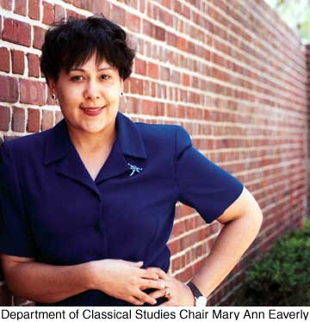
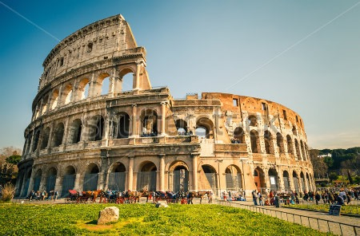
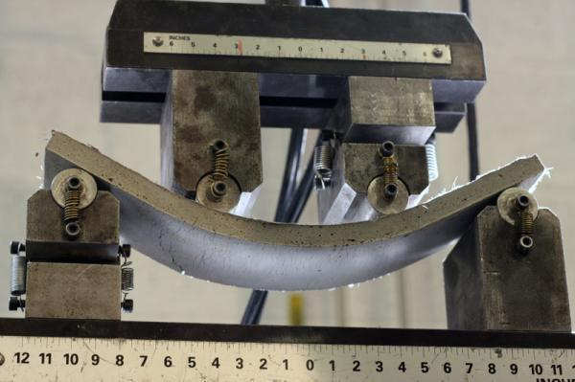
Concrete and Symbolic Value
(Mary Ann Eaverly, classics)
http://www.clas.ufl.edu/_styles/images/news/200204_images/eaverly.jpg
http://thumb9.shutterstock.com/display_pic_with_logo/234100/113646016/stock-photo-view-on-coliseum-in-rome-italy-113646016.jpg
http://geopolymerhouses.files.wordpress.com/2011/12/self-healing-concrete.jpg
Notes:
See materials used from different perspectives – Romans didn’t use water to drink/bathe…but for ornamentation. Our existing models of organizing people and places are laden with tacit meanings that strongly influence social integration. Importance of context: we need to know the meanings of things for the people who create them…we need to step aside from the immediacy of our own processes to think in another mindset.

Slide 14


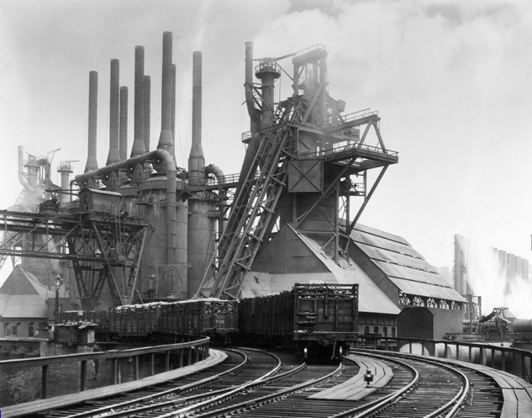
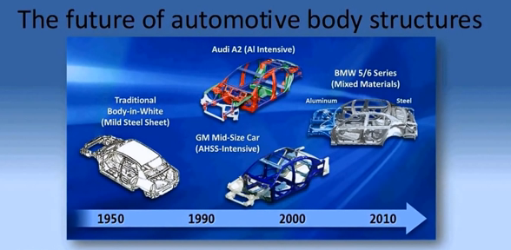
Steel and Creative Destruction
(Sean Adams, history)
http://clio.missouristate.edu/wrmiller/HST/HST525/Carnegie.jpg
Notes:
History: When you change how a material is made, you change work paths, labor regimes, etc. Creative destruction. Better understand the context in which you apply your trade. Understand political and economic forces in materials work.

Slide 15
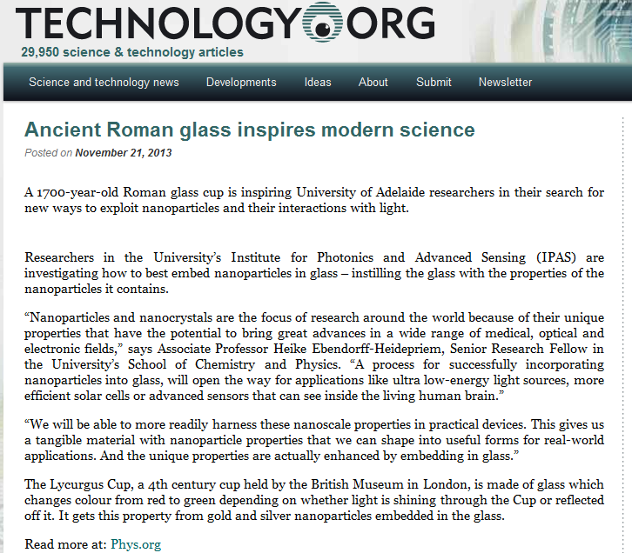
Many factors shape materials innovation
Notes:
Avoid Western bias about science…indigenous individuals have theory too.

Slide 16
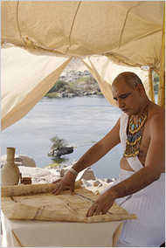
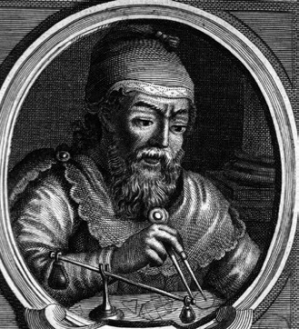




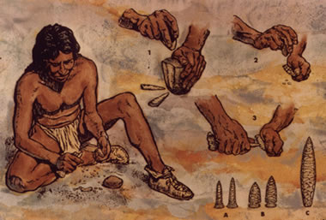
What is an engineer?
http://graphics8.nytimes.com/images/2006/10/09/arts/Imhotep190.jpg
http://justmediakits.com/images.mediakit/4/woman_engineer.17434.jpg
http://media.al.com/space-news/photo/8968163-large.jpg
http://feministing.com/files/2011/03/wired-20110316-074410.jpg
http://nihrecord.od.nih.gov/newsletters/2007/09_07_2007/images/story2Pic2.jpg
http://www.yam-mag.com/wp-content/uploads/2012/04/tbbt-howard.jpg
http://geology.com/rocks/pictures/flintknapping.jpg

Slide 17

Why should we talk to each other?
“We are living in a technical age. Many are convinced that science and technology hold the answers to all our problems. We should just let the scientists and technicians go on with their work, and they will create heaven here on earth. But science is not an enterprise that takes place on some superior moral or spiritual plane above the rest of human activity. Like all other parts of our culture, it is shaped by economic, political and religious interests.”
http://blogs.abc.net.au/.a/6a00e0097e4e68883301bb07bbe0c4970d-pi

Slide 18
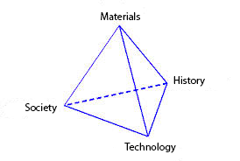
The Impact Paradigm
Material
What is the material of importance?
What are the general properties of this material?
What is the general abundance of the material?
Historical
What is the first known use of the material?
At what time did the material become enabling?
Technological
What technology did the material enable?
What property of the material enables the technology?
How sustainable is the material?
Societal
In which realms of society did the materials development have an impact?
What were the financial implications of the development?
What were the health implications of the development?
What were the political implications of the development (war)?
What were the social implication of the development?

Slide 19
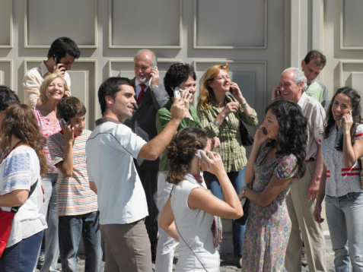
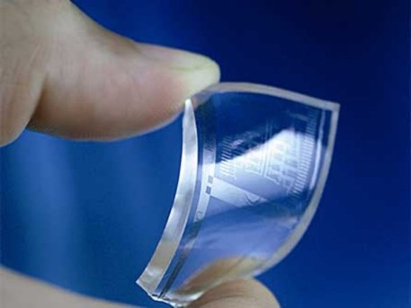
Semiconductors and Cyborgs
(Sophia Acord, sociology)
http://1.bp.blogspot.com/-Ids-mU9x1Fg/T6qlSt1EASI/AAAAAAAAAAk/u83xco-tlZE/s1600/cell.jpg
http://www.geek.com/wp-content/uploads/2013/10/graphene-2.jpg
Notes:
Sleeping policeman
Delegation – example of an alarm
We don’t remember; we google.
How do materials play an active role in our social lives? How do they affect how we interact?

Slide 22
Social Principles
Entanglement
Operational Chain
Trade
Intrinsic vs Extrinsic Value
Symbolism
Creative Destruction
Intellectual Property
Knowledge Preservation
Marketing
Delegation
Sustainability

Slide 23
Enduring Knowledge Statements
Materials shape the human experience, and vice versa.
Materials can be manipulated to solve technical and sociocultural problems.
Materials have intrinsic physical properties, only some of which are selected as more relevant in shaping society based on cultural perspectives
The impact of materials on society varies with the cultural and historical context
Understanding the impact of materials on society require a variety of approaches in the sciences, humanities, and social sciences.

Slide 24
Introduce Canvas Website

