Slide 1
Materials Science and Engineering
Types of Materials
Metals
Ceramics
Polymers
Semiconductors
Composites
How do we describe them?

Slide 2
Types of Materials
Metals
High density, Strong, ductile
High thermal & electrical conductivity
Opaque, reflective,
Can corrode
Ceramics
Medium density
Brittle, glassy, inelastic
Non-conducting (insulators)
Corrosion resistant
Polymers
Soft, ductile, low strength, low density
Thermal & electrical insulators
Optically translucent or transparent
Corrosion resistant

Slide 3
Properties of Materials
Atomic Properties
e.g. Density, mass etc.
example compare Magnesium, Tungsten and Aerogel
Thermal properties
Melting Point, Thermal Conductivity etc.
example compare Aerogel with Diamond
Mechanical Properties
Strength, Ductility, Hardness etc.
example compare ductility before and after quenching
Optical Properties
e.g. color, reflectivity etc.
Chemical Properties
Corrosion resistance, Reactivity etc.
Electrical Properties
Electrical Conductivity, Dielectric constant etc.
Magnetic Properties etc.

Slide 4
How do we measure these properties?
We can use tools
E.g. an Tensile testing machine is used to measure the amount of force necessary to deform the material.
This could tell us how strong something is or how stiff it is for when it might fail

Slide 5
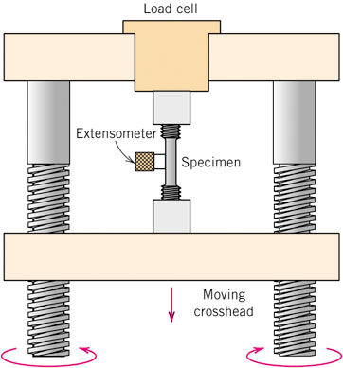
How do we determine these properties?
E.g. Mechanical Property Measurement
Concepts of Stress and Strain
One of the most common
materials tests is the
tensile test, in which a specifically shaped sample is placed under an increasing tensile load (force). The physical deformation of the sample is measured as a function of applied force.

Slide 6
How do we measure these properties?
We can use tools
E.g. an Tensile testing machine is used to measure the amount of force necessary to deform the material.
This could tell us how strong something is or how stiff it is for when it might fail
We can set up standard tests
Bend a material and then expose it to a change in environment
This could tell us how this material might react in a corrosive environment and when it might fail

Slide 7
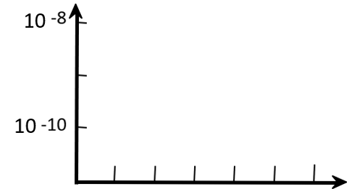
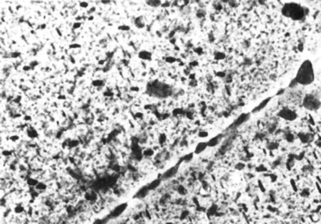
Corrosion
• Stress & Saltwater...
--causes cracks!
• Heat treatment: slows
crack speed in salt water!
“as-is”
“held at
crack speed (m/s)
160ºC for 1 hr
before testing”
Alloy 7178 tested in
saturated aqueous NaCl
solution at 23ºC
increasing load
--material:
7150-T651 Al "alloy"
(Zn,Cu,Mg,Zr)
4 mm

Slide 8
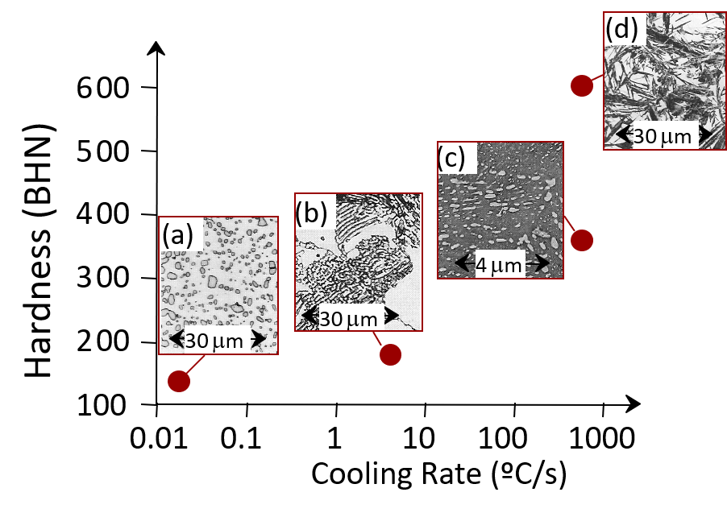
Four Materials Considerations
• Processing can change structure
ex: structure vs cooling rate of steel
• Structure dictates properties
ex: hardness vs structure of steel

Slide 9
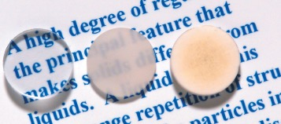
Example. Effects of processing on structure and optical properties of aluminum oxide.
Polycrystal
(low porosity)
Polycrystal
(high porosity)
single crystal
Science
Processing
Structure
Properties
Performance
Engineering

Slide 10
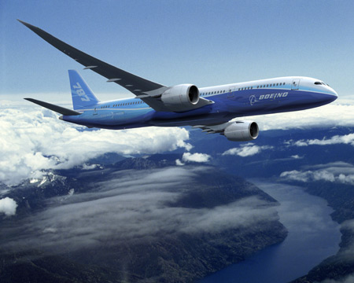
Materials Selection in Engineering: Aerospace
What are the requirements?

Slide 11
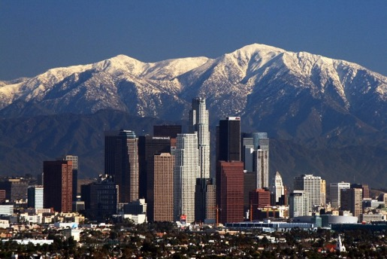
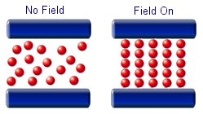
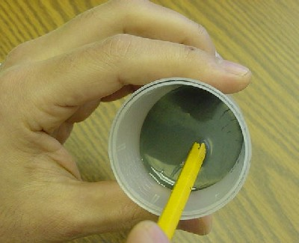
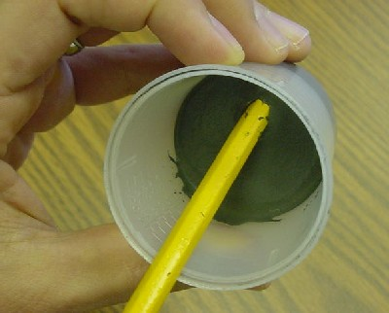
Materials Selection in Engineering: Civil
Skyscrapers that can withstand earthquakes?
Can we design a material with tunable stiffness?
Magnetorheological Fluid
No Magnetic Field
Magnetic Field On
http://science.howstuffworks.com/engineering/structural/smart-structure1.htm
Notes:
To make a skyscraper that can not sway in the wind or with an earthquake you need to make it stiff. But then in earthquakes the entire building will move with the horizontal vibrations of the earth, which will be good for the skyscraper, but perhaps not for the occupants.

Slide 12
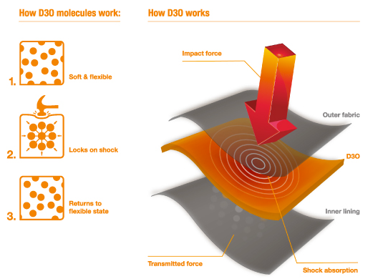
Materials Selection: Shark proof westuit?
Could you design a wetsuit that was flexible enough for swimming, but could withstand the impact of a shark’s bite?
http://www.d3o.com
Notes:
Find D30 video

Slide 13
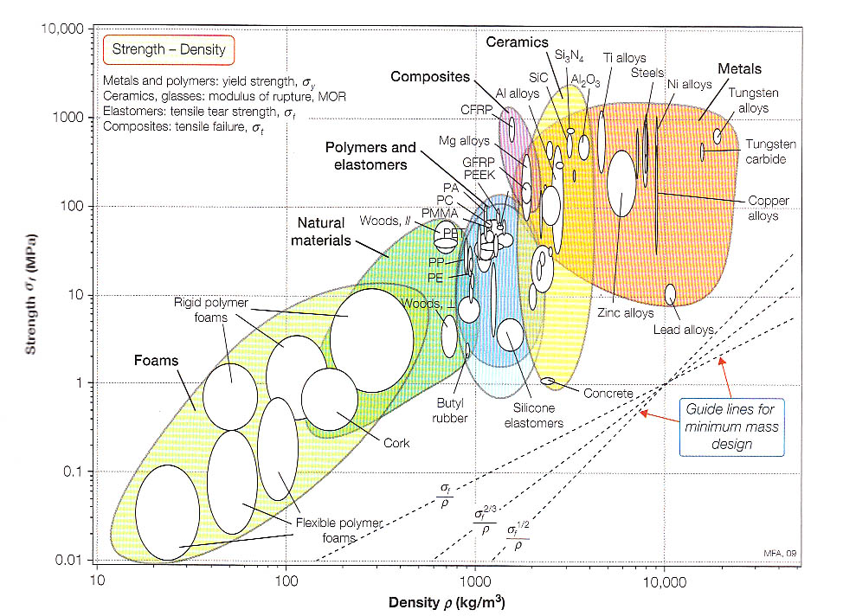
Materials Selection: Ashby Plots
M. Ashby, Materials Selection in Mechanical Design.

Slide 14
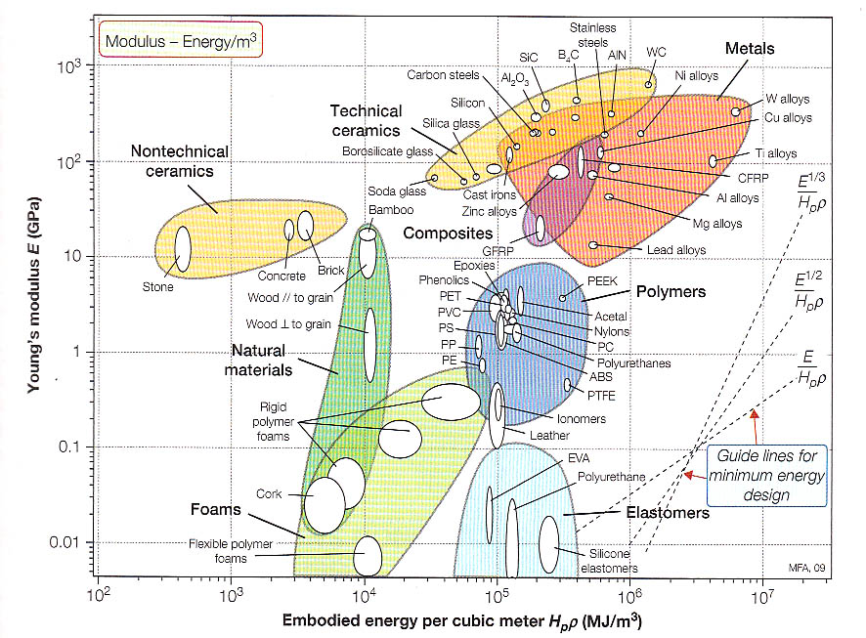
Materials Selection: Ashby Plots
M. Ashby, Materials Selection in Mechanical Design.
Notes:
Embodied energy is defined as the commercial energy (fossil fuels, nuclear, etc) that was used in the work to make any product, bring it to market, and dispose of it. Embodied energy is an accounting methodology which aims to find the sum total of the energy necessary for an entire product lifecycle. This lifecycle includes raw material extraction, transport,[1] manufacture, assembly, installation, disassembly, deconstruction and/or decomposition.

Slide 15
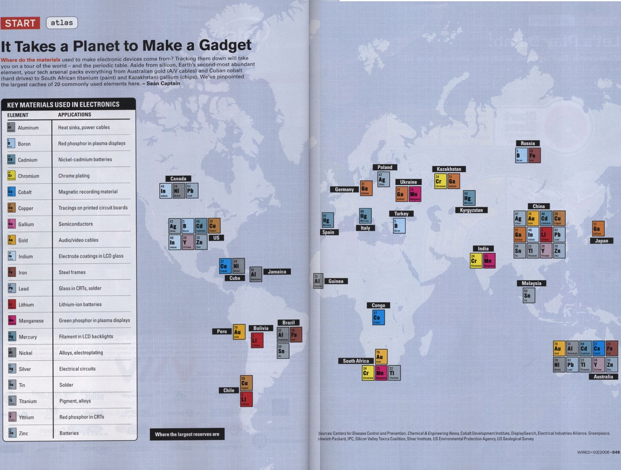

Slide 16
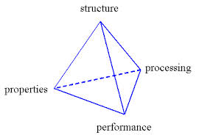
The MSE Tetrahedra
From a Materials Engineering Perspective
Notes:
Why?
Materials are enabling – let us make things happen
Eras of history designated by materials – stone, bronze, iron,

Slide 17
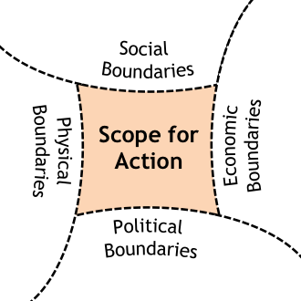
Materials have social lives
http://www.sswm.info/sites/default/files/toolbox/SEECON%202010%20System%20Boundaries.png
Notes:
Government policies
Market forces
Organizations (factories, advertisers)
Why?
Materials are enabling – let us make things happen
Eras of history designated by materials – stone, bronze, iron,

Slide 18
Materials have cultural meanings
http://shrimptoastpie.files.wordpress.com/2011/01/trendy-traditional.jpg
Notes:
Societies are run by cultural forces. Culture (religious beliefs, gender norms)
Material culture refers to the physical objects, resources, and spaces that people use to define their culture. These include homes, neighborhoods, cities, schools, churches, synagogues, temples, mosques, offices, factories and plants, tools, means of production, goods and products, stores, and so forth. All of these physical aspects of a culture help to define its members' behaviors and perceptions. For example, technology is a vital aspect of material culture in today's United States. American students must learn to use computers to survive in college and business, in contrast to young adults in the Yanomamo society in the Amazon who must learn to build weapons and hunt.
Non-material culture refers to the nonphysical ideas that people have about their culture, including beliefs, values, rules, norms, morals, language, organizations, and institutions. For instance, the non-material cultural concept of religion consists of a set of ideas and beliefs about God, worship, morals, and ethics. These beliefs, then, determine how the culture responds to its religious topics, issues, and events.
When considering non-material culture, sociologists refer to several processes that a culture uses to shape its members' thoughts, feelings, and behaviors. Four of the most important of these are symbols, language, values, and norms.

Slide 19
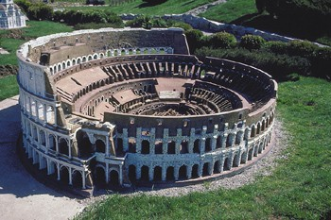
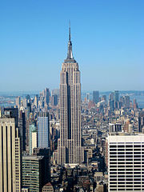
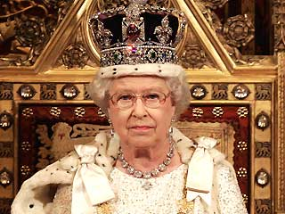
http://1.bp.blogspot.com/_Jj4lDZWN9hs/TJtjbYPKe5I/AAAAAAAAATQ/o82h-4hs8XY/s1600/Marilyn-Monroe-Diamonds-29664.jpg
http://www.webanswers.com/post-images/5/5E/EB0F78A6-E6D2-136D-3770ADADD7EFBAFA.jpg
http://www.waterwarcrimes.com/uploads/3/6/3/8/3638406/3074905.jpg
http://upload.wikimedia.org/wikipedia/commons/thumb/c/c7/Empire_State_Building_from_the_Top_of_the_Rock.jpg/180px-Empire_State_Building_from_the_Top_of_the_Rock.jpg
Notes:
Symbolism
Value

Slide 20
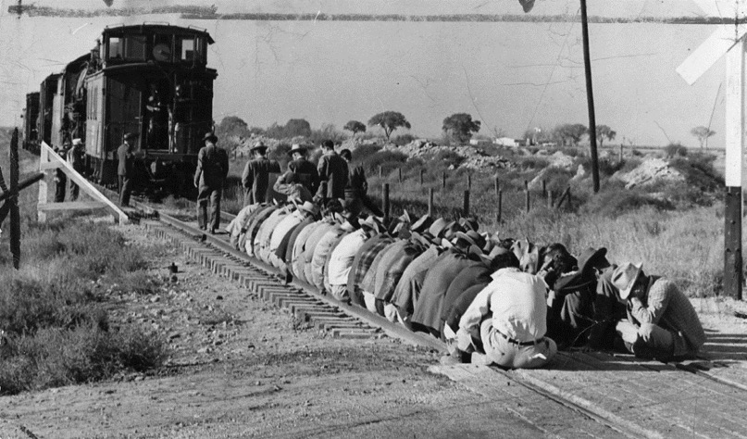
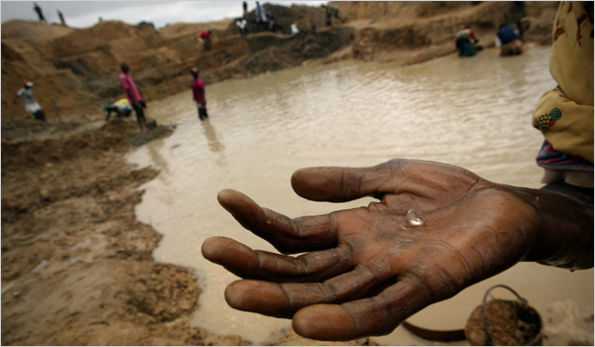
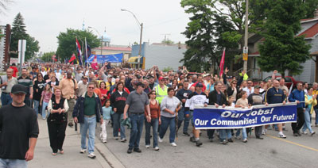
Materials are part of social, political, and economic regimes
Canada: High strike rate now leading to factory occupations
http://ucblibraries.colorado.edu/archives/images/Miners_1949StrikeAgainstThePotashCompanyofAmericainCarlsbandNew-Mexico_large.png
http://graphics8.nytimes.com/images/2006/12/17/weekinreview/17mcneil_CA0.600.jpg
Notes:
Creative destruction

Slide 21
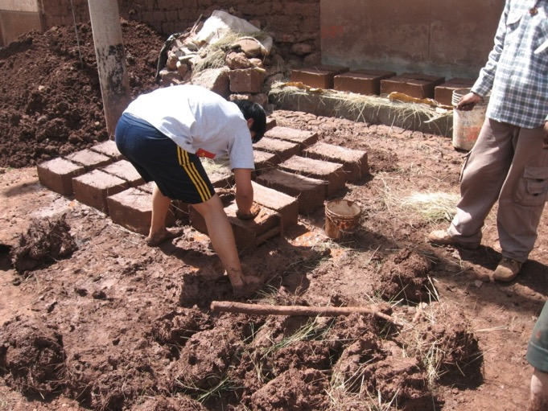
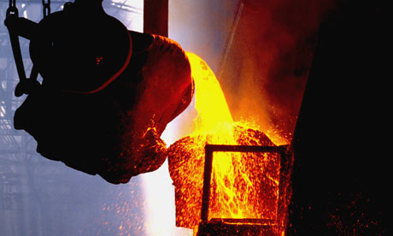
Materials have relationships to other materials
http://farm4.staticflickr.com/3592/3504506171_db2e3cfc60_o.jpg
http://www.commodityonline.com/images/21232354605103abfda606a.jpg
Notes:
Entanglement
Copper needs charcoal for smelting
Clay bricks need fuel to be fired.
Alloys need to be alloyed

Slide 22
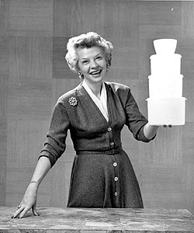
What we can do with materials is shaped by human mediators
http://assets4.designsponge.com/wp-content/uploads/2013/03/browniewise.jpg?73626
http://clio.missouristate.edu/wrmiller/HST/HST525/Carnegie.jpg
Notes:
(argumentation, advertising)

Slide 23
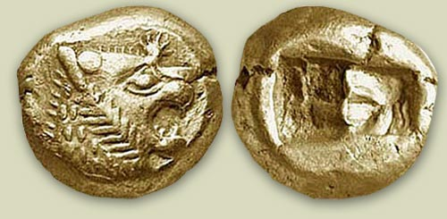
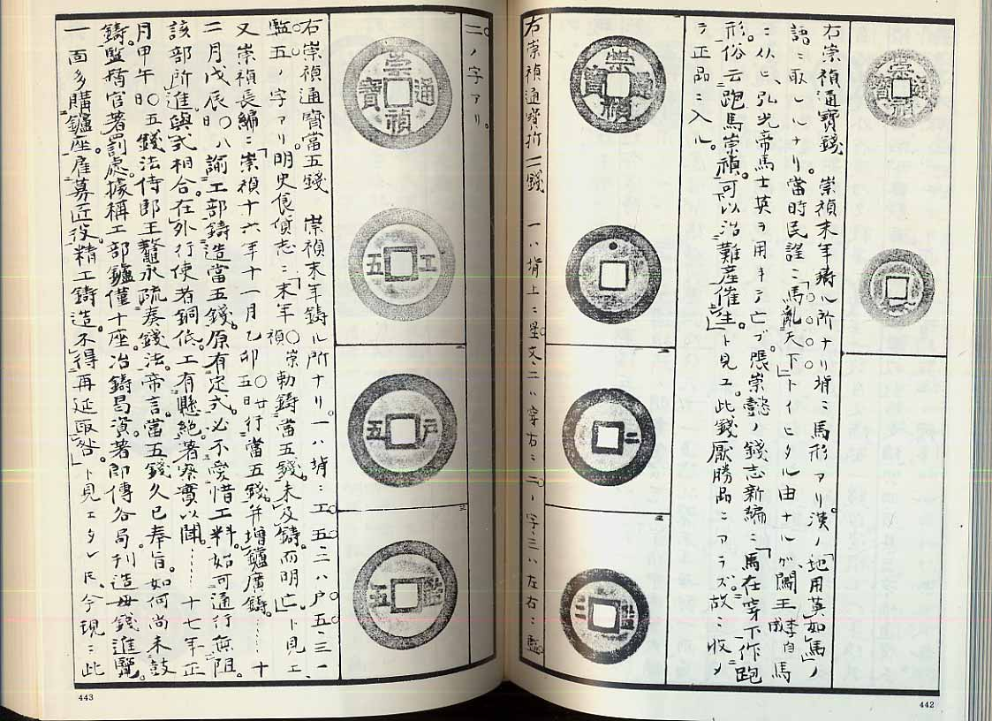
Materials affect how we think and interact with each other
http://www.coincoin.com/bOkudToasenS.jpg
Notes:
So, this means that materials impact our lives in both big and small ways – from buildings to coins/phones.

Slide 24
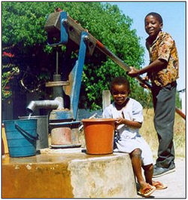
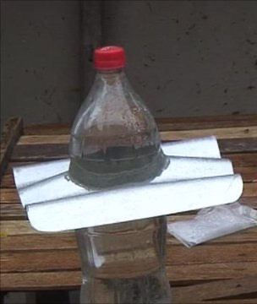
Some materials are more appropriate than others
http://www.designecologysf.com/wp-content/uploads/2012/02/waterbottle-light.png
http://news.bbcimg.co.uk/media/images/55447000/jpg/_55447048_jex_1171488_de46-1.jpg
http://akvopedia.org/wiki/images/thumb/4/4e/Bush_pump.jpg/250px-Bush_pump.jpg

Slide 25
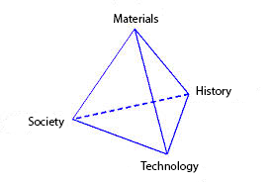
The MSE Tetrahedra (Reconsidered)
From a Sociocultural Perspective
Notes:
Why?
Materials are enabling – let us make things happen
Eras of history designated by materials – stone, bronze, iron,

Slide 26
Physical materials
Cultural norms
Engineering processes
Social institutions
IMOS
Notes:
AFFORDANCES???

Slide 27
So Materials can have Social Properties as well as physical properties For example: what is sustainability?

