Slide 1
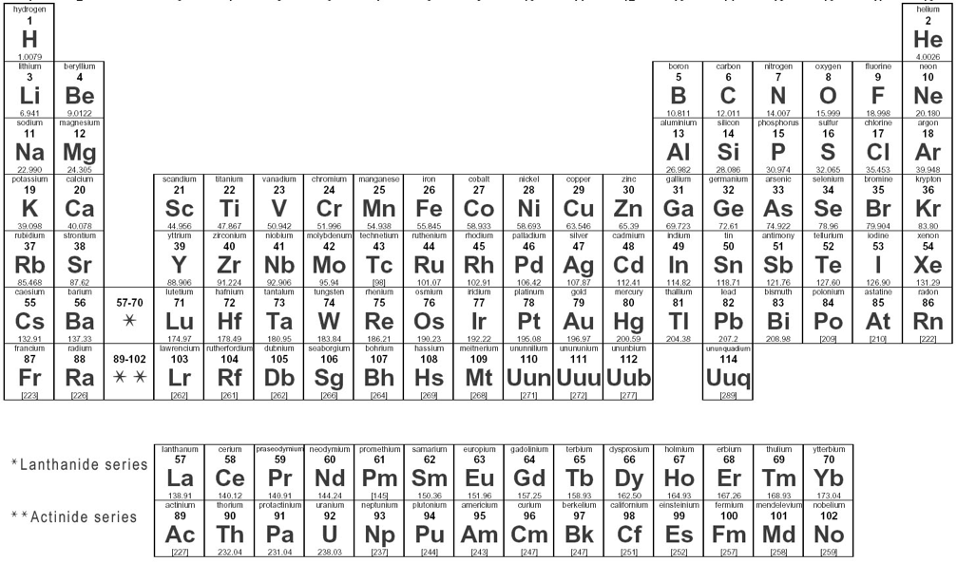
Rare Earths
Rare earths are defined by their location in the periodic table

Slide 2
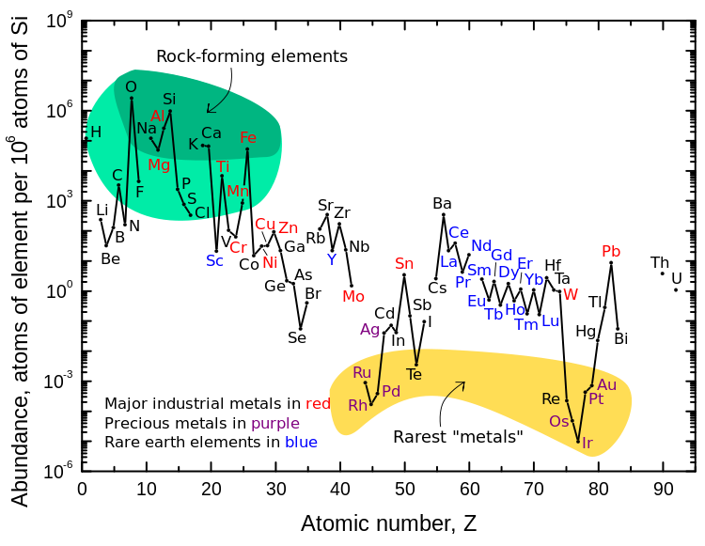
Rare Earths
Rare Earth Elements are not very rare
For example Cerium is about as abundant as Copper
They were termed this because they are not easily smelted
Chemically very similar
Often found in Clay
Very difficult to isolate
Very polluting to extract
https://en.wiki2.org/wikipedia/commons/thumb/0/09/Elemental_abundances.svg/im420-620px-Elemental_abundances.svg.png

Slide 3
Rare Earths Applications
Why do we care about Rare Earths?
Rare Earth Oxide are used for Phosphors in Lighting
Critical for new low energy LED’s
Neodymium makes magnets much stronger
Critical for wind turbines
Critical for electric vehicles
Cerium
Polishing glass
Alloying agent for steel
http://www.alternative-energy-news.info/technology/wind-power/wind-turbines/

Slide 4
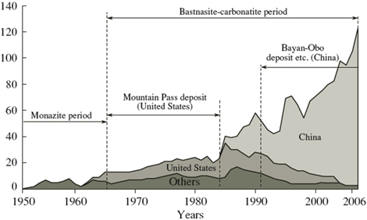
Rare Earths
Where do we get them?
China currently dominates world production
Over 95% of world production in 2010
Why would this be an issue?
In 2012 china dropped production by 20%, why? what happened?
http://1.bp.blogspot.com/_bTv7utrx0s4/TB753lBg6rI/AAAAAAAAADk/fisxywh6Sh0/s1600/global+rare+earth+production+1950+2010.jpg

Slide 5
Novel Applications of Rare Earths
Another potential application for Rare Earth Oxides in in the conversion of Solar energy to chemical energy through the use of a novel process in which CO2 and H2O are converted to organic molecules which could be to deliver energy to cars etc.
If interested watch this TED Talk video for more information.
https://www.youtube.com/watch?v=gSIsc7xBX3A

