Slide 1
Material Properties: Affordances and Constraints
Prepared by
Susan D. Gillespie
Department of Anthropology
University of Florida

Slide 2
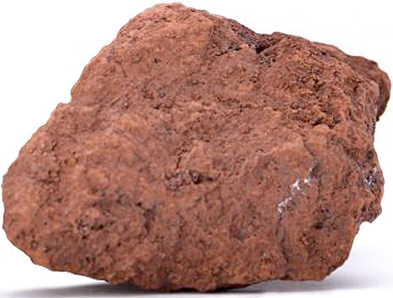
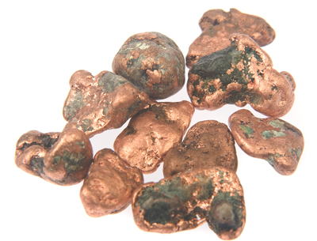
matter has its own properties
materials are “bundled” with many properties
only some properties are realized in making things
http://southafrica.angloamerican.com/our-operations/iron-ore.aspx
http://www.thecrystalhealer.co.uk/Copper-nugget
iron ore
copper nuggets

Slide 3
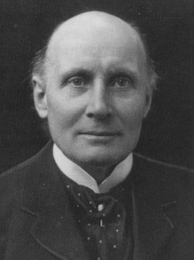
potential and actual properties
distinction made by British philosopher Alfred North Whitehead
(1861-1947)
many potential properties are not known to those who use materials
or are known but not actualized—put to use
or they may become recognized later
e.g., oxidation of iron
http://www.iep.utm.edu/whitehed/

Slide 4
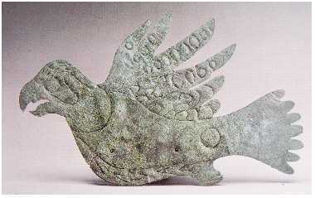
actualizing potential properties
potential properties can be a source of innovation once actualized or realized
copper is a soft metal, can be hammered and cut into shapes
http://www.thecrystalhealer.co.uk/Copper-nugget
https://en.wikipedia.org/wiki/Metallurgy_in_pre-Columbian_America
copper falcon, Hopewell Culture, Ohio c. 200 BC

Slide 5
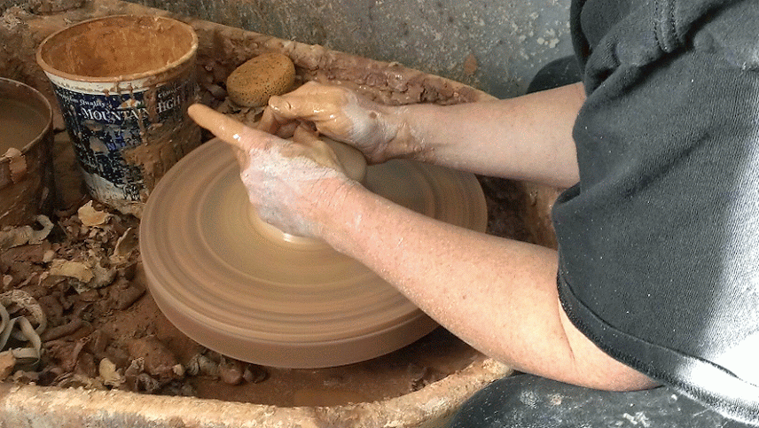
affordances and constraints
advantageous properties in a given situation are affordances
(ecological psychologist James J. Gibson 1904-1979)
specifically, qualities of an object or environment that communicate opportunities to do certain things
affordances must be socially agreed upon
e.g., the plasticity of clay
http://www.reannagteine.com/CommonQuestions.html

Slide 6
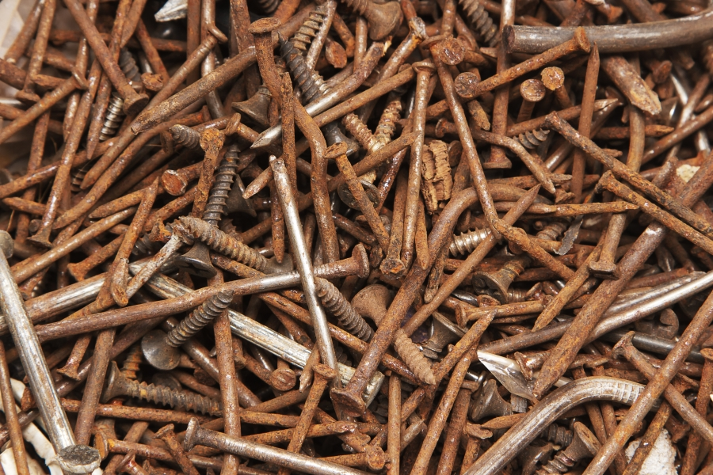
disadvantageous properties are constraints
they limit human actions and thwart human intentions
e.g., rust,
corrosion
http://wonderopolis.org/wonder/why-do-some-things-rust/

Slide 7
the impact of materials on society
materials and made things play a role in social change through entanglements with humans
materials have both independent properties and dependencies on humans and other things
people take advantage of “affordances”
they avoid or work-around “constraints”
social change depends on the interplay of affordances and constraints of human-material interactions

