Slide 1
The Entanglement of Clay at Çatalhöyük
prepared by
Susan D. Gillespie
Department of Anthropology
University of Florida

Slide 2
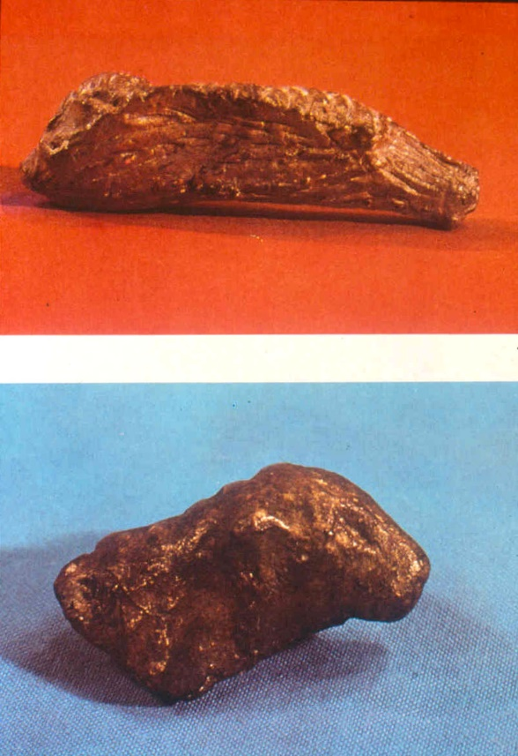
earliest clay objects
Upper Paleolithic figurines
c. 30,000 BC
ritually “exploded” in heat of fire

Slide 3
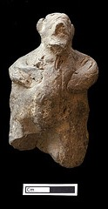
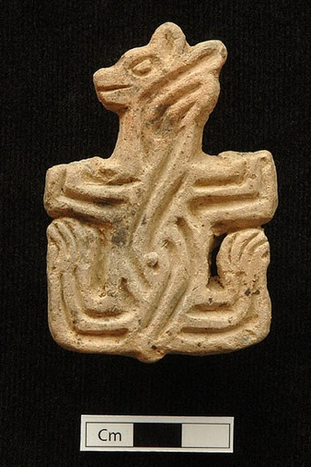
Neolithic Period: the “Age of Clay”
clay: fine-grained earth that develops plasticity and cohesiveness when mixed with water
clay stamp
figurine
http://www.flickr.com/photos/catalhoyuk/1443100379/sizes/z/in/photostream/
http://www.flickr.com/photos/catalhoyuk/7685669192/sizes/z/in/photostream/

Slide 4
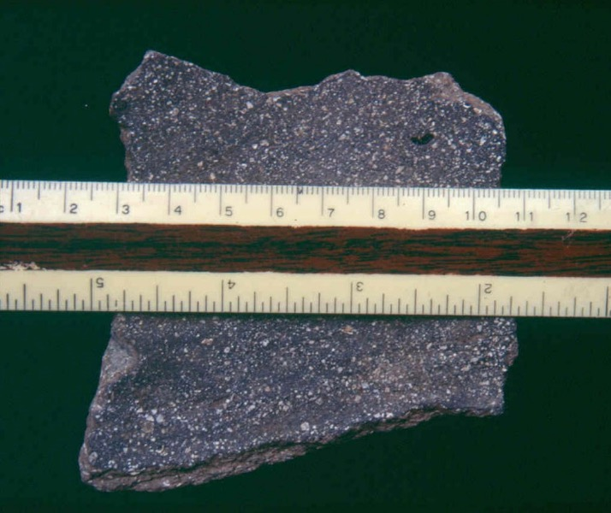
paste = clay + temper
temper: aplastic material added to clay to minimize shrinking and cracking when dry
pulverized shell temper is characteristic of Mississippian period pottery
c. AD 1000 in mid-continental US
photo by S. D. Gillespie

Slide 5
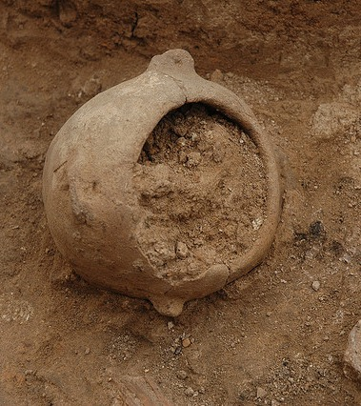
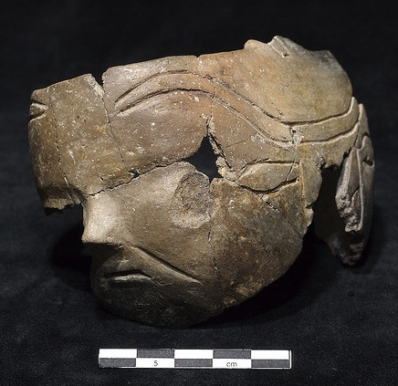
early pottery
ceramic and subceramic objects: earth + water + fire
durable
insect-proof
relatively water-proof
heat-proof
http://www.flickr.com/photos/catalhoyuk/220965367/sizes/z/in/photostream/
http://www.flickr.com/photos/catalhoyuk/971964416/sizes/z/in/photostream/

Slide 6
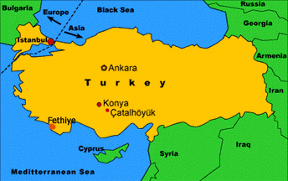
entanglement in the “Age of Clay” at Çatalhöyük
a very large, well preserved mound settlement in southern Anatolia (Turkey)
occupation spans about 7500 to 5700 BC
http://www.smm.org/catal/introduction/

Slide 7
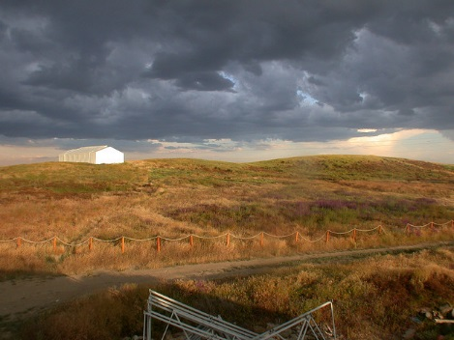
Çatalhöyük (“forked mound”)
http://www.flickr.com/photos/catalhoyuk/132005667/sizes/z/in/photostream/

Slide 8
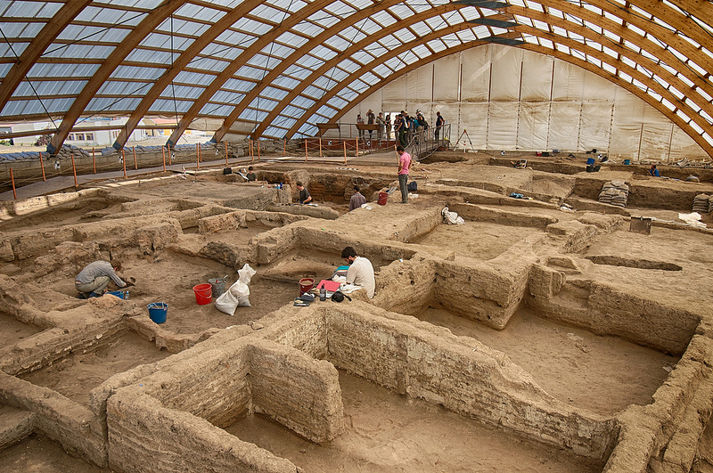
excavations by Ian Hodder began in 1993
http://www.flickr.com/photos/catalhoyuk/9403326478/

Slide 9
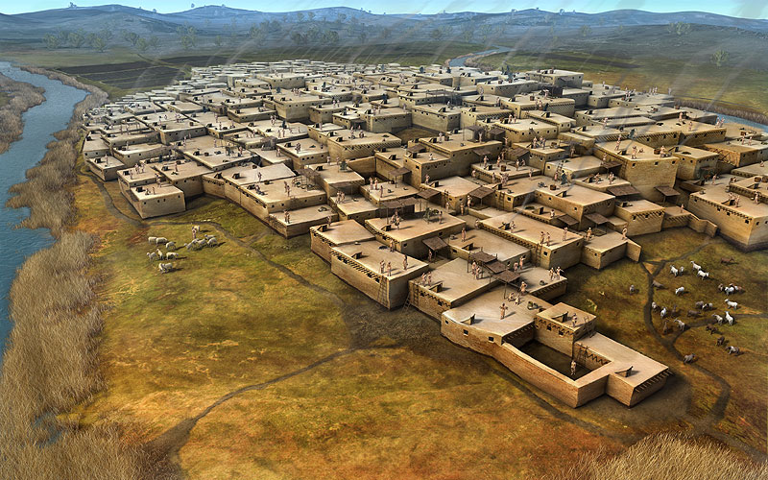
reconstruction of the settlement shows individual conjoined houses
http://www.rpgbooster.com/inspiration-8-mysterious-cities/

Slide 10
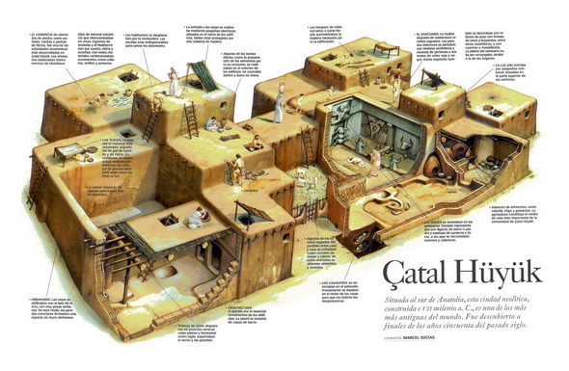
everyday life in clay brick houses
new houses were built atop the ruins of older houses, creating a mounded settlement
http://genealogyreligion.net/tag/catalhoyuk

Slide 11
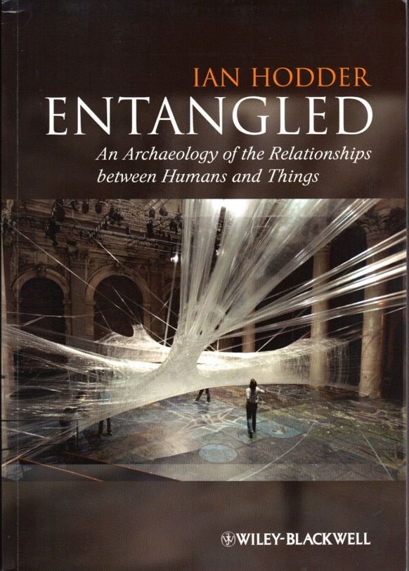
a theory of entanglement
Ian Hodder
http://www.skylife.com/en/2013-february/where-everybody-belongs-catalhoyuk

Slide 12
premises of entanglement theory
humans depend on things
things depend on other things
things depend on humans
humans depend on things that depend on humans (entanglement as interdependency)
the entanglement of humans and things played out over time influences the success or failure of social and cultural traits
(Hodder, Ian [2012] Entangled: An Archaeology of the Relationships between Humans and Things,
Wiley-Blackwell.)

Slide 13
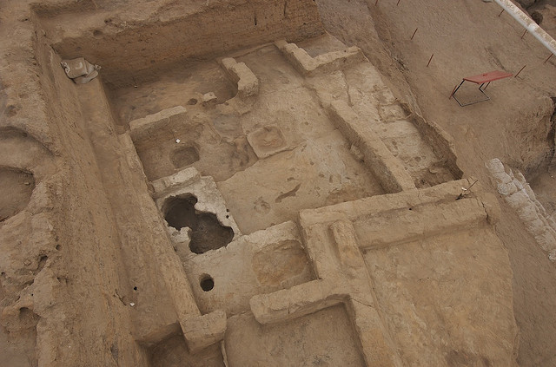
#1. people depended on clay
clay house walls, benches, hearths
http://www.flickr.com/photos/catalhoyuk/914432721/sizes/z/in/photostream/

Slide 14
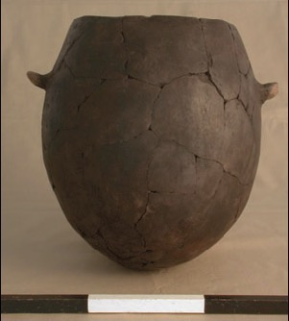
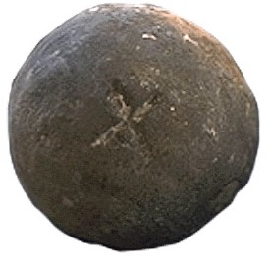
everyday life surrounded by clay
clay was used to cook their food
heated clay balls used to cook food in clay-lined baskets
later replaced by heat-proof pots
(Hodder, Ian [2011] Human-Thing Entanglement: Towards an Integrated Archaeological Perspective. Journal of the Royal Anthropological Institute (N.S.) 17, 154-177; Fig. 7, p. 169)
http://www.smm.org/catal/mysteries/clay_balls/ball_game/005/

Slide 15
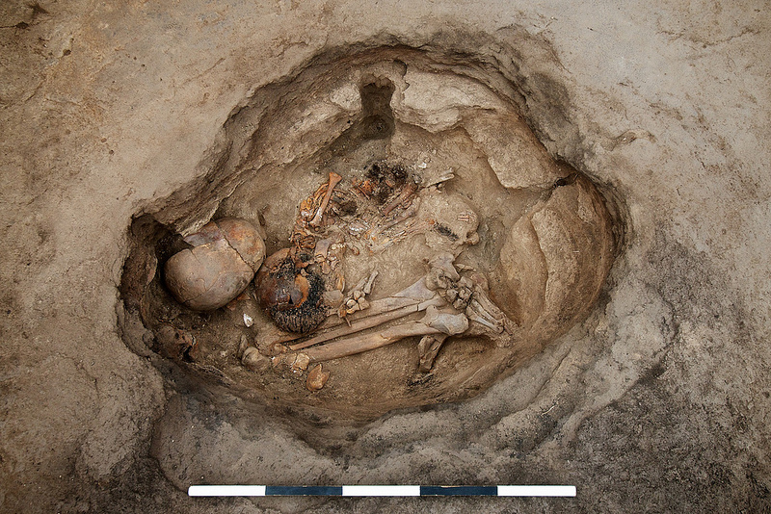
clay and the dead
the dead were buried under house floors
the surrounding clay absorbed odors from decaying bodies
http://www.flickr.com/photos/catalhoyuk/9358064425/sizes/c/in/photostream/

Slide 16
#2: things depend on other things
a “thing” is literally an assembly, a gathering of components, qualities, properties
a ceramic pot as a “thing” is an assembly of
clay (and its properties)
temper (an aplastic added to clay to prevent cracking)
water
fire –and sheep dung fuel
the kiln to heat it and make it durable
http://www.flickr.com/photos/catalhoyuk/220965367/sizes/z/in/photostream/

Slide 17
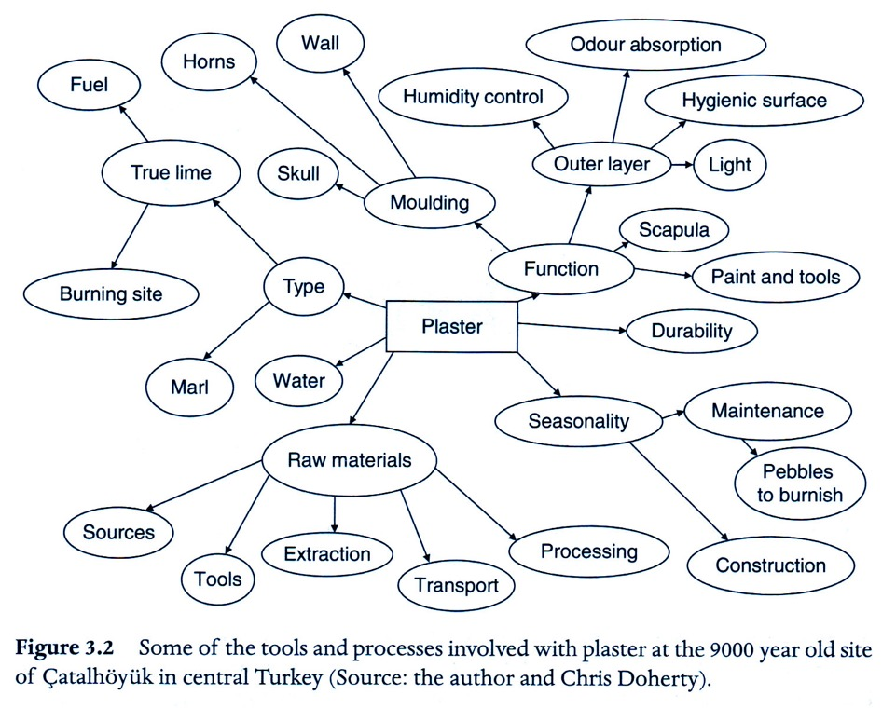
a thing depends on other things
clay plaster for houses depended on many other things
(Hodder, Ian [2012] Entangled: An Archaeology of the Relationships between Humans and Things
[Wiley-Blackwell], Figure 3.1, p. 46)

Slide 18
clay walls depended on adjoining house’s walls to keep them from slumping
note double walls
http://www.flickr.com/photos/catalhoyuk/9403326478/

Slide 19
#3: things depend on humans: clay walls depended on people for repair
note tilting
house wall
Ian Hodder
points to a
feature
http://www.flickr.com/photos/catalhoyuk/7555374446/sizes/c/in/photostream/

Slide 20
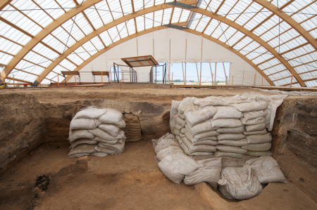
archaeologists continue to repair and conserve the walls today (Bldg. 77)
http://vincemichael.files.wordpress.com/2012/10/bldg-77_end-of-season_2010.jpg?w=450&h=298

Slide 21
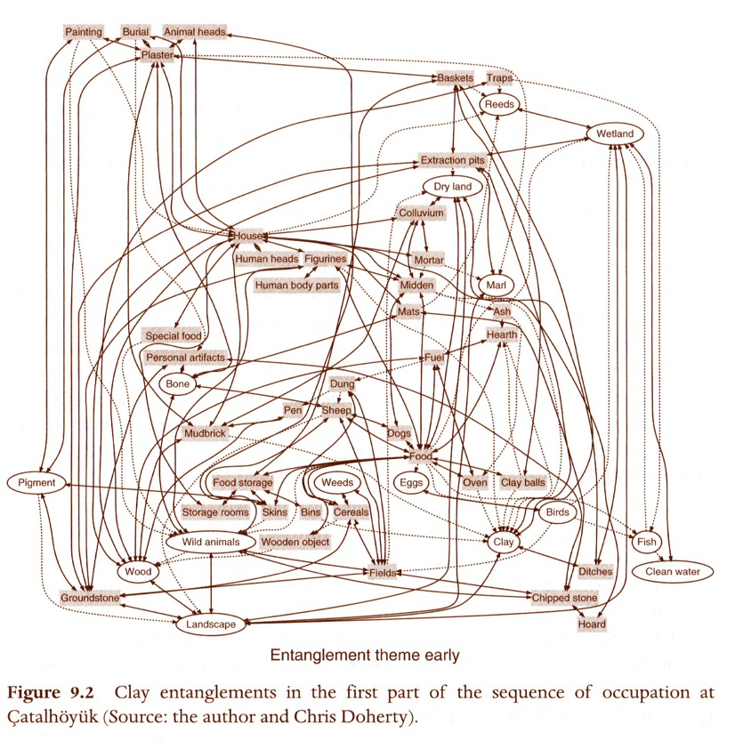
result: entanglement!
#4: humans are “trapped,” depending on things that depend on humans and other things
clay “tanglegram”
(Hodder, Ian [2012] Entangled: An Archaeology of the Relationships between Humans and Things
[Wiley-Blackwell], Figure 9.2, p. 181)

Slide 22
a tanglegram is a graphic depiction of the entanglement of humans and things
arrows linking nodes indicate dependence as a constraint on action
one-way arrow indicates one node depends on another, but not vice versa
two-way arrow indicates mutual dependence
nodes involving a dependence with humans are drawn as rectangles
nodes not so dependent on humans are circles
(Hodder, Ian [2012] Entangled: An Archaeology of the Relationships between Humans and Things
[Wiley-Blackwell], p. 181-182)

Slide 23
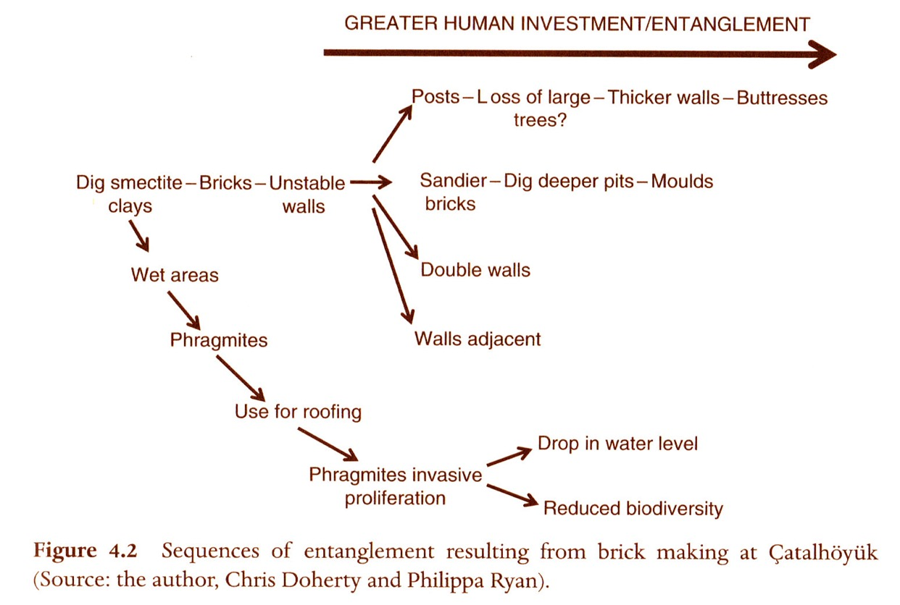
responding to the demands of things that depend on humans strengthens the entanglement over time
(Hodder, Ian [2012] Entangled: An Archaeology of the Relationships between Humans and Things
[Wiley-Blackwell], Figure 4.2, p. 67)

Slide 24
the entanglement of things and humans drives social change
materials have their own qualities, interactions, and dependencies on humans and other things, many of which are unacknowledged
when things start to fall apart, the usual reaction is to fix them within the parameters of the “traps” or social investments of entanglement
new materials or objects are selected if they fit within, or at least overlap with, the existing entanglements—a source of constraint on action
thus social change has a direction, but it is not fully predictable

Slide 25
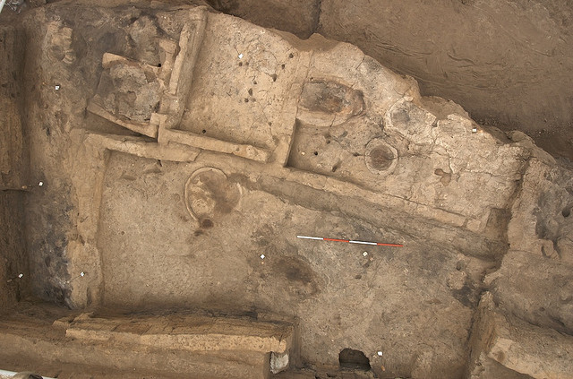
an excavated clay house
http://www.flickr.com/photos/catalhoyuk/3063560991/sizes/z/in/photostream/

Slide 26
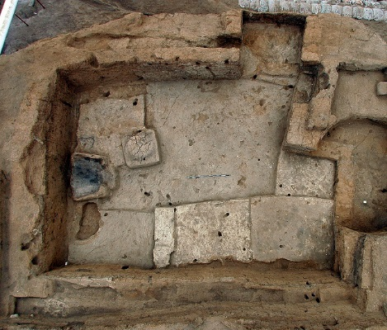
another overhead view
http://www.flickr.com/photos/catalhoyuk/220965365/sizes/z/in/photostream/

Slide 27
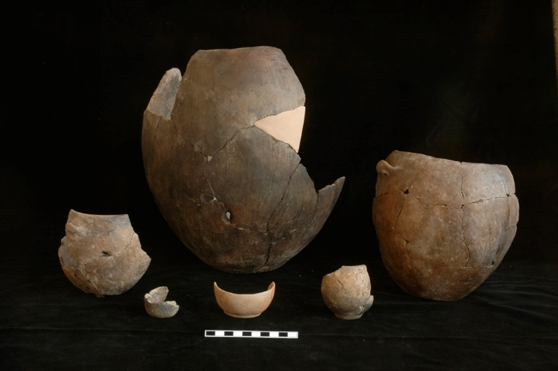
examples of pottery
http://www.flickr.com/photos/catalhoyuk/177054852/sizes/o/in/photostream/

