Slide 1
Ceramics and Glass
https://www.youtube.com/watch?v=tPd1GIwjRFM

Slide 2
Ceramic/Glass
Describe a Ceramic? (Quartz)
Describe a Glass? (Obsidian)

Slide 3
Ceramic
Inorganic, nonmetallic solid
Metal and nonmetal or metalloid atoms primarily held in ionic and covalent bonds
Brittle, high melting point, poor conductor, stiff, chemically resistant, waterproof
Crystallinity varies from crystalline to semicrystalline to amorphous

Slide 4
Glass
Inorganic, nonmetallic solid
Metal and nonmetal or metalloid atoms primarily held in ionic and covalent bonds
Brittle, high melting point, poor conductor, chemically resistant, waterproof
Crystallinity: Does not exist i.e. its amorphous also considered a frozen liquid

Slide 5
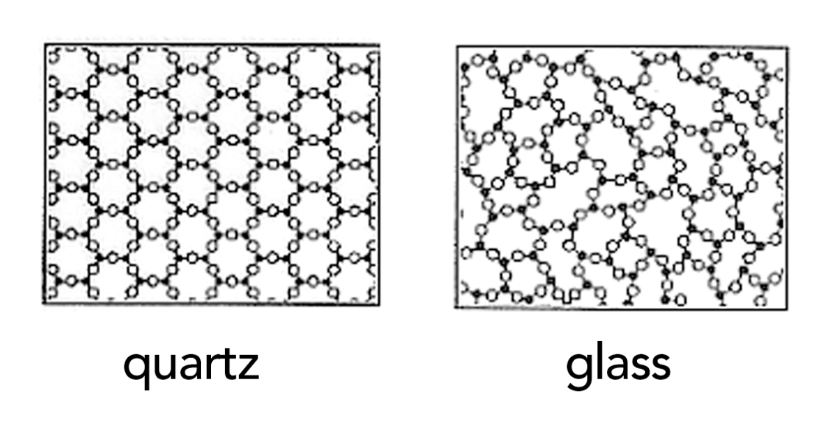
Structure
Crystalline Amorphous
http://www.cmog.org/article/what-is-glass

Slide 6
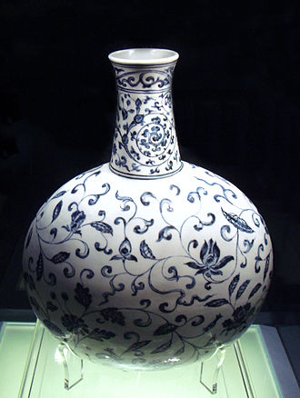
Ceramics
Ceramic comes from Keramos (Greek for pottery)
Early forms of ceramics were formed by the heat treatment of Clay
E.g. Kaolinite clay after firing above 1000°C forms Porcelain a ceramic
Other forms include
Earthenware
Stoneware
Bone China
A Ming Dynasty porcelain vase dated to 1403–1424
https://upload.wikimedia.org/wikipedia/commons/thumb/4/4f/Blue_and_white_vase_Jingdezhen_Ming_Yongle_1403_1424.jpg/330px-Blue_and_white_vase_Jingdezhen_Ming_Yongle_1403_1424.jpg

Slide 7
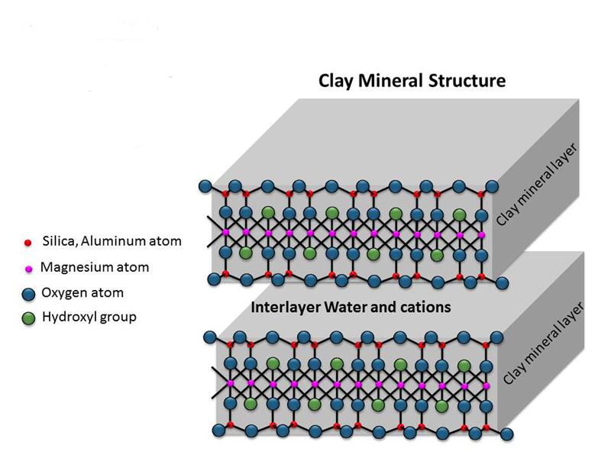
Clay structure
Properties:
With water layers can slide past each other
→ plasticity
Upon drying the clay it will harden but no chemical reaction is induced → sundried bricks
Upon firing (>1000°C) can induce chemical bonding of the layers
(formation of Si-O-Si bonds) → Ceramics
Silica, Aluminum atom
Aluminum or Magnesium
Oxygen atom
Hydroxyl group

Slide 8
Ceramics
Another type of ceramic is called a Technical Ceramic
Oxides
Quartz (SiO₂), Alumina (Al₂O₃), Ceria (CeO₂), Zirconia (ZrO₂)
Nonoxides
Carbide (e.g. SiC), Nitride (e.g. Si2N4), Silicide (e.g. TiSi2), Boride (Nd₂Fe₁₄B)
Functional Ceramics
Electroactive, multiferroic, piezoelectric ceramics
Materials that can convert energy from one form to another or respond in unusual ways to external stimulai (subject of the video)

Slide 9
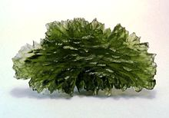
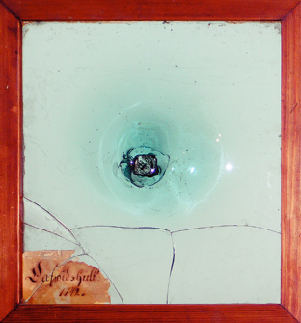
Glass
Lets focus on one subset of ceramics ie traditional Glass (leave metallic Glass for later)
Glass is an Amorphous solid
Forms:
Oxides, Borides, Polymers even Metals
Most common glasses are based on SiO₂
Moldavite, a natural glass formed by meteor impact, from Besednice, Bohemia
Oldest mouth-blown window-glass in Sweden (Kosta Glasbruk, 1742)
https://anjouclothing.files.wordpress.com/2013/01/7.jpg?w=640
https://s-media-cache-ak0.pinimg.com/236x/cb/e8/6f/cbe86f708b15d1a2c549503c2ba6f5ee.jpg

Slide 10
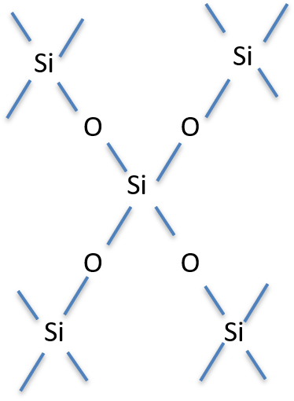
SiO₂
Glass is amorphous ie structure is random in long range
It is inherently unstable so it will crystallize with time (called devitrification)
Melts at 1713°C very high
Given a fire gets no more than 1000°C how did we ever get to develop it?

Slide 11
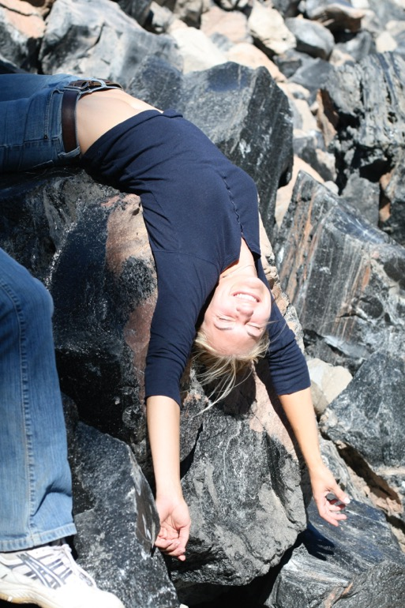
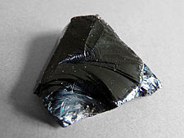
Earliest Forms
Obsidian
Volcanic Glass
Didn’t need a fire
Used extensively for spearpoints
https://upload.wikimedia.org/wikipedia/commons/thumb/1/17/Lipari-Obsidienne_(5).jpg/225px-Lipari-Obsidienne_(5).jpg

Slide 12
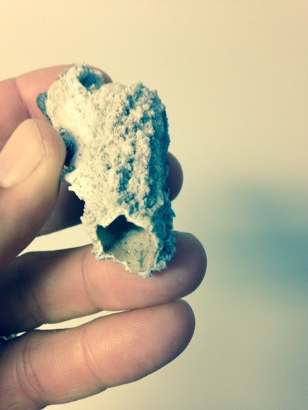
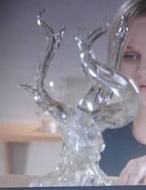
What about lightning made Glass?
This is Hollywood’s version
Sweet Home Alabama
Fulgurites look like this
http://slckismet.blogspot.com/2013/03/who-could-have-predicted-that-sweet.html

Slide 13
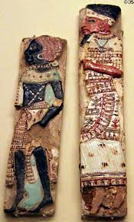
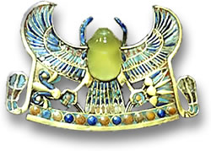
History Egypt
King Tutankhamun’s Glass Scarab
Desert Glass was 26M years old so most likely came from a meteorite
Ancient Egyptian faience & glass palace inlays showing Nubian & Philistine slaves (1182-1151 BCE) from Thebes at Museum of Fine Arts. Boston, MA.
http://www.gemselect.com/other-info/king-tuts-tomb-of-treasures.php
http://travelphotobase.com/v/USMAB/MAAF2141.HTM

Slide 14
What made glass making possible?
The Faience was made by using Nile sediment
This contained Natron (NaCO₃)
Sodium is a network modifier
Melts at 850°C and reacts with SiO₂
Lower the melting point of glass significantly
Sodium Silicate glass dissolves in water
Add Lime (CaO) to strengthen the network
Thus the invention of Soda lime glass (still used today)

Slide 15
Brief History
Around 3000BC faience glazes were used
As fires got hotter one gets more complete reaction
Around 1600BC glass workers started making core wound vessels
By 1500BC glass was in western Asia, Crete, Egypt and Greece
900-600BC new methods in Greece
Slump Glass and Thousand Flower method
By 100BC glass blowing is developed in Syria /Palestine area
Made glass inexpensive
Roman Conquest took technology back to Rome

Slide 16
Roman Glass
Romans loved Glass
Made clear colorless glass in Alexandria ~100AD through addition of MnO₂
Drinking vessels
One of the first times you could see what you were drinking
Contributed to appreciation of wine
Made first windows
Made first mirrors

Slide 17
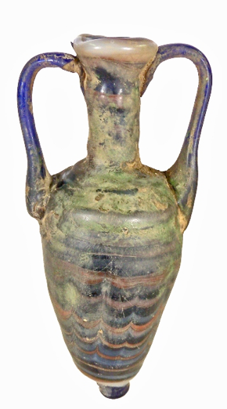
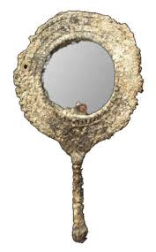
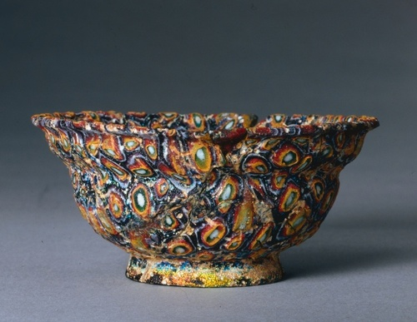
History Phoenicia and Rome
400-200BC Phoenician Core wound Vessel
1-100AD Milefiori Roman thousand flower bowl
Roman Mirror
http://sadigh.weebly.com/featured-artifacts/category/amphoriskos
http://ancientpeoples.tumblr.com/post/61430046465/millefiori-bowl-1-100-ad-roman-glass-source
http://mjgrafx.8m.com/Welcome%20to%20Ruby's%20World/RUBYSVILLE/Stories/The%20History%20of%20Mirrors.htm

Slide 18
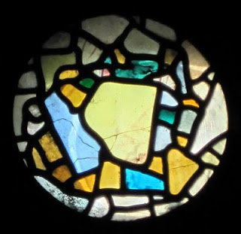
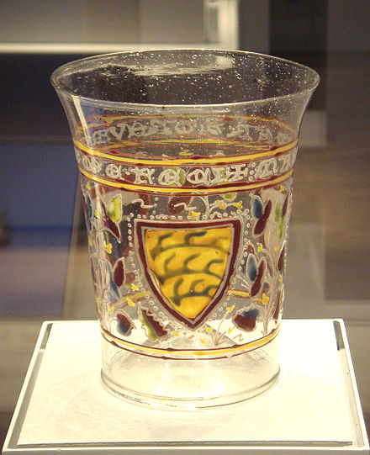
European history
Oldest Stain glass 670AD England
Impact on churches was significant
Early Murano (Italy) Glass 1330
Ultra pure silica pebbles
http://northeasthistorytour.blogspot.com/2011/03/oldest-stained-glass-window-in-world.html
http://en.wikipedia.org/wiki/Venetian_glass

Slide 19
History Continued
1500’s and 1600’s development of telescopes and microscopes
Revolutionized science and medicine
Galileo and the solar system
Leeuwenhook and bacteria
Offshoot of the printing press?
1608 Jamestown first “industry”
the first export was glass to England
1959 UK Invention of Float Glass
Use molten Tin
1970’s development of Fiber optic glass
Create chlorides and distill
Repeaters every 18.5 miles, handle 24000 calls/fiber

Slide 20
Properties of Glass/Ceramics that can be changed
Mechanical Properties
Glass and ceramics are typically very brittle
They are weak in tension but strong in compression
How does one combine these observations to make glass stronger?
Rupert Drop

Slide 21
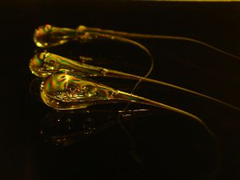
Rupert Drop
Origin as early as 1625
Prince Rupert gave them to King Charles II in 1660 who gave them to the Royal Society for study
http://www.youtube.com/watch?v=xe-f4gokRBs
http://ceramics.org/wp-content/video/rupert_drop.jpg

Slide 22
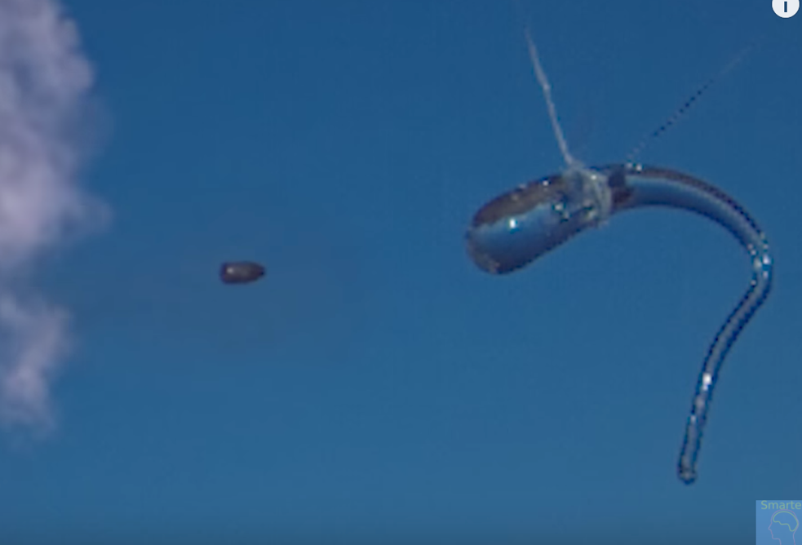
What happens if you shoot a Rupert Drop with a bullet?
Video

Slide 23
Properties of Glass/Ceramics that can be changed
Mechanical Properties
Glass and ceramics are typically very brittle
They are weak in tension but strong in compression
How does one combine these observations to make glass stronger?
Rupert Drop
Corning ware

Slide 24
Properties of Glass/Ceramics that can be changed
Mechanical Properties
Glass and ceramics are typically very brittle
They are weak in tension but strong in compression
How does one combine these observations to make glass stronger?
Rupert Drop
Corning ware
Gorilla Glass

Slide 25
Properties of Glass/Ceramics that can be changed
Mechanical Properties
Glass and ceramics are typically very brittle
They are weak in tension but strong in compression
How does one combine these observations to make glass stronger?
Rupert Drop
Corning ware
Gorilla Glass
Substitute K for Na

Slide 26
Changing the properties of Glass/Ceramics
Glass and ceramics are typically very brittle
They are weak in tension but strong in compression
How does one combine these observations to make glass stronger?
Rupert Drop
Corning ware
Gorilla glass
How about a harder ceramic?
Sapphire?
On the Mohs Hardness scale (1-10)
Gorilla Glass is a 7
Sapphire is a 9 (Only diamond is harder)

Slide 27
Chaine Operatoire
Chaine Operatoire is a tool used in Anthropology to study the step-by-step production, use, and eventual disposal of artifacts
“The study of the technique - or chaîne opératoire - enables one to better understand not only the society in which the technique originated, but also the social context, actions, and cognition that accompanied the production of an object.”*
A similar approach today is to study the “Lifecycle” of a material commonly termed “Cradle to Grave” analysis or “Cradle to Cradle” in the context of sustainable materials. However as you will discover the social context considered in Chaine Operatoire is often ignored in a lifecycle analysis.
Dr. Sassaman will discuss how ancient civilizations manipulated glass and ceramics and how Chaine Operatoire helps us better understand these people and their actions.
During the third class on glass you will discuss how this approach can be applied to a future functional/technical ceramic
*Soressi, Marie et al. PaleoAnthropology:336. doi:10.4207/PA.2011.ART63

Slide 28
Closing thought
As Mark Miodownik observed in his book “Stuff Matters”
“Perhaps it is because we look through it rather than at it that glass has not become a part of the treasured fabric of out lives. The very thing that we value it for has disqualified it from our affections. It is inert and invisible not just optically but culturally”
However I would add that with the growth of new applications as you will observe with functional ceramics, these materials may indeed become treasured materials for what they can do rather than how they look.

Slide 29
Additional Modern applications
Flexible Glass based on Aluminum oxide
https://www.businessinsider.com/foldable-phone-screen-flexible-display-technology-glass-plastic-lcd-oled-2019-4
Float Glass https://www.youtube.com/watch?v=ig4G5WbOMLc
Gorilla Glass https://www.youtube.com/watch?v=wT8xI4PEU8c
http://wwwen.zte.com.cn/endata/magazine/mobileworld/2014/4/articles/201409/t20140903_426941.html
Fiber Optics https://www.youtube.com/watch?v=0MwMkBET_5I

