Slide 1
Multifunctional Ceramics
Methods of Transducing Energy

Slide 2
Multifunctional ceramics
Can take many forms:
Piezoelectrics (mechanical to electrical) (e.g. PbZrTiO₃)
Thermoelectrics
Ferroelectrics
Technical Ceramics
Conductive Ceramics
Dielectric Ceramics
Magnetic Ceramics Etc.

Slide 3
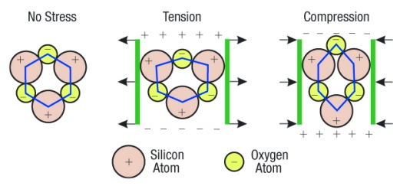
How do they work?
Use the crystal structure to facilitate the transducer action: E.g. piezoelectric Quartz
Application of stress induces a positive and negative side to the crystal. This electric filed can be very large e.g. thousands of volts
http://paganpath.com/study/academy/crystals/347-2

Slide 4
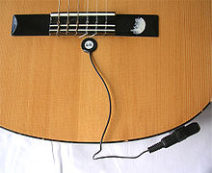
Piezoelectric guitar pickup
https://upload.wikimedia.org/wikipedia/commons/thumb/6/62/Piezoelectric_pickup1.jpg/220px-Piezoelectric_pickup1.jpg

Slide 5
Multifunctional ceramics
Can take many forms:
Piezoelectrics (mechanical to electrical) (BaTiO₃, PbZrTiO₃)
Thermoelectrics (Bi₂Te₃ or Bi₂Se₃)
Ferroelectrics
Technical Ceramics
Conductive Ceramics
Dielectric Ceramics
Magnetic Ceramics Etc.

Slide 6
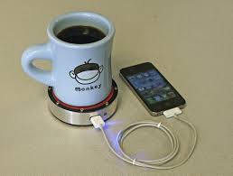
Thermoelectic

Slide 7
Multifunctional ceramics
Can take many forms:
Piezoelectrics (mechanical to electrical) (PbZrTiO₃)
Thermoelectrics (Bi₂Te₃ or Bi₂Se₃)
Ferroelectrics (BaTiO₃)
Technical Ceramics
Conductive Ceramics
Dielectric Ceramics
Magnetic Ceramics Etc.

Slide 8
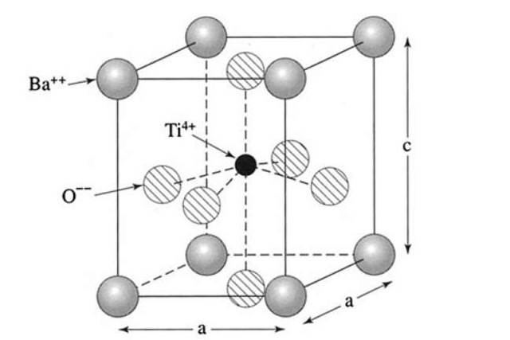
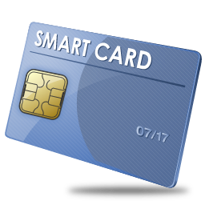
What other forms of these functional ceramics exist
Ferroelectrics
Display a permanent polarization after electric field is removed.
Way of storing information
Used in the chip for your smartcard
Examples include BaTiO₃
http://cmt-stl.org/bringing-smart-cards-to-the-region/
http://what-when-how.com/electronic-properties-of-materials/electrical-properties-of-polymers-ceramics-dielectrics-and-amorphous-materials-part-3/

Slide 9
Multifunctional ceramics
Can take many forms:
Piezoelectrics (mechanical to electrical) (PbZrTiO₃)
Thermoelectrics (Bi₂Te₃ or Bi₂Se₃)
Ferroelectrics (BaTiO₃)
Technical Ceramics
Conductive Ceramics
Dielectric Ceramics (MnO₂)
Magnetic Ceramics Etc.

Slide 10
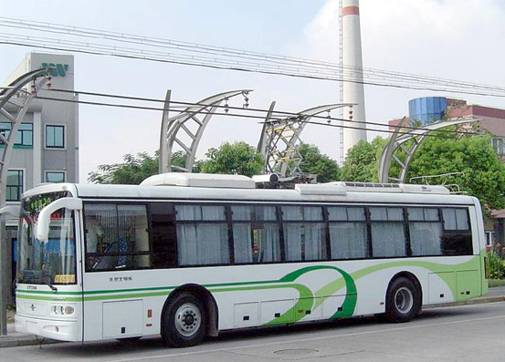
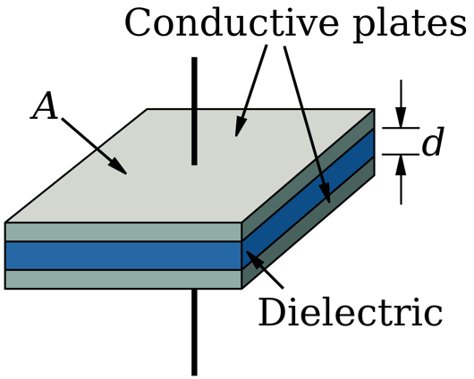
Dielectric Ceramics
MnO₂/Activated Carbon supercapacitor
Used to store electrical charge
Unlike a battery the discharge is very rapid
The ability to store charge is both materials and structure dependent
Used in all circuits, Powering Transportation
Ceramic layer
Charge capacitor at each bus stop
http://citytransport.info/Electbus2.htm
https://en.wikipedia.org/wiki/Polymer_capacitor

Slide 11
Example of an Supply Chain to Build a super capacitor for a Bus
Need MnO₂ and Activated Charcoal
Mn
Mined in South Africa
Transport Mn to plant in US
(trade agreements, tariffs, labor)
Recycle Mn from bus when its retired
Install in bus and test
Purify Mn (steps, waste?)
Transport to bus fabrication facility
Test Cell Performance
Convert Mn to MnO₂
(what form? Nanoparticles?)
Fabricate Supercapacitor cell using
MnO₂ and Activated Carbon (steps?)
Source of Activated Carbon
Coal
Create Activated Carbon (what is this?)
Waste byproducts from coal refining
Mine Coal and refine

Slide 12
Embodied Energy and Embedded Energy
Embodied Energy attempts to measure the total of all the energy necessary for an entire product lifecycle including raw material extraction, transport,^{[1]} manufacture, assembly, installation, disassembly, deconstruction and/or decomposition.
Embedded Energy is the energy required for each step.
https://www.appropedia.org/Embedded_energy#cite_note-1

Slide 13
Sustainability
The UN World Commission on Environment and Development: “sustainable development is development that meets the needs of the present without compromising the ability of future generations to meet their own needs.

Slide 14
Example of a Supply Chain to Build a super capacitor for a Bus
Need MnO₂ and Activated Charcoal
Alternative source of Mn?
Mn
How do I improve the mining operation
Transport Mn to plant in US
(modify the transportation?)
Recycle Mn from bus when its retired
Install in bus and test
Purify Mn (steps, waste?)
Transport to bus fabrication facility
Test Cell Performance
Convert Mn to MnO₂
(what form? Nanoparticles?)
Fabricate Supercapacitor cell using
MnO₂ and Activated Carbon (steps?)
Alternative Source of Activated Carbon
Old tires?
Create Activated Carbon (what is this?)
Convert Tires to pure carbon
Steps? Waste? Expertise
Transport tires to factory
(How?)

Slide 15
So How did you address sustainability?
Did you consider
Changing the Energy Source for mining, refining
Changing Transportation methodology
Reducing Plastic Packaging, Cardboard
Improving Water utilization, reclamation
Improving tracking during all phases
Machine learning or AI to improve efficiency
Empowering employees to make suggestions
Talking to your vendors about their sustainable practices?
Inform the consumer about your new sustainable practices?

