Slide 1
Shape Memory Alloys
Smart Materials

Slide 2
What is a shape memory alloy
Typically mixture of metals
Nickel and Titanium most common alloy Nitinol
These metals have two atomic arrangements
One at high temperature (cubic)
One at low temperature (monoclinic)
The cubic phase remembers its shape

Slide 3
How does it work?
One way memory effect
Original shape is formed at hot temperatures when material is cubic
Upon cooling the material transforms to the monoclinic or slanted arrangement
Material is deformed at room temperature into any shape and it will hold that shape
However upon heating it will return to the cubic phase and the original shape it took when hot

Slide 4
History
Nitinol was accidently discovered in 1962 when a sample bent many times was presented at a meeting and one of the participants decided to hold his pipe up to the material and it returned to its original shape

Slide 5
Applications
Automotive
Valve used to control the lumbar support for car seats
Cell Phones
Auto focus actuator on your smart phone
Medicine
Stents and braces
Eyeglasses
Eyeglass frames like Flexon and Titanflex
Transition temp below RT so they can undergo large deformations and return to their original shae at Room Temp.
Construction
Reinforcing concrete

Slide 6
Other smart materials
Piezoelectric PZT for concrete monitoring
Peizoelectric PZT and concrete for tightening bolts remotely
Fiber optic sensors for monitoring
Thermal Conductivity monitoring for corrosion monitoring
New concretes that are stronger
Future applications in concrete?

Slide 7
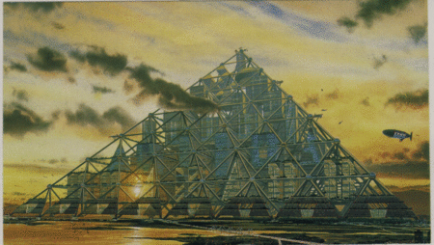
Shimizu Mega-City Pyramid
Over a mile high (6561 feet)
House 1 million people
Help with problem of insufficient space
Footprint is <2 x 2 miles
Problems: 36 concrete piers support the structure must be able to withstand the earthquakes
Need new lightweight superstrong materials for the struts (Carbon Nanotubes)
https://en.wikipedia.org/wiki/Shimizu_Mega-City_Pyramid

