Slide 1
Types of Cells
First second and third generation
First Traditional Crystalline Si (mono or poly crystalline)
Ingot
Ribbon
Wafer
Second thin films:
Amorphous Si,
CdTe
Copper Indium Gallium Selenide
Third Experimental
Organic
Perovskite

Slide 3
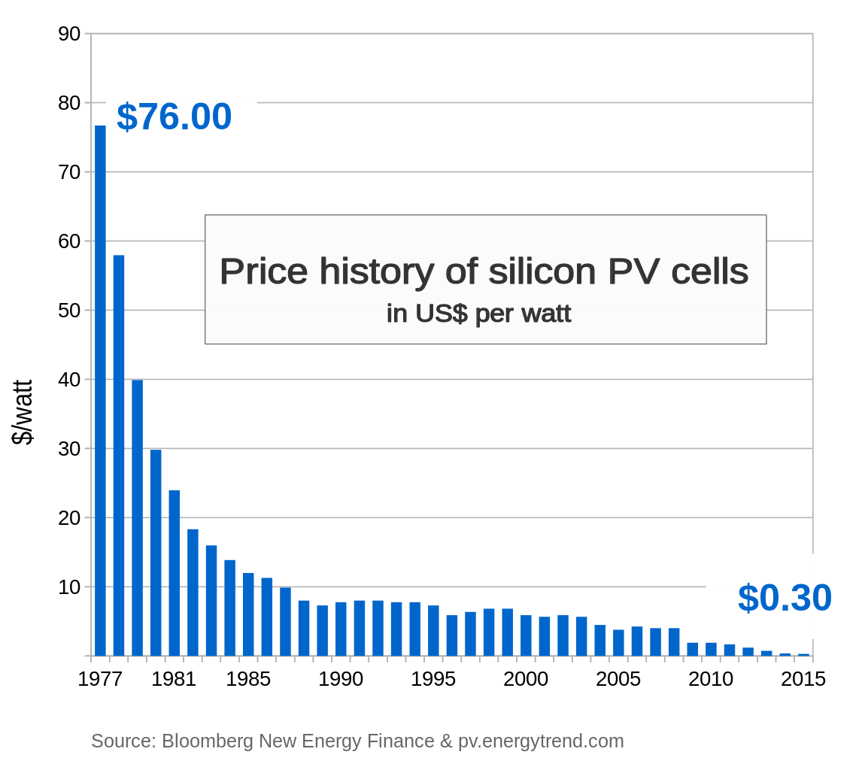
Solar Energy Price

Slide 4
Comparison (solar cheaper than coal and gas)

Slide 5
PV

Slide 7
News
Solar in Florida

