Slide 1
Copper and bronze
Florin Curta
Department of History

Slide 2
Who came up with the idea of a “Bronze Age”?
Christian Jürgensen Thomsen (1788-1865)
Lucretius, de rerum natura v 1283-1287
Man's ancient arms Were hands, and nails and teeth, stones too and boughs- Breakage of forest trees- and flame and fire, As soon as known. Thereafter force of iron And copper discovered was; and copper's use Was known ere iron's, since more tractable Its nature is and its abundance more. With copper men to work the soil began, With copper to rouse the hurly waves of war, To straw the monstrous wounds, and seize away Another's flocks and fields. For unto them, Thus armed, all things naked of defence Readily yielded. Then by slow degrees The sword of iron succeeded, and the shape Of brazen sickle into scorn was turned: With iron to cleave the soil of earth they 'gan, And the contentions of uncertain war Were rendered equal.
(translation by William Ellery Leonard, 1916)

Slide 3
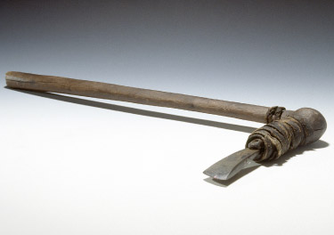
Earliest evidence of the use of copper
Çatal Hüyük (ca. 6500 BC)
Ötzi (ca. 3300-3200 BC)

Slide 4
Native copper
no impurities, so it can be worked out by hammering

Slide 5
Working copper
Cold treatment
annealing

Slide 6
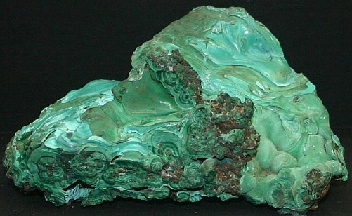
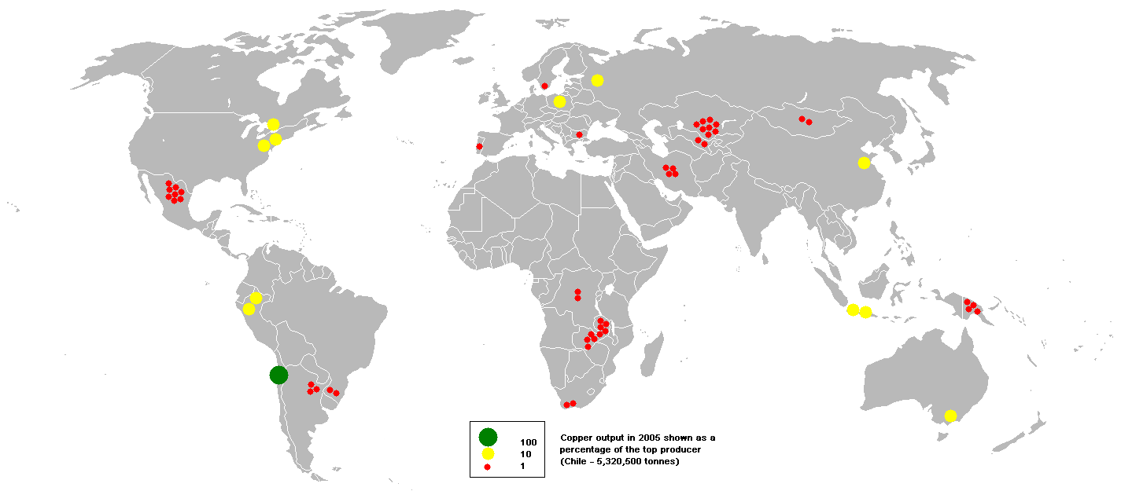
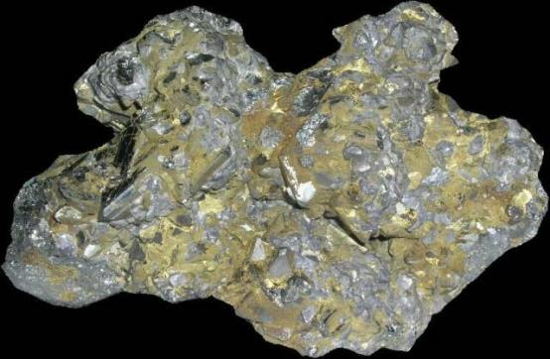
Copper ores: oxidized and sulphides
Malachite (CuCO₃)
Fahlerz (Cu₂SBS₃)

Slide 7
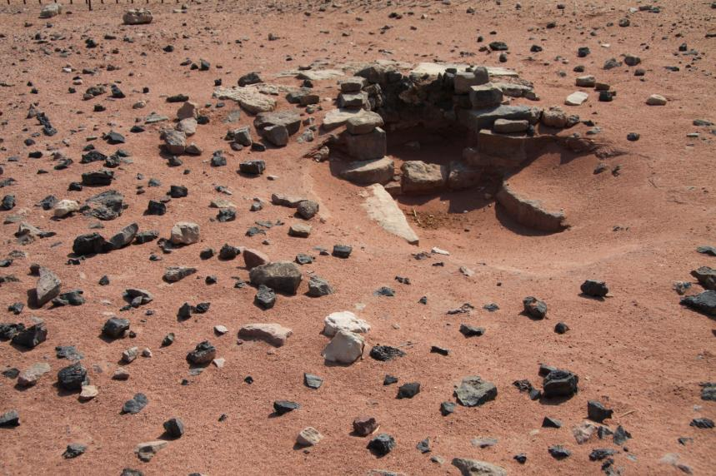
Copper smelting
Crucible
furnace
Timna (Israel), 4460-4240 BC

Slide 8
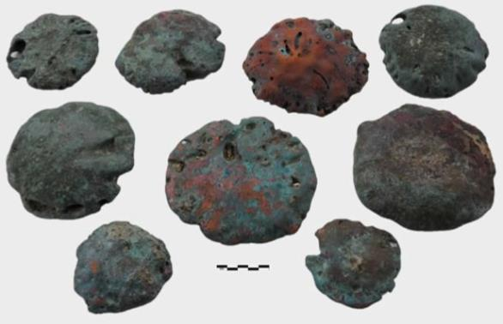
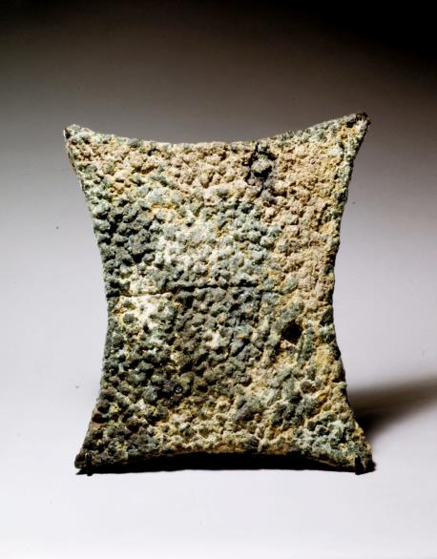
Copper ingots
Hazor (north Israel)
Devon coast (England)

Slide 9
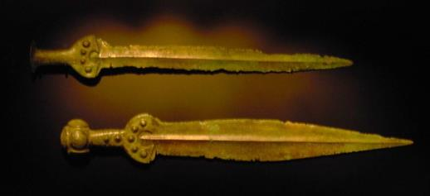
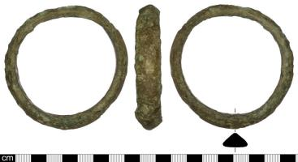
Copper and bronze
Melting point
Hardness (brinell scale)
Copper: 1083 centigrades (1981 F)
A 10 percent tin-copper alloy: 1000 centigrades (1832 F)
Copper: between 50 HB (cast) and 100 HB (cold worked)
A 10 percent tin-copper alloy: between 100 HB (cast) and 230 HB (cold worked)

Slide 10
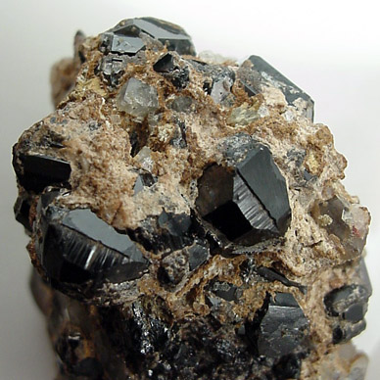
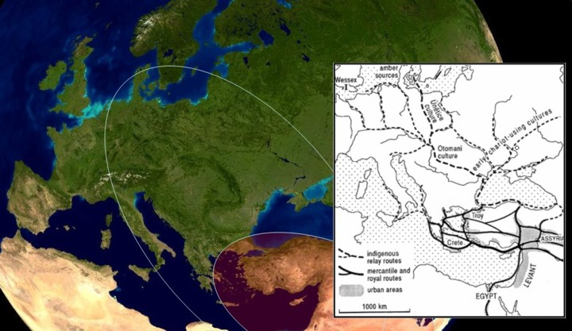
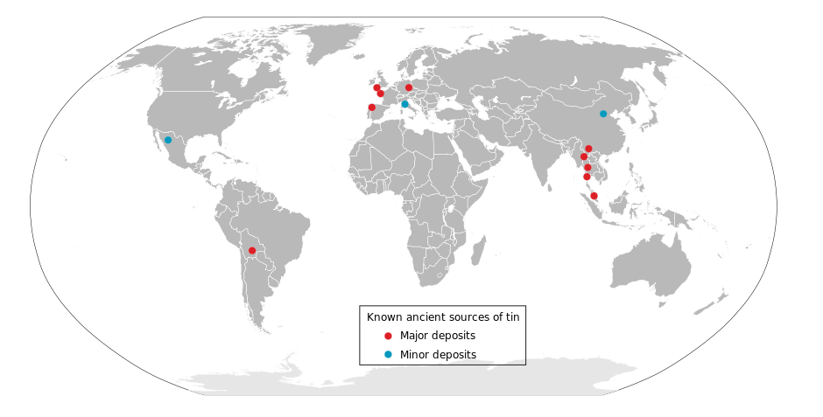
Sources of tin (tinstone, SnO₂)

Slide 11
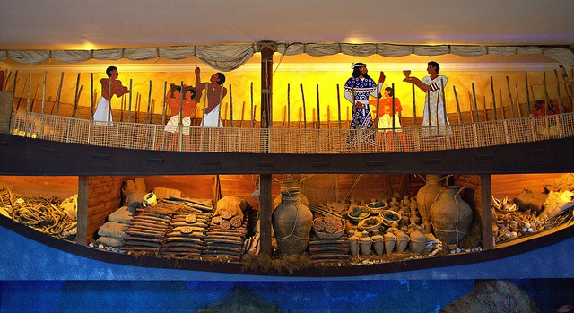
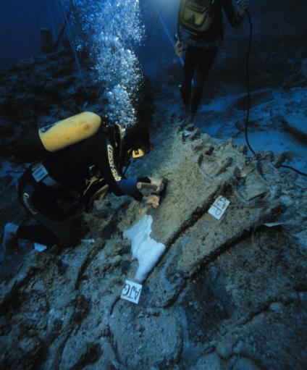
Uluburun, southern coast of Turkey

Slide 12
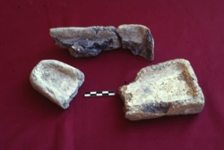
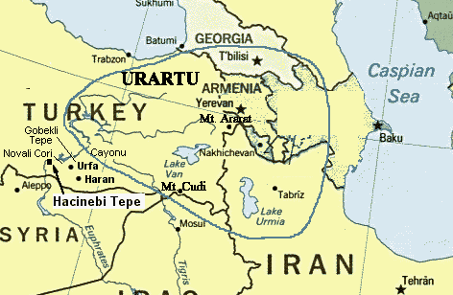
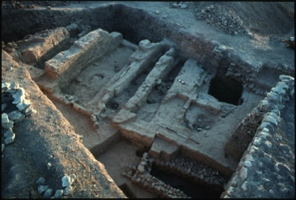
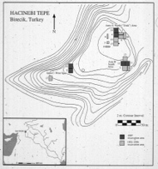
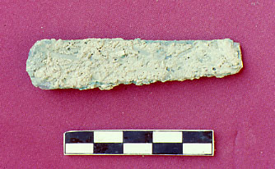
A protoindustrial center: Hacinebi (Eastern Turkey)
IMOS
Intended for classroom instruction only.
Do not circulate.

Slide 13
Bronze-Age hoards and burials
Sibiu (romania)
Mycenae (greece)

Slide 14
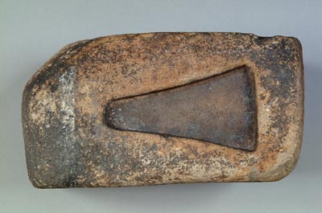
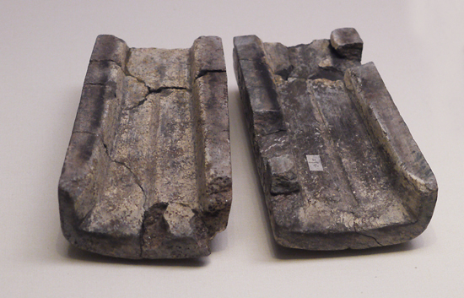
Moulds
Dongxiafeng (China)
Pulverbatch (England)

Slide 15
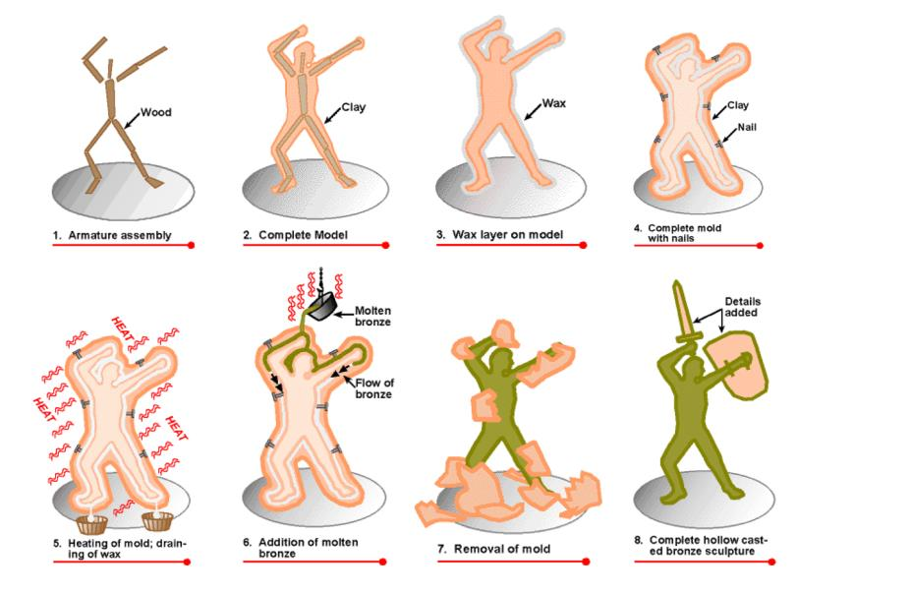
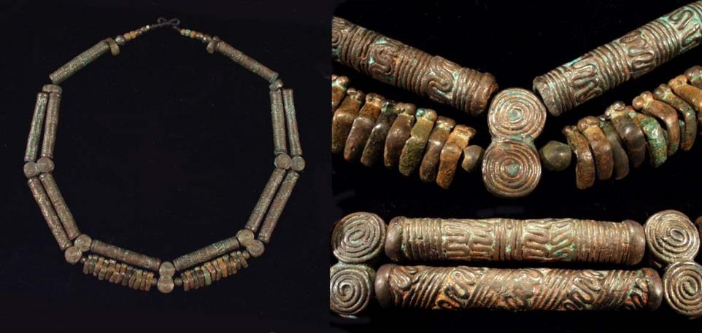
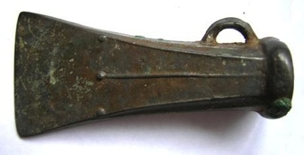
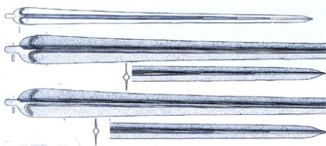
Lost wax casting

Slide 16
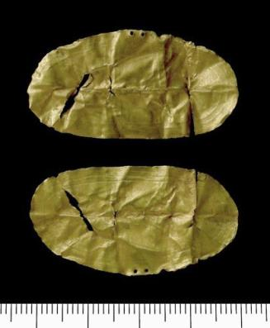
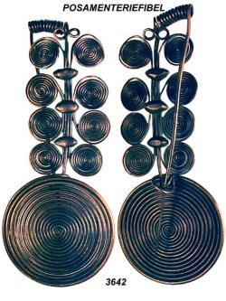
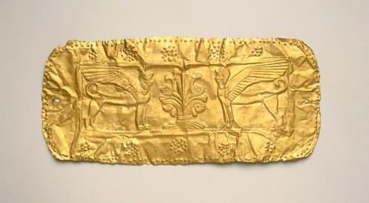
New techniques
Wire drawing
Thin sheet
Repoussé

Slide 17
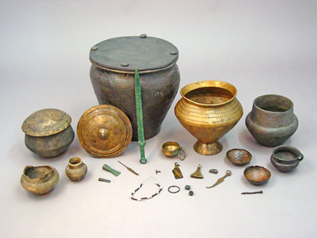
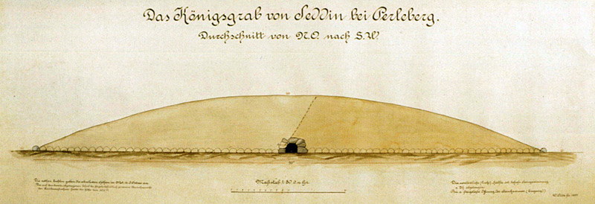
Bronze-Age smiths or aristocrats?
Weissig (Germany)
Villena (spain)
IMOS
Intended for classroom instruction only.
Do not circulate.

Slide 18
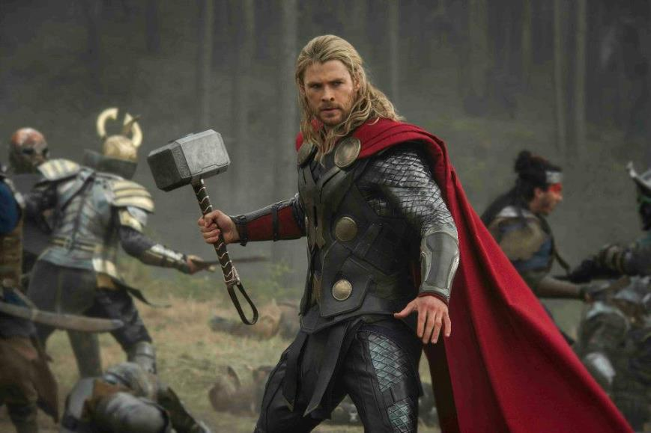
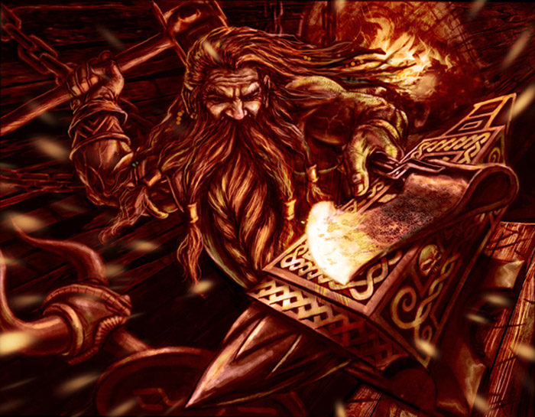
Mythological smiths: the dwarves of Nidavellir

Slide 19
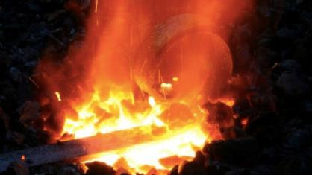
The triple importance of metallurgy:
technological: a series of new skills became necessary and commonplace
Economic: raw materials and finished products became abundantly available
3. social: the effects of new artifact types introduced the possibility of new scales of value and new possibilities for the demonstration of social divisions

