Slide 1
Up Up and Away
Heart of Gold

Slide 2
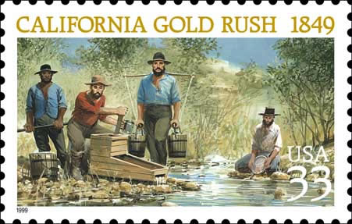
GOLD!
http://www.jmaw.org/wp-content/uploads/2013/11/CA-Gold-Rush-Stamp.jpg
Notes:
What did you think of the books?
What is your opinion of the respective writing styles? Organizations?
What did you learn from reading two accounts of the same period? Did you notice differences in emphasis?

Slide 3
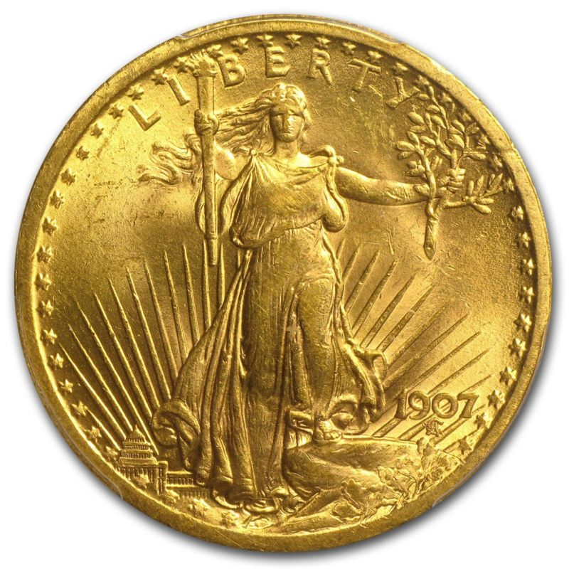
The Properties of Gold
Color: Golden, butter yellow with a metallic luster
Hardness: 2-3 (diamond 10)
Chemistry: Element, Au
Gold is easily identified in nature because of its distinct color,
Gold is very ductile and malleable (1g= 1m² leafing, optically transparent)
Gold does not oxidize
Gold does not combine or react with other elements very often, when it does it forms sulfide minerals.
Gold does not react with Acids except Aqua Regia (Nitric and Hydrochloric mix)
Gold does not react with Nitric acid alone, most metals do, Acid Test
Gold has very good electrical conductivity
Specific Gravity: very dense
  Gold cubic meter weighs 19,300kg
  Lead cubic meter weighs 11,340kg
http://i.ebayimg.com/00/s/MTUwMFgxNTAw/z/EPIAAOSwYshUZBVE/$_3.JPG?set_id=2
Notes:
What did you think of the books?
What is your opinion of the respective writing styles? Organizations?
What did you learn from reading two accounts of the same period? Did you notice differences in emphasis?

Slide 4
The Properties of Silver
Electrically and thermally conductive
One of eight precious metals in the coinage metal family
Color that is metallic and silver-white.
It is behind only Gold in malleability and ductility.
Exposure to Oxygen produces Silver Oxide that turns the specimen to a dark gray or black.
Exists as an chloride or sulfide in nature
Hardness: 2.5-3
It is the most lustrous metal on Earth
Use in photography, antimicrobial
It has the highest electrical conductivity of all metals
Notes:
What did you think of the books?
What is your opinion of the respective writing styles? Organizations?
What did you learn from reading two accounts of the same period? Did you notice differences in emphasis?

Slide 5
Sliver extraction: Cupellation
Heat lead and silver in a porous ceramic cup with ground up pottery or bone or shells
960°C lead oxidizes and forms a monoxide called litharge
Oxide is absorbed by the ceramics or bone and forms litharge cakes
Silver metal is left behind
1 ton of lead yields 1lb of silver
Toxic process: Lead oxide, polluted many lakes in Europe

Slide 6
What to do with the Lead?
Too soft for military applications
Alloyed with Tin for solder
Roof sheeting
Lead water pipes However these were quickly coated with minerals that reduced the lead ingestion
  Flint Michigan
Lead accumulates in the nervous system, bones, liver etc.
Impairs red blood cell production
Anemia, fatigue, death
If silver comes from Lead then how about other metals. Spurred interest in a alchemy

Slide 7
Gold Extraction
Amalgamation
  Mix Gold Ore with Mercury
  Forms an amalgamation (gold dissolves into the mercury)
  Boil off mercury, leaves gold behind
Cyanidation
  Gold dissolves in cyanide solution
  Extract very high % of gold but potentially toxic
Liquation
  If gold and silver are mixed with copper
  Mix in lead and heat until lead melts
  Gold and silver more soluble in lead than copper
  Pour off lead and follow with cupellation

Slide 8
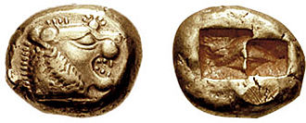
Separating Gold and Sliver: Parting
If silver is mixed with gold it’s called electrum
Parting is used to separate the gold and silver
Parting involves heating (1000°C for 24 hours) with salt to form silver chloride and gold
Recover the silver chloride and turn back into silver
First done in Lydia
Early 6th century BC Lydian gold coinage
https://en.wikipedia.org/wiki/Gold_parting

Slide 9
6 terms to refine gold and silver
Cupellation
  extracting Silver from Lead
Amalgamation
  extracting Gold from rocks using Mercury
Cyanidation
  extracting Gold from rocks using Cyanide
Liquation
  extracting Gold and Silver from copper using lead
Parting
  separating Gold and Sliver from each other using Salt
Slucing
  extracting gold from gravel using gravity

Slide 10
History of Gold
40,000 B.C. Experts of fossil study have observed that bits of natural gold were found in Spanish caves allegedly used by the Paleolithic Man
3000 B.C. Pharaohs and temple priests used the relic metal for adornment in ancient Egypt. However, it is curious to note that the early Egyptian's medium of exchange was not gold but barley. Egyptians liked gold (King Tut’s tomb 240lbs of gold, $7M)
560 B.C. The first coins made purely from gold are minted in Lydia, a kingdom of Asia Minor.
344 B.C. Alexander the Great crosses the Hellespont with 40,000 men, beginning one of the most extraordinary campaigns in military history sponsored by Gold
300 B.C. Greeks and Jews of Alexandria begin to practice alchemy, quest to turn base metals into gold. Reaches its pinnacle late Dark Ages through the Renaissance.
58 B.C. After a victorious campaign in Gaul, Julius Caesar brings back enough gold to give 200 coins to each of his soldiers and repay all of Rome’s debts.
(Romans pioneered Amalgamation and Liquation)
742 A.D. – 814 A.D. Charlemagne overruns the Avars (Russia) and plunders their vast quantities of gold, enabling control over much of western Europe

Slide 11
History of Gold
1066 A.D. With the Norman conquest, a metallic currency standard is finally re- established in Great Britain with the introduction of a system of pounds, shillings, and pence. The pound is literally a pound of sterling silver.
1511 A.D. King Ferdinand of Spain says to explorers, “Get gold, humanely if you can, but all hazards, get gold,” launching massive expeditions to the newly
discovered lands of the Western Hemisphere.
1700 A.D. Gold is discovered in Brazil, which becomes the
largest producer of gold by 1720, with nearly two thirds of the world’s output.
1799 A.D. A 17-pound gold nugget is found in Cabarrus County, North Carolina, the first documented gold discovery in the United States.
1803 A.D. Gold is discovered at Little Meadow Creek, North Carolina, sparking the first U.S. gold rush
1848 A.D. John Marshall finds flakes of gold while building a sawmill for John Sutter near Sacramento, California, triggering the California Gold Rush and hastening
the settlement of the American West.

Slide 12
History of Gold
1850 A.D. Edward Hammong Hargraves, returning to Australia from California, predicts he will find gold in his home country in one week. He discovered gold in
New South Wales within one week of landing.
1857 USS Central America sinks, 30,000 lbs of gold lost off North Carolina
(Ship of Gold in a Deep Blue Sea)
1859 A.D. Comstock lode of gold and silver is struck in Nevada.
1868 A.D. George Harrison, while digging up stones to build a house, discovers gold in South Africa – since then, the source of nearly 40% of all gold ever mined.
1898 A.D. Two prospectors discover gold while fishing in Klondike, Alaska, spawning the last gold rush of the century.
1903 A.D. The Engelhard Corporation introduces an organic medium to print gold on surfaces. First used for decoration, the medium becomes the foundation for
microcircuit printing technology
.
1933 A.D. To alleviate the banking panic, President Franklin D. Roosevelt prohibits private holdings of all gold coins, bullion, and certificates.

Slide 13
History of Gold
1935 A.D. Western Electric Alloy #1 (69% gold, 25% silver, and 6% platinum) finds universal use in all switching contacts for AT&T telecommunications equipment.
1940 Niels Bohr Nobel Prize and the Nazi’s
1974 Americans permitted to own gold again
1988 USS Central America discovered by Tommy Thompson. 5% recovered
2012 Tommy Thompson goes into hiding to avoid paying his investors
2015 Tommy Thompson found and prosecuted
To date only about 1/5 of the 0.5 Billion dollars in gold on the ship has been recovered
Total gold found to date a single cube 20 meters on a side (174,100 tons)
All of it from meteors why?

Slide 14
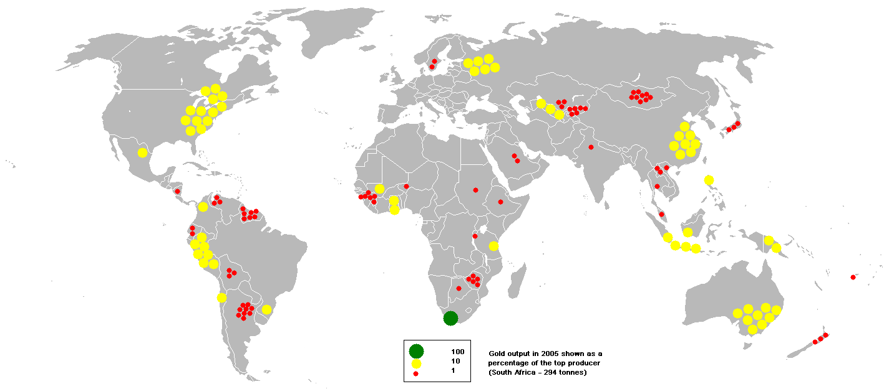
Modern Sources of Gold
This bubble map shows the global distribution of mined output of gold in 2005 as a percentage of the the top producer (South Africa - 294 tonnes).
http://www.bgs.ac.uk/mineralsuk/commodity/world/home.html

Slide 15
Modern Uses of Gold
Most all of the uses of gold can be tied to its lack of chemical reactivity.
Gold was also considered a currency standard.
  Left that around WW-I too much debt
The primary use of gold is for jewelry and awards.
Gold is used in the dental industry.
The conductivity and stability of gold make it useful in the microelectronics industry.
Gold leaf is applied for decorative purposes (furniture, dishes, architecture).
Gold particles used for intense red coloring in glass
Gold is a great reflector (face shields) and used in cockpits for deicing (so thin)
Notes:
What did you think of the books?
What is your opinion of the respective writing styles? Organizations?
What did you learn from reading two accounts of the same period? Did you notice differences in emphasis?

Slide 16
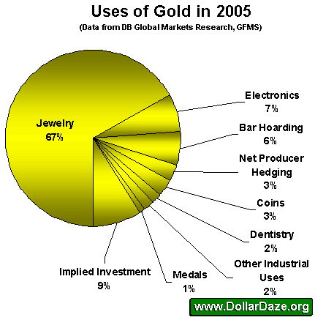
http://dollardaze.org/blog/pages/00063/GoldUses2005.gif
Notes:
What did you think of the books?
What is your opinion of the respective writing styles? Organizations?
What did you learn from reading two accounts of the same period? Did you notice differences in emphasis?

Slide 17
Uses of Silver
Silver is one of the most useful metals and has uses in decorative arts, industry and photography.
It is the world’s best conductor of electricity and heat and is used to make coins and bullion, jewelry silverware, photographic film.
The typical concentration of Silver used in coins is 90% with the other 10% being Copper for added strength.
Dentistry mixtures and electrical contacts use Silver alloys and photographic emulsions contain silver halides that are sensitive to light.
Notes:
What did you think of the books?
What is your opinion of the respective writing styles? Organizations?
What did you learn from reading two accounts of the same period? Did you notice differences in emphasis?

Slide 18
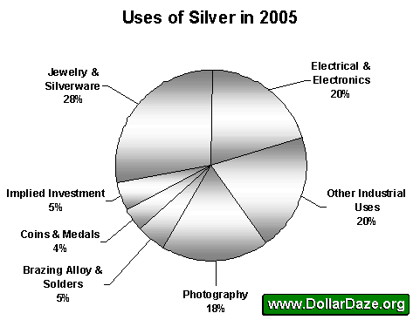
http://dollardaze.org/blog/pages/00066/SilvUses2005.gif
Notes:
What did you think of the books?
What is your opinion of the respective writing styles? Organizations?
What did you learn from reading two accounts of the same period? Did you notice differences in emphasis?

Slide 19
Is it really pure?
Alloys
To keep costs down and make Gold harder, goldworkers often alloy it with other metals. Mixing Gold with these other metals changes its color.
Blue Gold: Gold with Iron
Green Gold: Gold mixed with a higher Silver content than Copper
Pink Gold (or Rose Gold): 50% Gold, 45% Copper and 5% Silver
White Gold: Gold with Palladium, Nickel, Zinc, Copper, Tin and Manganese
Yellow Gold: 50% Gold, 25% Silver and 25% Copper
Measuring Gold
Jewelers indicate the amount of gold in an alloy by the Karat system.
24kt: 100% Gold-very soft
18kt: 75% Gold-will not tarnish; softer than 14kt., but with a deeper color
14kt: 58.33% Gold-will not tarnish
12kt: 50% Gold
10kt: 41.6% Gold; less than 10kt. cannot be called Gold in the US or 9kt. in the UK
Sterling Silver: 92.5% Silver and 7.25% Copper.
Notes:
What did you think of the books?
What is your opinion of the respective writing styles? Organizations?
What did you learn from reading two accounts of the same period? Did you notice differences in emphasis?

Slide 20
Conclusions
Value: The Regard that something is held to deserve, the importance, worth or usefulness of something
Gold and Silver have a long history of being valuable because of their stability, malleability, scarcity and aesthetic appeal
This made them ideal for coinage and jewelry.
New applications in nanotechnology, electronics and medicine are adding additional value to these ancient materials

Slide 21
Gold and Nanotechnology

Slide 22
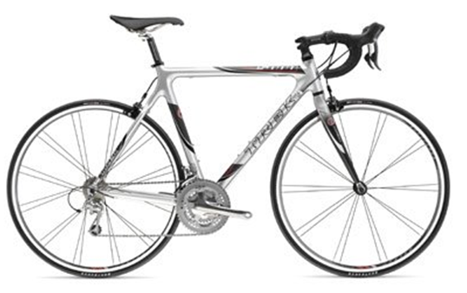
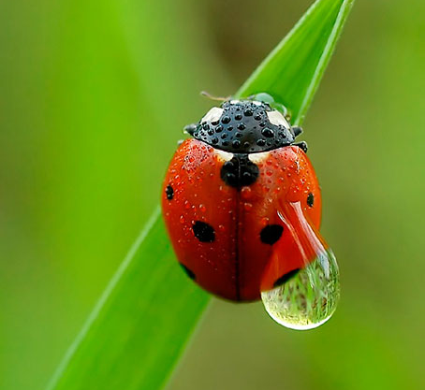
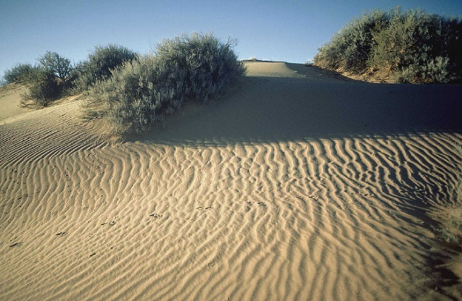
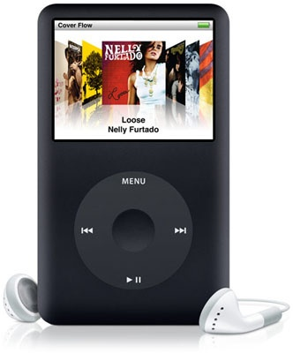
Exactly how small is a nanometer?
1/100th of a meter
(centimeter)
1 meter
1/1000th of a meter (millimeter)
1/10th
of a meter
All these are still visible with your eyes.
Slide courtesy of Greta Peterson U. Wisc.

Slide 23
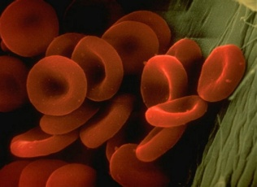
. . . Smaller than you can see!
Nanoscale objects are 100 times smaller!!!
6-8 µm
One-millionth of a meter (micrometer)
Slide courtesy of Greta Peterson U. Wisc.

Slide 24
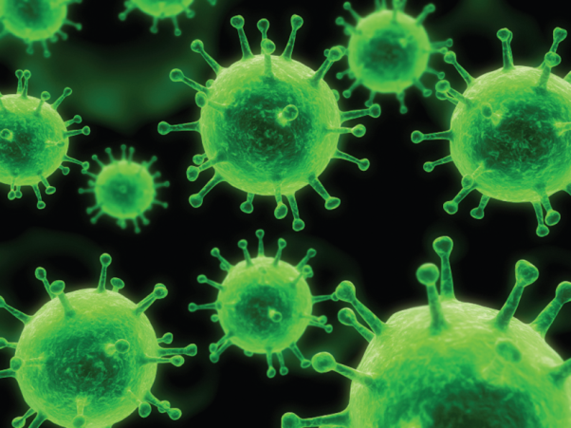
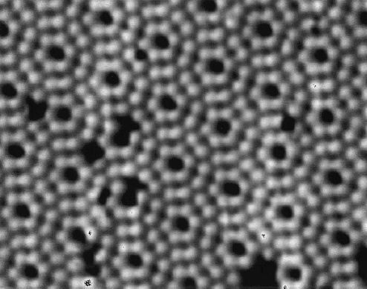
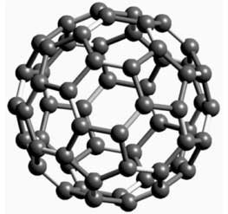
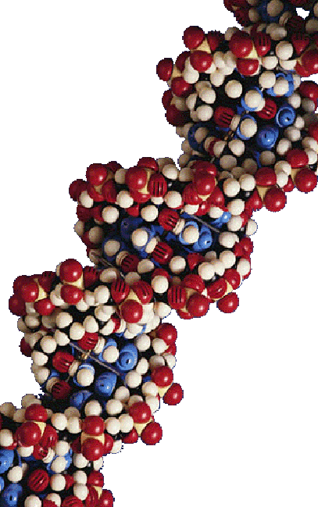
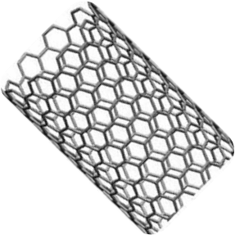
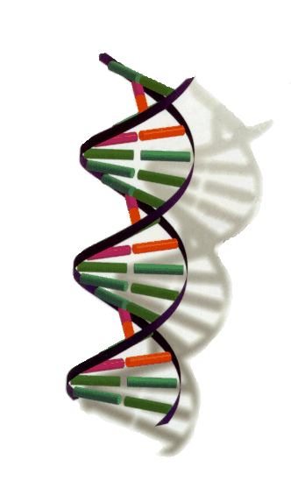
. . . Smaller than you can see!
A nanometer is one billionth of a meter!!
Buckyball
~1 nm
Atoms
<1 nm
Viruses
3-50 nm
Nanotube
~1 nm
DNA
2.5 nm
Slide courtesy of Greta Peterson U. Wisc.

Slide 25
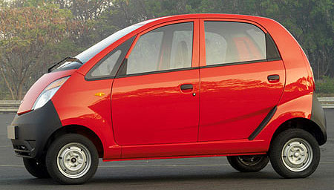
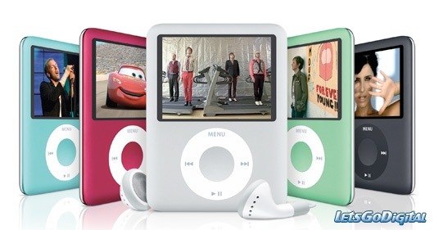
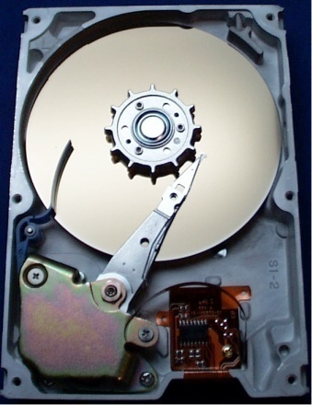

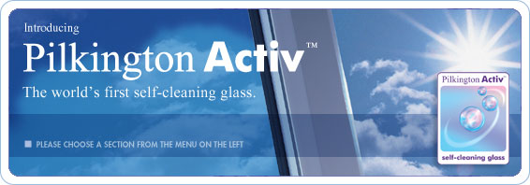



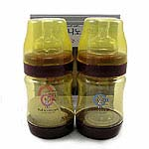

“Nano” all around us
Tata Nano
Self-cleaning windows
VX Nano Cordless Laser Mouse
Samsung washing machine
Apparel with silver nanoparticles
Baby gear
Slide courtesy of Greta Peterson U. Wisc.
Notes:
http://paultan.org/topics/cars/india/tata/
www.letsgodigital.org/fr/16606/apple-ipod-nano/
http://www.logitech.com/index.cfm/mice_pointers/mice/
devices/3271&cl=us,en
http://www.arcoutdoors.com/x-system/products.html
http://www.samsung.com/ph/silvernano/ - Samsung's SilverCareTM Technology
http://www.alibaba.com/catalog/11163650/Nano_Silver_Babycares.html

Slide 26
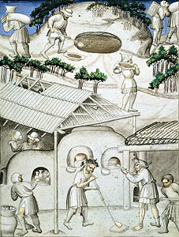
Medieval nanotechnologists
Recipe for Stained glass
Sand
Chemicals to lower the melting point of sand
  Sodium Carbonate (soda ash)
  Calcium Oxide (lime)
Chemicals to create the color
Lots of heat!
  Mixture becomes molten at
  1500 °F
Depiction of a forest glass shop from Sir John Mandeville's Travels, Dated 1420 – 1450. British Library, London
Slide courtesy of Greta Peterson U. Wisc.
Notes:
26

Slide 27
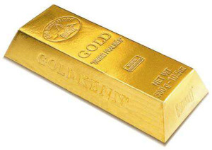
Things are different . . .
Size really does matter!
Bulk
Nano
Slide courtesy of Greta Peterson U. Wisc.

Slide 28
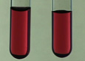
Things are different . . .
Size really does matter!
Bulk
Nano
Nanoparticles interact differently with light.
Slide courtesy of Greta Peterson U. Wisc.

Slide 29
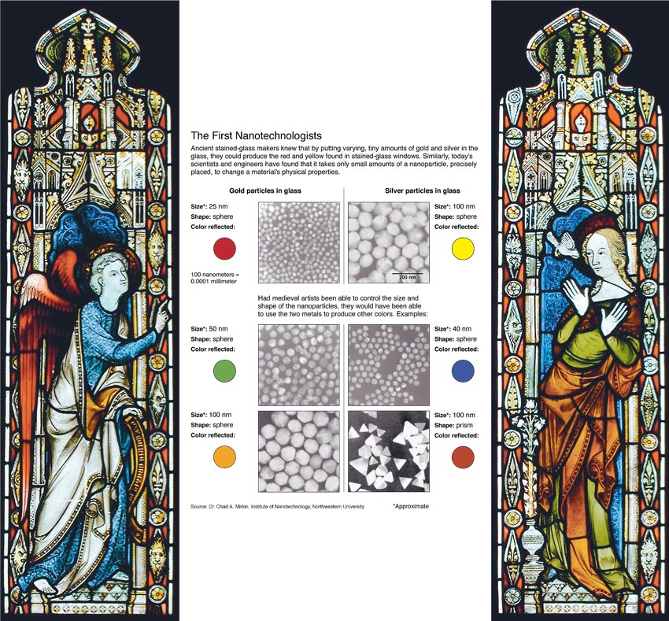
Changing the size of the gold particles affects color
Size=25 nm
Shape: Spherical
Color: RED
Size=50 nm
Shape: Spherical
Color: GREEN
Size=100 nm
Shape: Spherical
Color: ORANGE
Chang, Kenneth. “Tiny is Beautiful: Translating ‘Nano’ Into Practical.” New York Times 22 Feb 2005: Science.
Slide courtesy of Greta Peterson U. Wisc.

Slide 30
Changing the size and shape of the silver particles affects color
Size=100 nm
Shape: Spherical
Color: YELLOW
Size=40 nm
Shape: Spherical
Color: BLUE
Size=100 nm
Shape: Triangular
Color: RED
Chang, Kenneth. “Tiny is Beautiful: Translating ‘Nano’ Into Practical.” New York Times 22 Feb 2005: Science.
Slide courtesy of Greta Peterson U. Wisc.

Slide 31
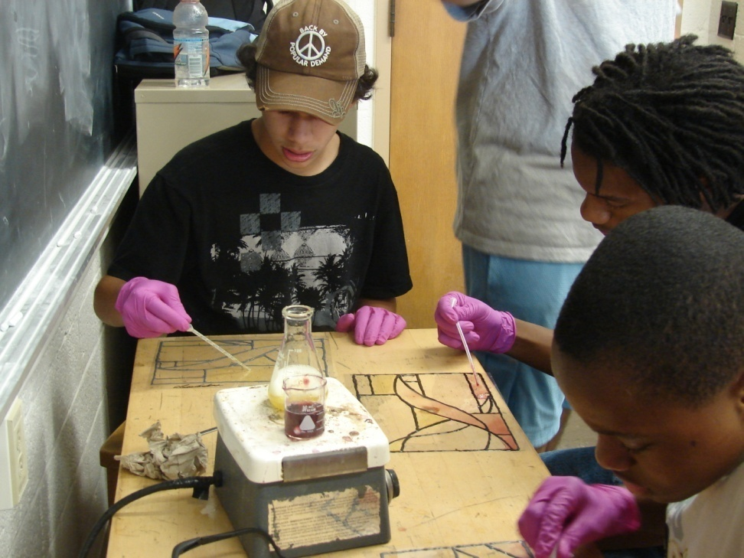
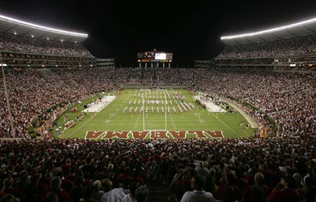
Plasmon resonance
A small class vs. a football stadium full of people
Slide courtesy of Greta Peterson U. Wisc.

Slide 32
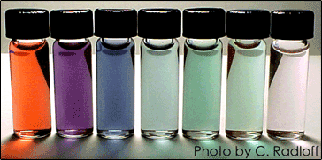
Gold nanoparticles today
glass bead
60-100 nm
How does it work?
One application: Nanoshells absorb infrared light, which causes them to heat up.
Tissue absorption of infrared light is minimal; Penetration is optimal
Shells are coated with targeting-molecules: concentrates in tumor cells
Increasing the temperature of the cells by more than 30°C kills them!
N. Halas, J. West (Rice University); Hirsch , et al. PNAS. 100:13549 (2003)
Slide courtesy of Greta Peterson U. Wisc.

Slide 33
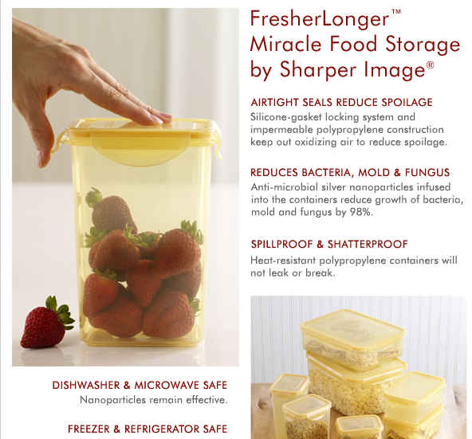
Silver nanoparticles today
Silver nanoparticles are used to kill bacteria in:
Athletic apparel
Socks
Refrigerators
Storage containers
Washing machines
Slide courtesy of Greta Peterson U. Wisc.

