Slide 1
Andrew Carnegie, Steel and “Creative Destruction”
I. The Education of an Entrepreneur
A. The Meaning of “Creative Destruction”
B. Carnegie’s Roots
C. The Pennsylvania Railroad’s Visible Hand
1. Thomas Scott
2. The “Eureka Moment”
D. The Context
II. Revolutionizing Iron and Steel at Carnegie Steel
A. Iron “Puddlers”
B. “Hard Driving”
1. J. Edgar Thompson Works (1875)
2. Bessemer Process
3. Cost Accounting
4. “Throughput”
C. Henry Clay Frick and PA Coke
IV. Andrew Carnegie the Industrialist
A. Homestead Strike (1892)
B. Competition with J.P. Morgan
1. U.S. Steel (1901)

Slide 2
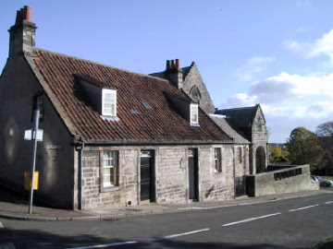
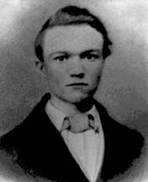
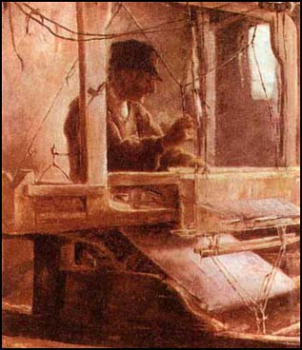
Carnegie, The Boy

Slide 3
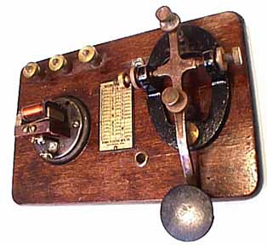
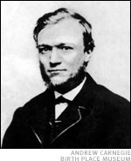
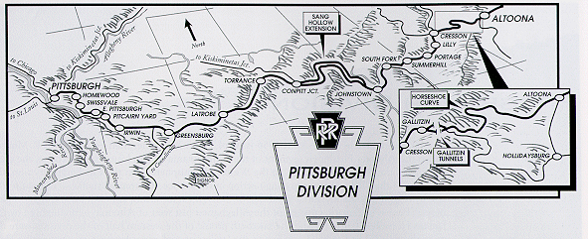
Carnegie, the Up and Comer

Slide 4
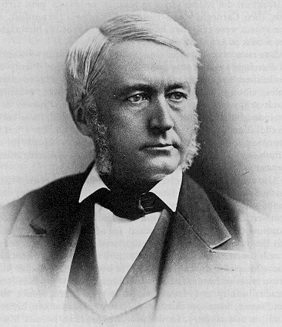
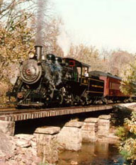
Thomas Scott

Slide 5
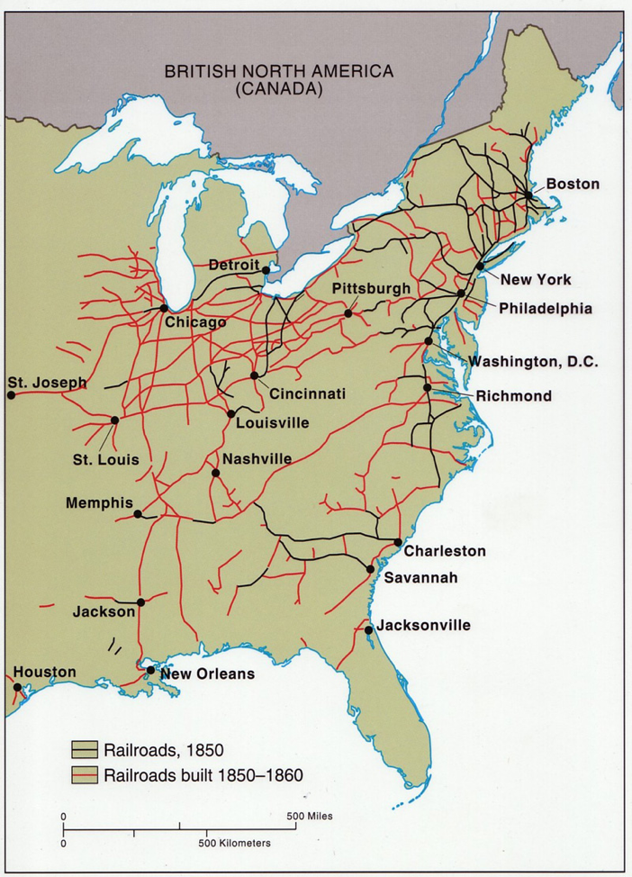

Slide 6
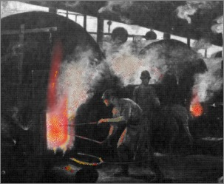
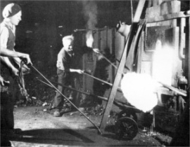
Iron “Puddling”

Slide 7
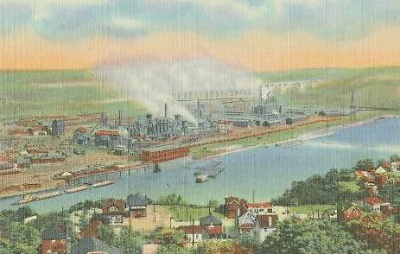
J. Edgar Thompson Works
Braddock, PA

Slide 8
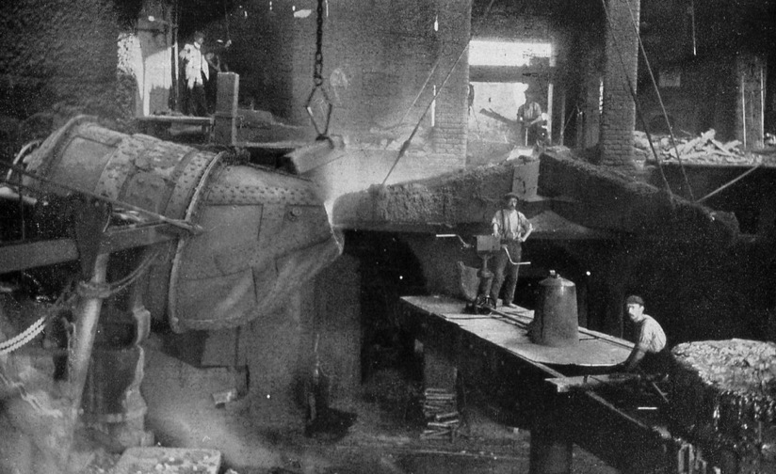
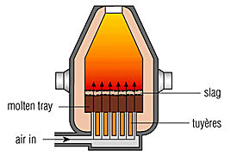
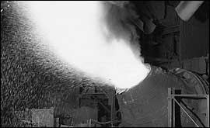
Bessemer Process

Slide 9
American Steel Production, 1877-1887

Slide 10
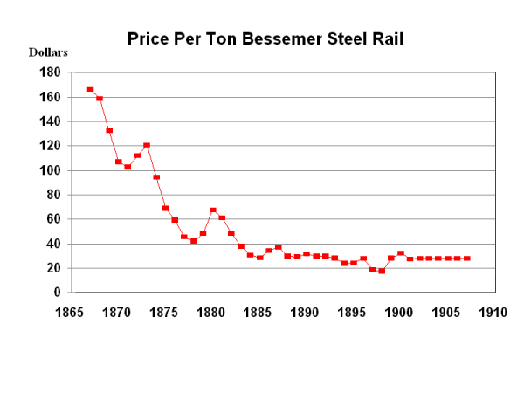

Slide 11
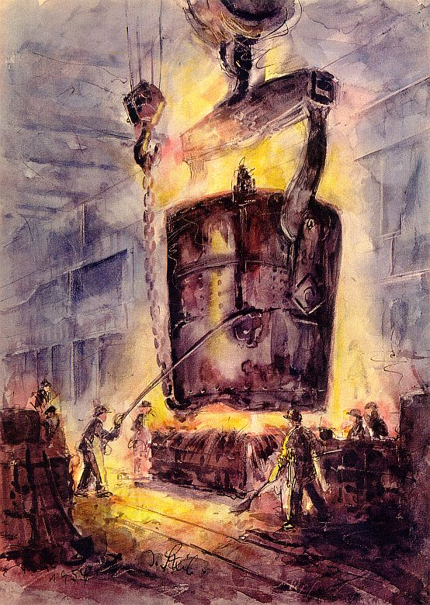
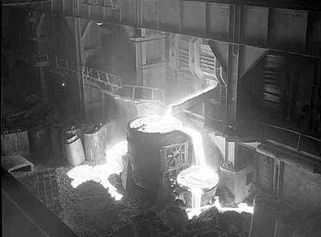
Open-Hearth Process

Slide 12
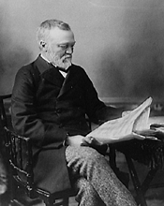
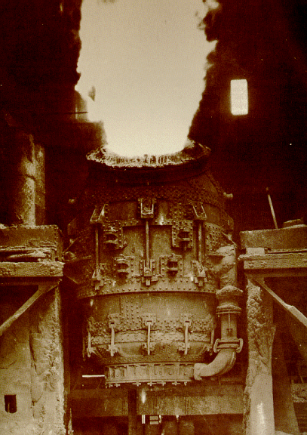
Carnegie, The Hard Driver

Slide 13
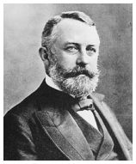
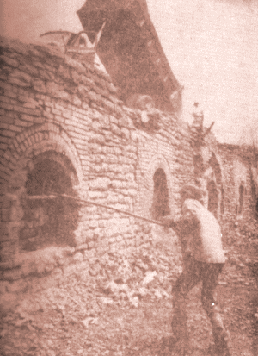
Henry Clay Frick
“Beehive” Coke Oven in Pennsylvania

Slide 14
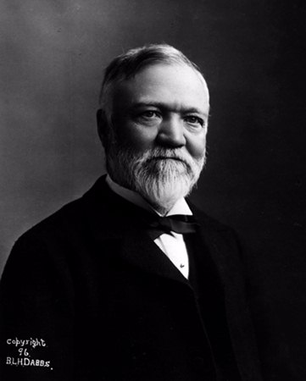
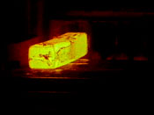
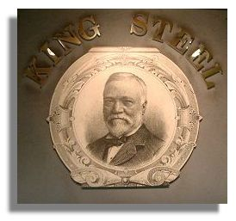
Carnegie, The Industrialist

Slide 15
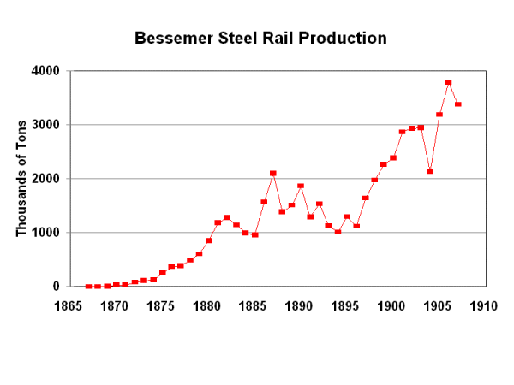

Slide 16
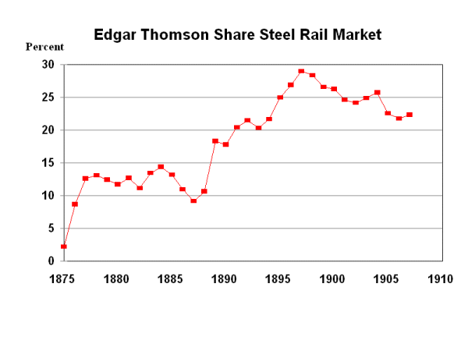

Slide 17
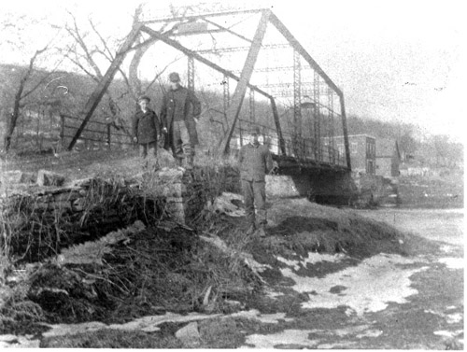
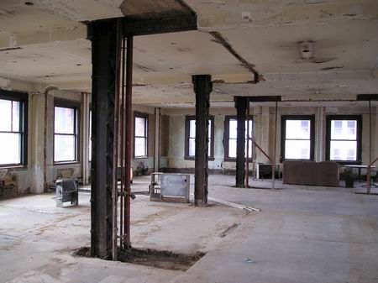
Carnegie Steel Bridge, 1900
Carnegie Steel Construction Beams

Slide 18
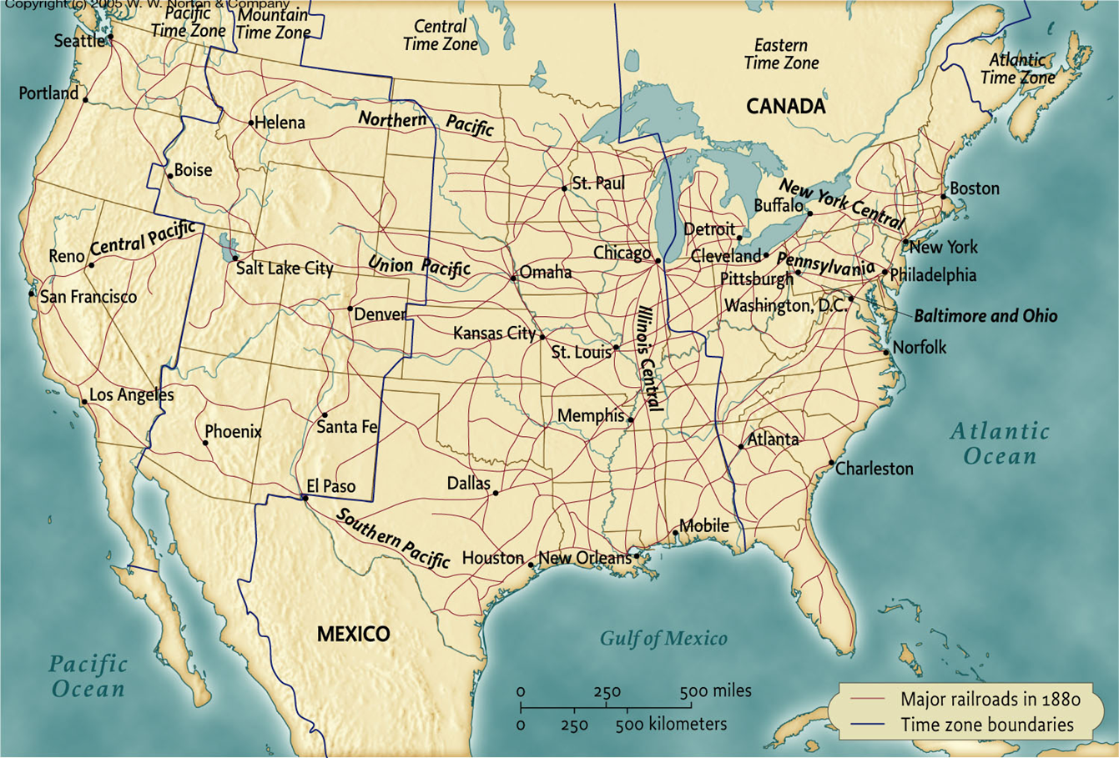

Slide 20
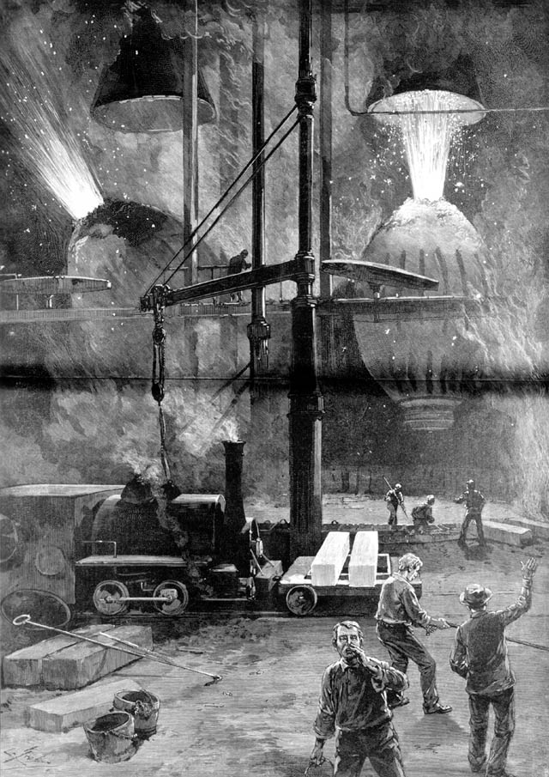
“Making Bessemer Steel at
Pittsburgh” (1886)

Slide 21
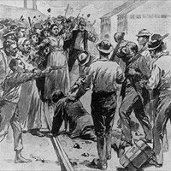
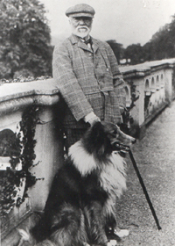
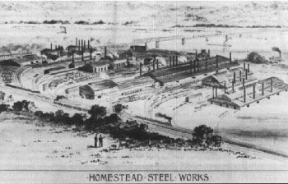
Homestead Strike
1892

Slide 22
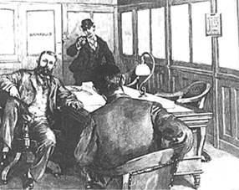
Attempted Assassination of Frick, 1892

Slide 23
Carnegie, The Industrialist

Slide 24
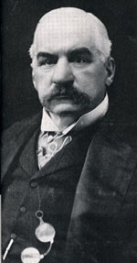
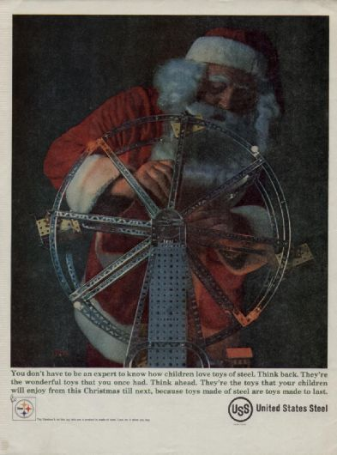
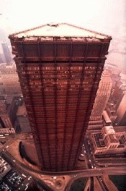
U.S. Steel

Slide 25
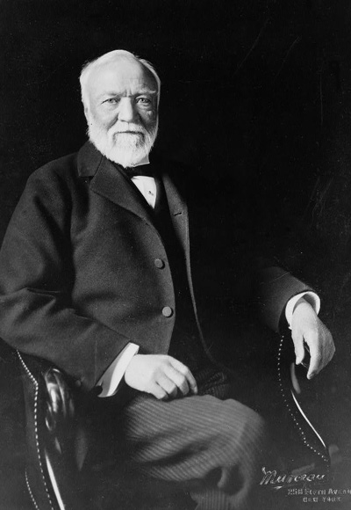
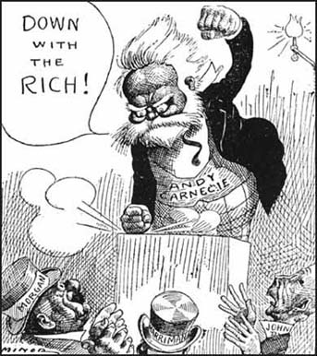
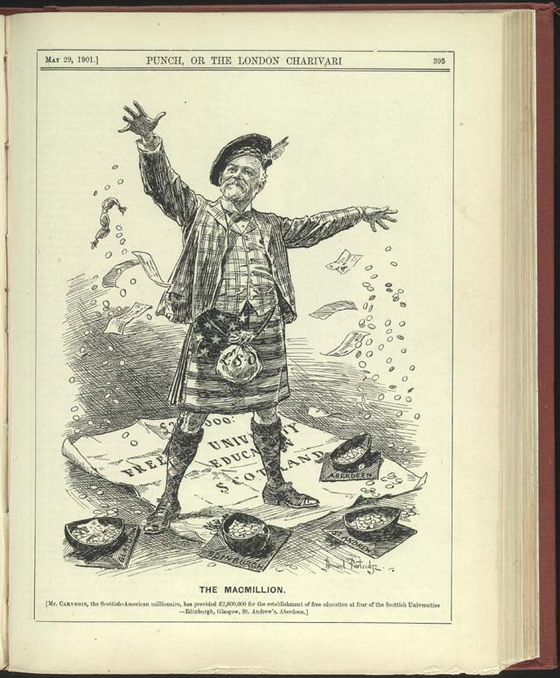
1908
1901
The Philanthropist, 1913

