Slide 1
Bare Naked Ladies
Aluminum

Slide 2
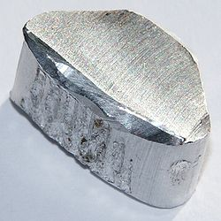
Aluminum
Aluminum
The most abundant metal in the earths crust (only Si and O are more abundant)
Properties
Relatively soft,
Durable
Lightweight
Ductile
Appearance ranging from silvery to dull gray
It is nonmagnetic and does not easily ignite
A good reflector (approximately 92%) of visible light
The yield strength of pure aluminum is only 7–11MPa (steel is 250-500MPa)
Corrosion resistant except in salt water
Low emissivity
Difficult to weld (TIG)
Why is it useful?
Wikipedia.com
Notes:
What did you think of the books?
What is your opinion of the respective writing styles? Organizations?
What did you learn from reading two accounts of the same period? Did you notice differences in emphasis?

Slide 3
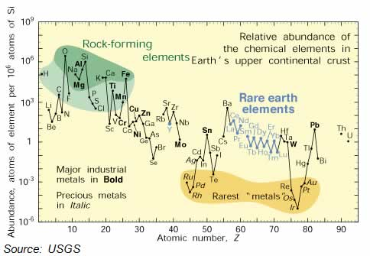

Slide 4
Challenges with Aluminum
Certain metal oxides are very stable and Al₂O₃ is one of them.
Charcoal and CO cannot reduce Al₂O₃
Alchemy based on turning metals into gold
By 1700’s beginning to realize this is futile
To understand how we get Aluminum need to understand the history of oxides
Studies of Phlogiston (proposed in 1667 by Becher)
Firey substance possessed by Materials
Burning something gave off Phlogiston left Calx
In 1774 Priestly isolated oxygen from mercury oxide using sunlight
Gas supported burning of candle but what is it?

Slide 5
Early Chemistry
1772-78 Antoine Lavoisier in France
Interested in Priestley’s work
Used careful balances weight products and reactants
Metal gains weight when heated in Air
So how is this possible? Something burns it gives off Pholgiston
Others assigned a negative weight to Phlogiston ?
Lavoisier repeated mercury oxide exp. both ways
Proved gas was oxygen and necessary for combustion
Laid theory of Pholgiston to rest and started modern chemistry
Proved S was an element not compound
First to organize elements by weight
First to show elements may change form but weight was fixed
1794 at 50 executed for selling dilute tobacco (French revolution)
Pardoned a year later

Slide 6
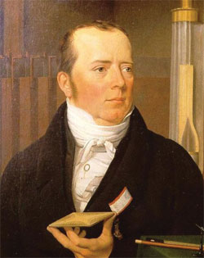
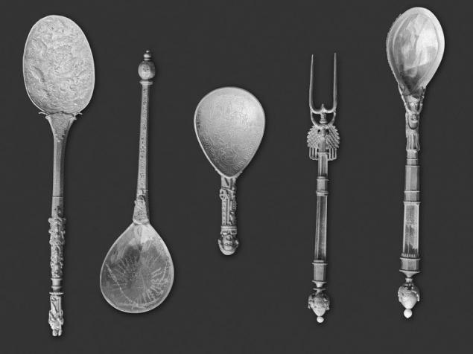
Aluminum Challenge Continued
How does one discover a metal that cannot be reduced by CO?
Must forcibly inject electrons
Volta Pile
Sir Humphrey Davy 1807
Use Cu and Zn that had been reduced using CO
Generate electricity (battery) and reduce potash
K₂SO₄ and NaOH turned into Na and K metals
Hans Orsted first to reduce Al 1825
Same Orsted who discovered electric currents generate magnetic fields
Used Potassium mercury amalgam metal to reduce Aluminum chloride
Sodium also worked and for 60 years this was the only way to make Al
Very expensive (much more valuable than gold) (jewelry)
Napoleon III used Al dinnerware for best guests (others got gold)
Hans C. Orsted
http://www.aps.org/publications/apsnews/200807/physicshistory.cfm
http://bashny.net/t/en/275779

Slide 7
Aluminum Challenge continued
1886 Charles Hall(US) and Paul Heroult (France)
Independently invent cheap method of producing Al
What was the challenge?
Al₂O₃ is not conductive so can’t just apply electrodes
Melts 2072°C yikes! Made process very expensive
Cool trick Hall and Heroult figured out in 1885
Use Cryolite (Na₃AlF₆)
melts at ~950°C very accessible, much cheaper
Al₂O₃ dissolves in molten cryolite
Next challenge isolate Al₂O₃ from Bauxite use Bayer Process: Convert to Bauxite to Al(OH)₃ and back to Al₂O₃
Needed to use electricity to reduce Al₂O₃

Slide 8
Hall vs Herault
Who get the patent?
Hall conducted his successful reduction of Al using cryolite experiment on Feb. 23 1886
He applied for a patent July 9 1886
It was not granted because Heroult had applied for his patent April 23 1886 or 10 weeks before Hall
Finally Hall’s patent was granted 3 years later in on April 2 1889, Why?
Hall produced his lab book which showed he had done the experiment on Feb 23 but Heroult could only show his patent date of April 23
Moral: Keep good lab books
BTW the laws have since changed, Now its first to file not first to discover
Aside: Both men were born in 1863 and both died in 1914

Slide 9
Aluminum Refinement
Hall–Héroult process
Aluminum Production
Notes:
What did you think of the books?
What is your opinion of the respective writing styles? Organizations?
What did you learn from reading two accounts of the same period? Did you notice differences in emphasis?

Slide 10
Aluminum history continued
1856 cost of Al is $90/lb
1890 price drops to $0.30/lb
Worldwide production
1873 2.5 tons
1900 7300 tons
Today >40,000,000 tons
Consumes lots of electricity
Early plants concentrated near hydroelectric dams
Today uses ~15kWh of electricity per kilogram of Al
Consumes ~5% of electricity produced in US today
Greenhouse gas implications
Requires 95% less energy to recycle

Slide 11
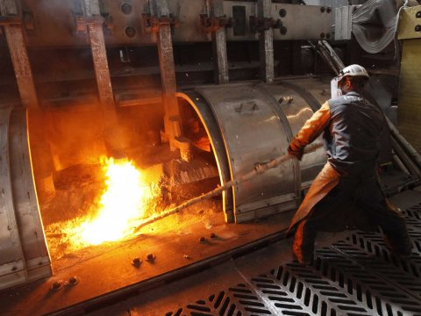
Al production
2011
1. United Co. Rusal 4,127 (Russia)
2. Rio Tinto Group 3,829 (Canada)
3. Alcoa Inc. 3,669 (US)
4. Chalco Aluminum Corp. of China 3,127 in
*thousands of tons
http://www.businessinsider.com/alcoa-q2-earnings-2015-7
http://www.bloomberg.com/news/2012-02-27/top-10-aluminum-companies-in-2011-by-production-table-.html

Slide 12
Property challenge
Yield Strength
Pure aluminum is only 7–11MPa
steel is 250-500MPa
How do you make it strong?
Options
Solid Solution Strengthening like Bronze
Doesn’t work very well
Work Hardening like Bronze or Iron
Doesn’t work very well (you try it)
Precipitation Hardening
How does that work?

Slide 13
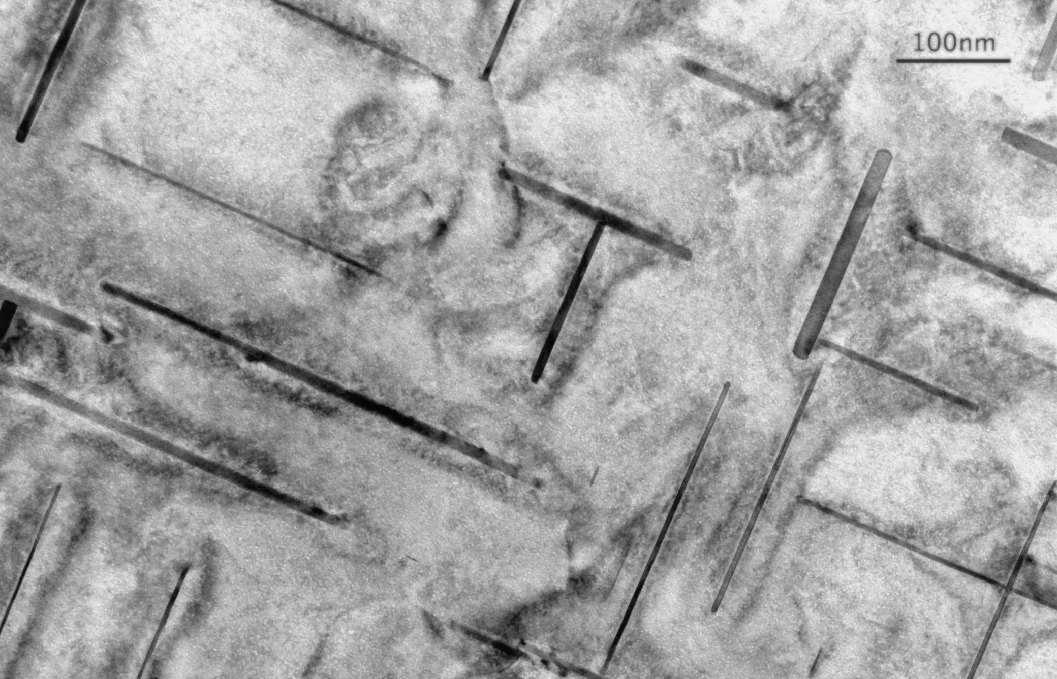
Precipitation Hardening
Add so much Copper (4%) or silicon to aluminum that when quenched its supersaturated (see phase diagram)
Heat up to low temperature
copper or silicon precipitates (like rock candy)
Precipitates block dislocations
Makes Aluminum very hard
Yield strength increases >100X
Also called Age hardening
https://en.wikipedia.org/wiki/Microstructure

Slide 14
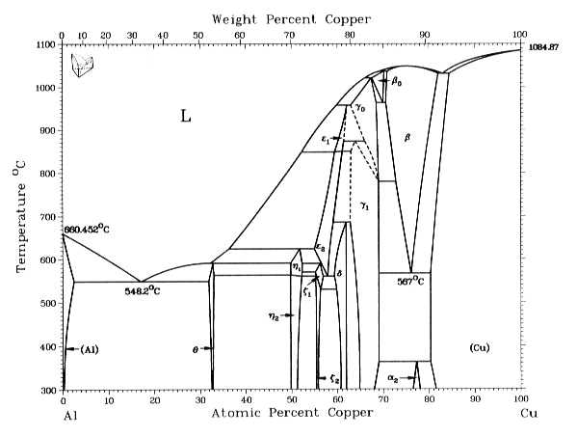
Strengthening Mechanisms
www.oregonstate.edu/instruct/me582/Exams/W09/ME582MT2.html

Slide 15
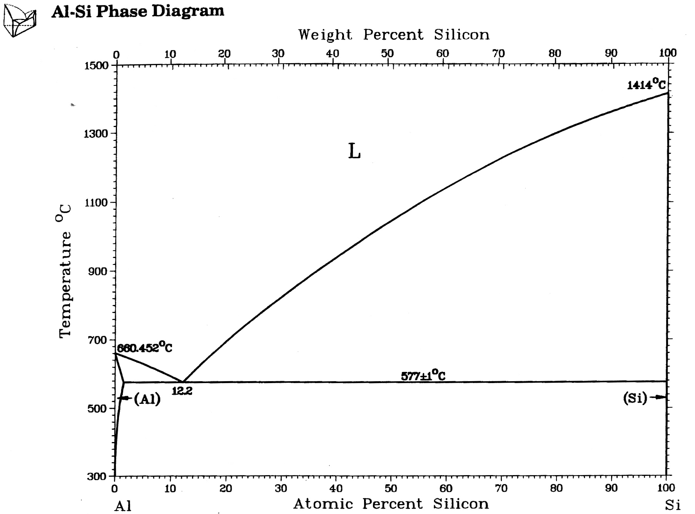
Al-Si

Slide 16
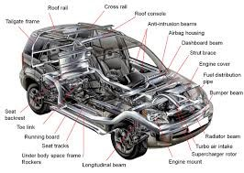
Aluminum Applications
Many applications
Transportation (automobiles, aircraft, trucks etc.) (1914)
Aluminum foils (1947)
Aluminum beverage cans (1963)
Construction (windows, doors etc)
Cooking Utensils
Street lights
Laptop casings
Electrical Transmission lines
Cell Phone casings
Sporting goods (e.g. bats etc.)
http://www.aluminumextrusiongroup.com/automotive-applications/

Slide 17
Aluminum Applications
Many applications so focus on one: Aircraft
Strength to weight ratio critical in Aircraft
Strength may be slightly less but weight is 1/3
Specific strength is 50% higher for Al compared to steel
Susceptible to Cyclic fatigue
Pressure cycling
Fails below yield strength
Cracks are key
Small crack 1/1000 mm no problem
But if after hundreds of cycles it grows to 1mm can be catastrophic

Slide 18
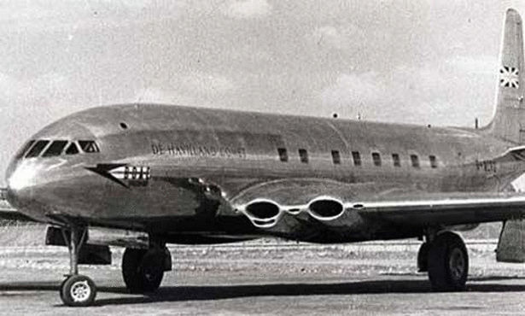
Aircraft
British DeHavilland Comet 1952
4 crashes in 2 years
Result of rivets and square windows (stress razors)
Reengineered by 1958 but too late
Boeing had launched 707 by 1958
Took over the market
In 2009 Civilian Aircraft accounted to 7.1% of all exports
Largest single export
http://www.extremetech.com/extreme/129764-tech-wrecks-lessons-from-some-of-the-biggest-hardware-screw-ups/3

Slide 19
Corrosion
Al is extremely reactive if powdered
Solid rocket fuel for Shuttle (Al + H₂0 => Al(OH)₃)
Why does Aluminum stay shiny and not rust?
Aluminum oxide coating very thin but conformal
Protects surface from further oxidation
When you mix metals the one that wants the oxygen most, wins and corrodes.
This means that almost always the Aluminum corrodes so be careful (seaplane)
Why does Aluminum fail at the beach?
The chlorine in salt water helps corrosion
Forms pits at grain boundaries etc.

Slide 20
Demonstration
Aluminum will react with HCl to form AlCl₃
The byproduct is hydrogen
2Al +6HCL => 2AlCl₃ + 3H₂

Slide 21
Extreme Corrosion Example
Intergranular fracture
Gallium and Aluminum
Redbull Can
Why Ga is prohibited on planes!!

Slide 22
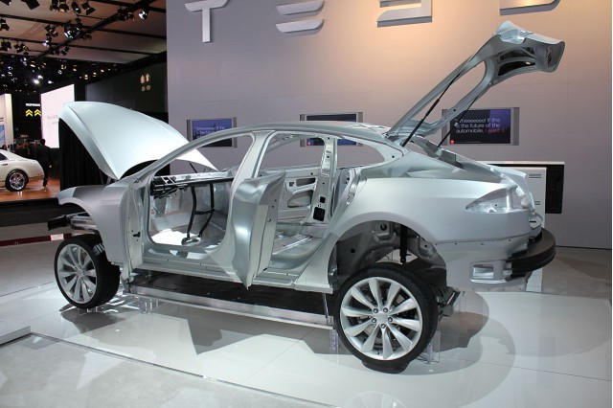
Going forward
New Applications
Tesla Model S is all aluminum

Slide 23
Future applications
Every kilogram of heavier material that is replaced by aluminum results in the elimination of 22 kilograms of carbon dioxide over the lifetime of the vehicle
Winning in competition with Mg for car and truck applications
Losing in plane applications to composites
Fuel Cell applications: Use AlGa liquid and react with water to create hydrogen for energy
Aluminum is ideal for offshore oil fields etc. less corrosion

Slide 24
Recycling Aluminum
Requires only 5% of the electricity
Nearly 40% of the aluminum used in the US is from recycled Al
There are a lot of nasty chemicals (chlorine etc.) required to clean the Aluminum and deal with the dross
Brazil leads the world with 98.2% of the aluminum cans being recycled (why?)
75% of all aluminum created since 1888 is still in use
In 2007 Apple switched to Aircraft grade Al for its cases and recycling of the laptop cases increased from 9.5% in 2006 to over 70% by 2010

Slide 25
Green Aluminum
Aluminum creates 7X more green house gases than Steel
1Ton of Al releases 18 tons of CO2 (coal plant)
New designation being considered
Green Aluminum
Low Carbon Aluminum
News Story from 2017
Charge a premium for hydroelectric Aluminum vs coal derived Aluminum
Sustana Aluminum from Alcoa guarantees <2.5 tons of CO2 per ton of Al

