Slide 1
Alcoa, Anti-Trust, and the Industrial Economy
I. The Rise of Big Business
A. Economies of Scale
B. Vertical Integration at Carnegie Steel
C. Horizontal Integration at Standard Oil
D. Political Response
1. Sherman Anti-Trust Act of 1890
II. The Alcoa Story
A. The Smelting Challenge
1. Charles Martin Hall
B. The Pittsburgh Reduction Company (188-1907)
C. The Aluminum Company of America
1. early production
2. product design
3. vertical integration
III. The Alcoa Monopoly?
A. the Aluminum Research Laboratory
B. Anti-Trust Prosecution
1. initial decision (1942)
2. appeal (1945)
3. breakup
C. the “splendid retreat”

Slide 2
Sales Outlets
Finished Products
Structural Steel, Rails, Etc.
Steel Ingot Production
Vertical Integration
at
Carnegie Steel
Pig Iron Production
Raw Materials
Iron ore, Coal, Limestone, Etc.

Slide 3
Consumers of Distilled Products
(Kerosene, Petroleum, Etc.)
Company A:
Refining
Standard Oil:
Refining
Company B:
Refining
Independent Crude Oil Producers

Slide 4
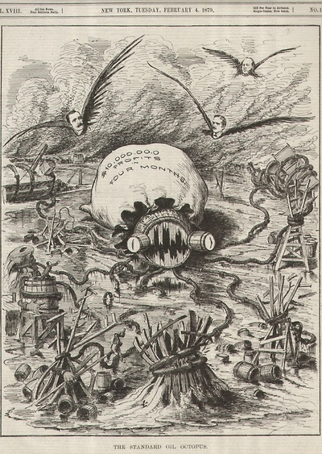

Slide 5
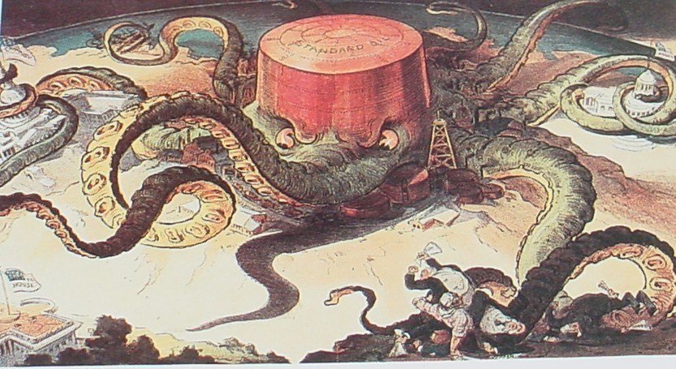

Slide 6
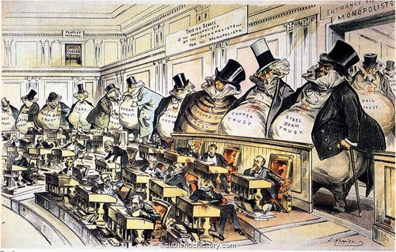
1889

Slide 7
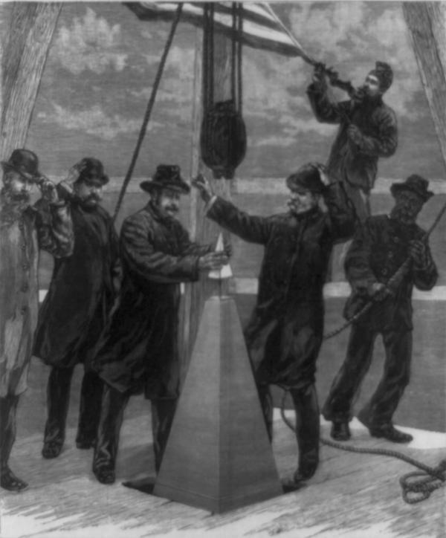
1884

Slide 8
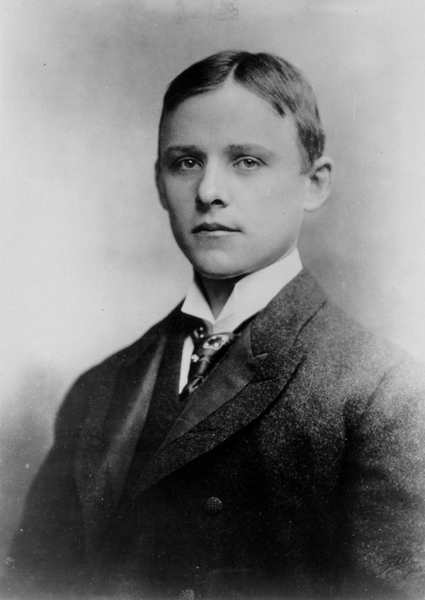
Charles Martin Hall, 1885

Slide 9
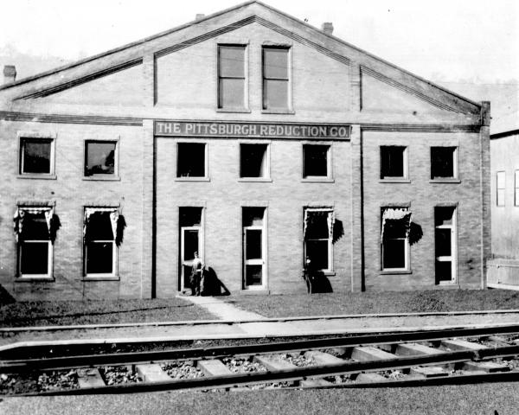
1890

Slide 10
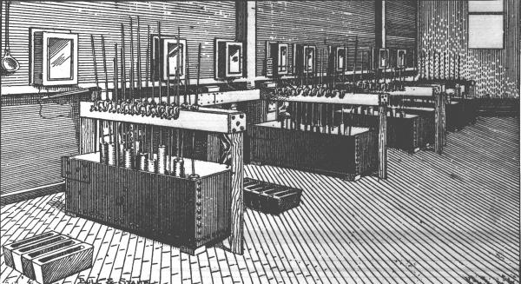
Pittsburgh Reduction Company’s Cell Room, 1886

Slide 11
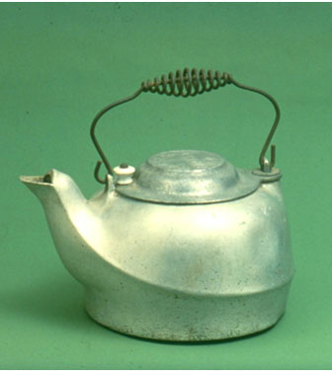
1889

Slide 12
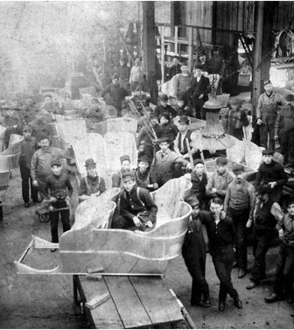
1901

Slide 13
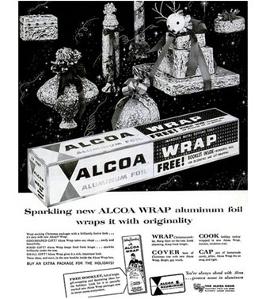

Slide 14
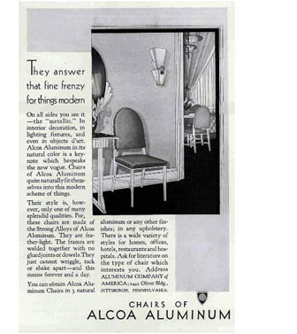
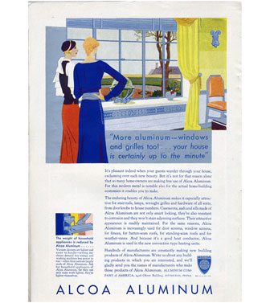
1922
1928

Slide 15
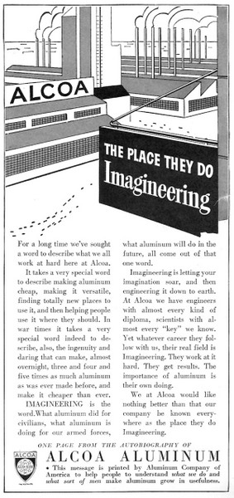
1942

Slide 16
US Estimates of Alcoa Market Share, 1940
Product | Percentage Produced by Alcoa
Bauxite Production for Aluminum | 100
Alumina | 100
Aluminum, Primary | 100
Sheet Aluminum | 60
Extruded Shapes | 40
Forgings | 60
Tubing, Rod, Wire, and Bar Aluminum | 60
Aluminum Foil | 50
Aluminum Pistons | 22
Cooking Utensils | 50
Source: Smith, From Monopoly to Competition, p. 200

Slide 17
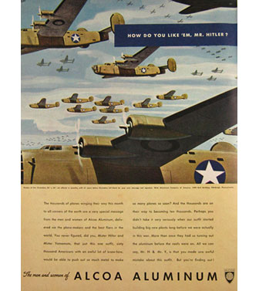
1943

Slide 18
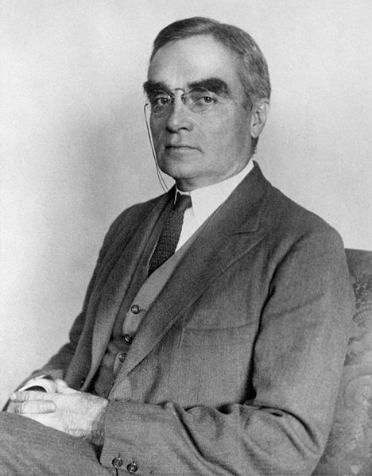
Justice Learned Hand

Slide 19
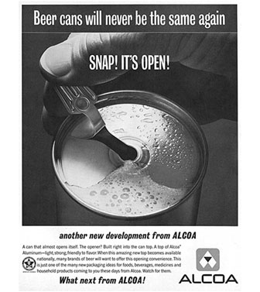
1962

