Slide 1
Cellophane
Video: Mr. Cellophane

Slide 2
Plastic
Eli Young Band
Love the good times, you hate the drama You ain't tryna fit into the crowd And when you dance, you dance how you wanna You do it like there ain't no one around Some girls in this bar actin' like movie stars I look up and there you are In the corner in your blue jean jacket Lip synching to a country song Ain't even tryin' but you look so classic Don't think you got a drop of makeup on I know what you're thinkin' Cause you know you're no good at fakin' The real thing, I couldn't make it without you Cause it ain't nothin' plastic about you Nothin' plastic about you When you're happy, everybody knows it You wear your heart way out on your sleeve When you're ticked off, you just got to show it Baby you can take it out on me Yeah I can tell when a girl's in her shell She ain't afraid to go be herself
In the corner in your blue jean jacket Lip synching to a country song Ain't even tryin' but you look so classic Don't think you got a drop of makeup on I know what you're thinkin' Cause you know you're no good at fakin' The real thing, I couldn't make it without you Cause it ain't nothin' plastic about you Nothin' plastic about you You're the real thing, there ain't no denyin' You shine just like a star without tryin' Girl you ain't even tryin' In the corner in your blue jean jacket In the corner in your blue jean jacket Lip synching to a country song Ain't even tryin' but you look so classic Don't think you got a drop of makeup on I know what you're thinkin' Cause you know you're no good at fakin' The real thing, I couldn't make it without you Cause it ain't nothin' plastic about you Nothin' plastic about you

Slide 3
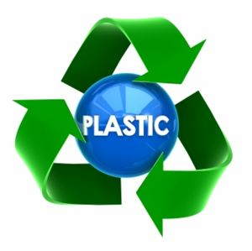
Properties of Plastics
Polymers (plastics) differ in general from metals and ceramics by being:
Lower in hardness
Lower in strength
Poorer in temperature stability
Less reactive (than most metals)
Greater in %elongation
Greater in terms of being customized
Greater in terms of ease of processing
Lower in density (generally a positive trait)
http://www.enoen.se/image/cache/data/Skyltdockor/Fella/Helkropp/Economy/85325-347x346-PlasticRecycling-500x500.jpg
Notes:
What did you think of the books?
What is your opinion of the respective writing styles? Organizations?
What did you learn from reading two accounts of the same period? Did you notice differences in emphasis?

Slide 4
What is a Plastic?
A long chain molecule made of repeat units called “mers”
1833 Berzelius coined the name polymer
The first purely engineered material starting from simple chemicals like ethylene and propylene
Traditionally a “polymer” is the pure primary material and a “plastic” is a polymer plus additives to improve its properties

Slide 5
What are typical Polymers?
C-C Ethane C=C Ethylene
C-C-C Propane C=C-C Propylene
-C-C- polymerize
What are the side groups?
H Polyethylene (PE) HDPE milk containers
Cl Poly vinyl chloride (PVC) Piping
CH3 Polypropylene (PP) Polypro clothing
Benzene Polystyrene (PS) Styrofoam
Fluorine (PTFE) Teflon
Side group affect crystallization and thus properties

Slide 6
Natural POLYMERS
Bitumen
Silk
Rubber
Coagulate tree sap of hheve Tree from Haiti
Observed by Columbus, Wore on feet
Early 1700’s brought back to France
1820 (1st) Macintosh
Mix rubber and naptha (gasoline)
Raincoats
Sticky or brittle
How do you solve this problem?

Slide 7
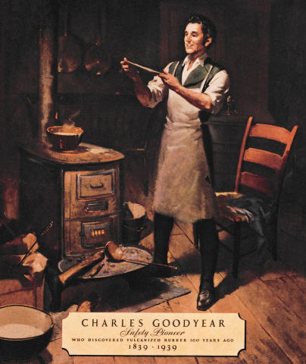
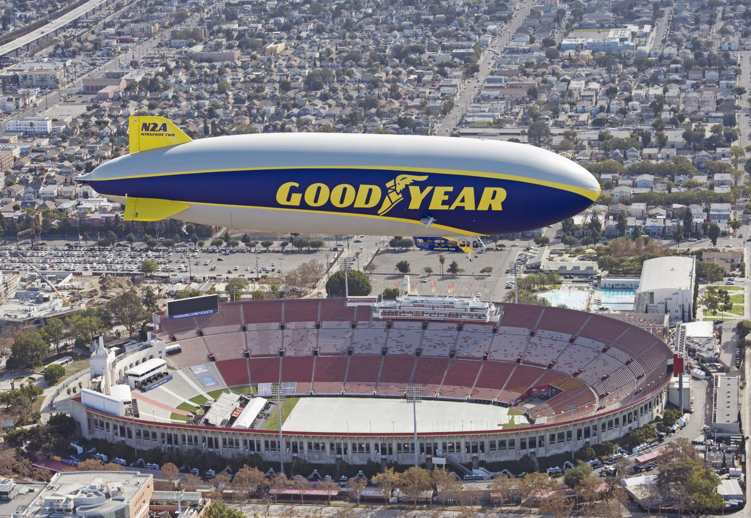
Rubber
Charles Goodyear 1830’S
Better inventor than entrepreneur
In and out of debt most of his life
Felt a calling (spiritual) to improving the qualities of rubber
Invented vulcanization of rubber
Process involves sulfur and heat
Produces material that is consistently tough, elastic, and stable with temperature.
Shared samples with Macintosh (oops)
https://www.utires.com/articles/wp-content/uploads/2017/05/charles-goodyear.jpg
https://frontofficesports.com/wp-content/uploads/2020/01/WF2_LA_01-1536x1061.jpg
Notes:
What did you think of the books?
What is your opinion of the respective writing styles? Organizations?
What did you learn from reading two accounts of the same period? Did you notice differences in emphasis?

Slide 8
RUBBER AND CROSS-LINKING
Rubber has a double bond in the backbone
-C=C-C-
This is critical
Used Sulfur to cross-link chains
Huge improvement
Rubber became a critical material in transportation
Supply issues in WW I Germany develops synthetic rubber called Buna S.
Hitler ramps up manufacturing for WW II, US loses rubber production to Japan so we synthesize our own as well, 9000 tons 1941, over 1M tons 1945
Today 2/3 of rubber is synthetic

Slide 9
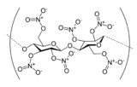
CELLULOSE NITRATE
1868 Phelan and Collender
Billiard ball challenge $10K prize to replace Ivory
1846 Schonbein Univ of Basil
Dissolve paper in nitric and sulfuric acid
Made cellulose nitrate
Parkes in GB softened with camphor
Hyatt made billiard balls
Problem in synthesis replace OH in cellulose with NO₃ from nitric acid
Explosive (e.g. Ping Pong Balls, TNT)
1890 Chadonnet replaces nitrate with xanthate
Invents first synthetic fiber Rayon

Slide 10
SYNTHETIC POLYMERS
Not based on natural products
1907 Baekeland: Bakelite
1933 Fawcett and Gibson: Polyethylene
1935 Carothers: Nylon, Neoprene
1938 Plunkett: Teflon
1951 Hogan and Banks: Polypropylene
1965 Kwolek: Kevlar

Slide 11
Polyethylene
1933 Fawcett and Gibson (ICI) polymerize ethylene
Critical material in WW II for radar
Standard insulation for all radar cables
Problem was side branching
Variable properties
Pile up of unused PE (Hula Hoop)
Ziegler Natta Catalysts invented in early 1950’s
Linear PE 100,000 mers
80% crystalline, HDPE Ziegler
Linear PP Natta
Won 1963 Nobel prize in chemistry

Slide 12
POLYETHYLENE
This is the most common plastic, 80,000,000 tons per year
Comes in many forms depending on the molecular weight
Ultra low molecular weight: floor wax
Low density: plastic bag saran wrap
Medium density: packaging film, gas pipes
High density: milk jugs, trash cans
Ultra high molecular weight: hip implants, bullet proof vests
The properties depend on the ability to line up the chains (crystallize the material, stretch example)

Slide 13
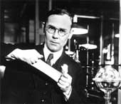
Nylon
Wallace Carothers
Professor of Organic Chemistry
U. Illinois, Harvard
DuPont Director of R&D 1928-1937
Developed Nylon & Neoprene
Lodged 50 patents
Hated public speaking. Suffered from chronic depression. Frequently consumed alcohol to calm his nerves.
Following the death of his sister and estrangement from his parents and wife of only 3 years, Carothers committed suicide at age 41 by ingesting cyanide dissolved in lemon juice.
https://educacionquimica.files.wordpress.com/2015/04/carothers2.jpg
Notes:
What did you think of the books?
What is your opinion of the respective writing styles? Organizations?
What did you learn from reading two accounts of the same period? Did you notice differences in emphasis?

Slide 14
Nylon
Carothers 1935
Reaction condenses water
Created Nylon
Can replace C=O (OH) with C=O(Cl)
Hexamethylene Diamine and Sebacoly Chloride
R₁= 6 carbons R₂=10 Carbons
Make Nylon 6,10 and HCl instead of H2O

Slide 15
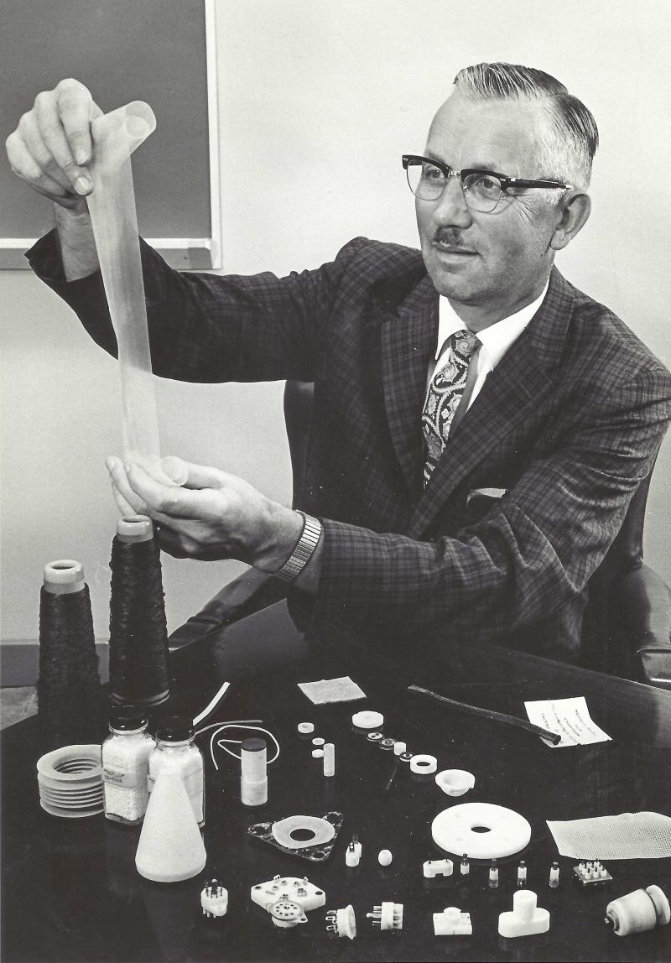
Teflon
Roy Plunkett 1938 Dupont
Accidently discovers Teflon
Pressure in bottle of tetrafloroethylene refrigerant dropped, sawed off top and discovered teflon inside
Kept secret until after war
1954 the wife of French engineer Marc Gregoire suggested he coat a pan with it
Used in seals, low friction coefficient
Very corrosion resistant
http://pleasanthillhistorycenter.com/yahoo_site_admin/assets/images/Roy_Plunkett2.239211645_std.jpg

Slide 16
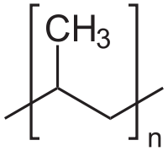
PolyPropylene
1951 J. Paul Hogan and Robert L. Banks (Phillips)
First to polymerize propylene
First polymer where the location of the sidegroups was controlled to make a difference in properties
Natta catalysts
Most PP today is isotactic, methyl all on one side
Notes:
What did you think of the books?
What is your opinion of the respective writing styles? Organizations?
What did you learn from reading two accounts of the same period? Did you notice differences in emphasis?

Slide 17
POLYPROPYLENE
This is the second most common plastic, 55,000,000 tons per year
It has an intermediate level of crystallinity between that of low-density polyethylene (LDPE) and high-density polyethylene (HDPE).
Polypropylene is normally tough and flexible.
Polypropylene is reasonably economical, and can be made translucent
Applications include clothing, carpeting, medical devices, rope, car batteries, wastebaskets, pharmacy prescription bottles etc.

Slide 18
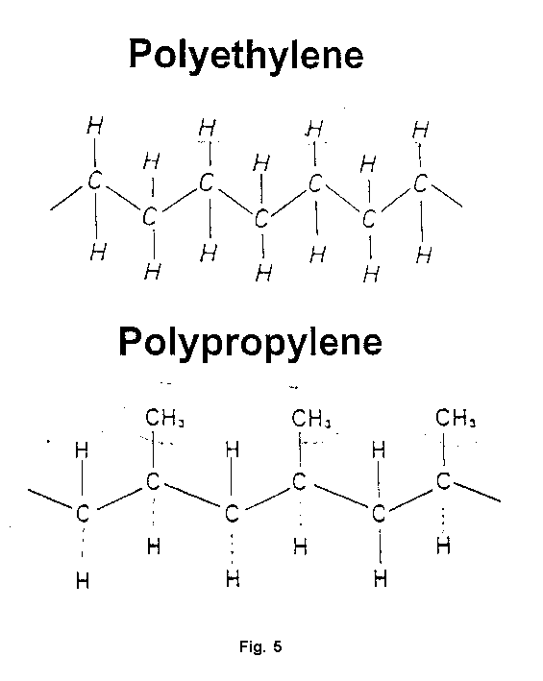
TUPPERWARE
The composition of tupperware is either low density polyethylene (LDPE) or polypropylene (PP)
http://www.isss.de/conferences/Mallorca1999/forum1.html

Slide 19
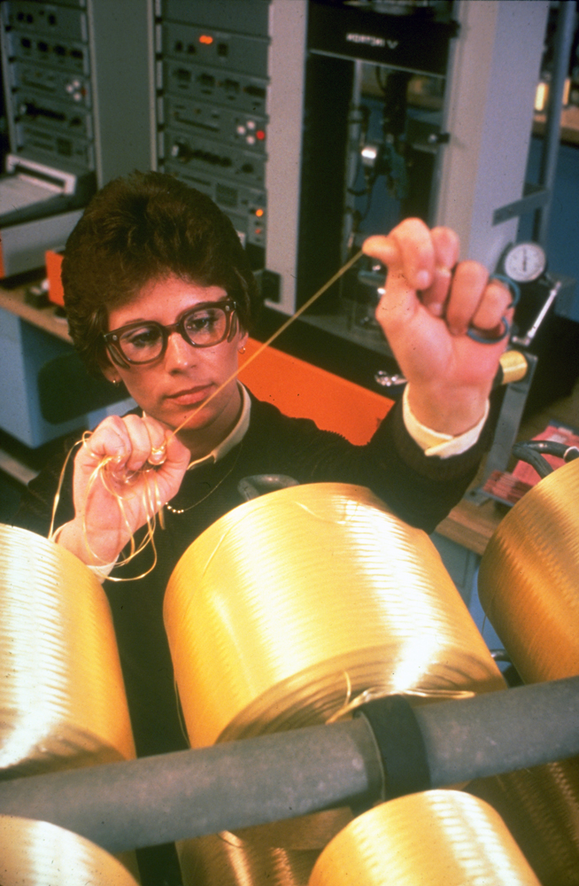
Kevlar
Stephanie Kwolek 1965
If you replace the backbone in nylon with Benzene rings you get Kevlar
Bullet proof vests
https://archive.triblive.com/wp-content/uploads/2019/07/vndkevlar3090516jpg.jpg

Slide 20
THERMOSETS VS THERMPLASTICS
Simpliest terms
Thermoplastics can be melted
Most plastics in everyday life are thermoplastics
2 liter bottles (PET) can be melted down and reused (easily recycled)
Thermosets are sufficiently cross-linked to prevent them from being melted
Makes it difficult to reuse them again for the same purpose
E.g. car tires can be ground up and reused but not melted down and reused

Slide 21
THE AGE OF PLASTICS
The appearance of a polymer occurs in ~800 AD with the use of gutta percha (a natural rubber).
Ashby “Materials and the Environment”
Notes:
What did you think of the books?
What is your opinion of the respective writing styles? Organizations?
What did you learn from reading two accounts of the same period? Did you notice differences in emphasis?

Slide 22
Summary THE AGE OF PLASTICS
In the developmental history of materials, the age of plastics is less than 100 years old. The paradigm shift that occurred in this age involves man’s ability to synthesize new materials.
Ashby “Materials and the Environment”
Notes:
What did you think of the books?
What is your opinion of the respective writing styles? Organizations?
What did you learn from reading two accounts of the same period? Did you notice differences in emphasis?

Slide 23
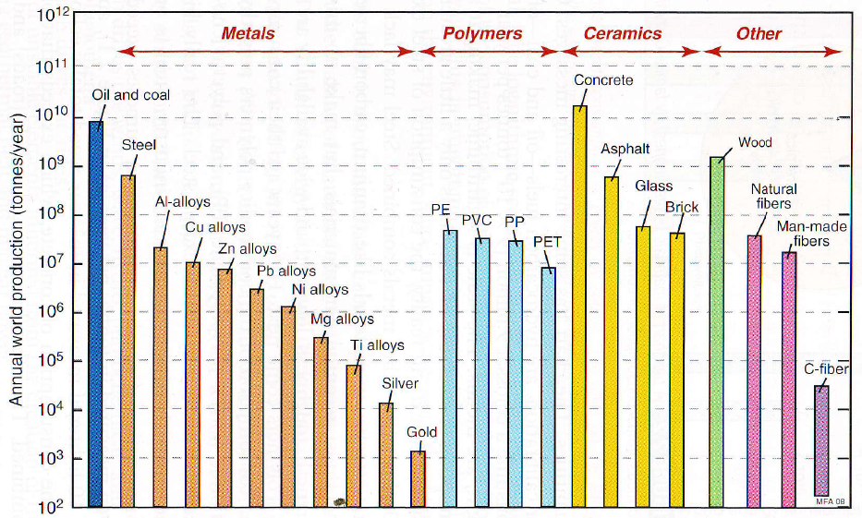
THE AGE OF PLASTICS
Today, polymeric materials are produced in quantities rivaling all other materials.
Ashby “Materials and the Environment”
Notes:
What did you think of the books?
What is your opinion of the respective writing styles? Organizations?
What did you learn from reading two accounts of the same period? Did you notice differences in emphasis?

Slide 24
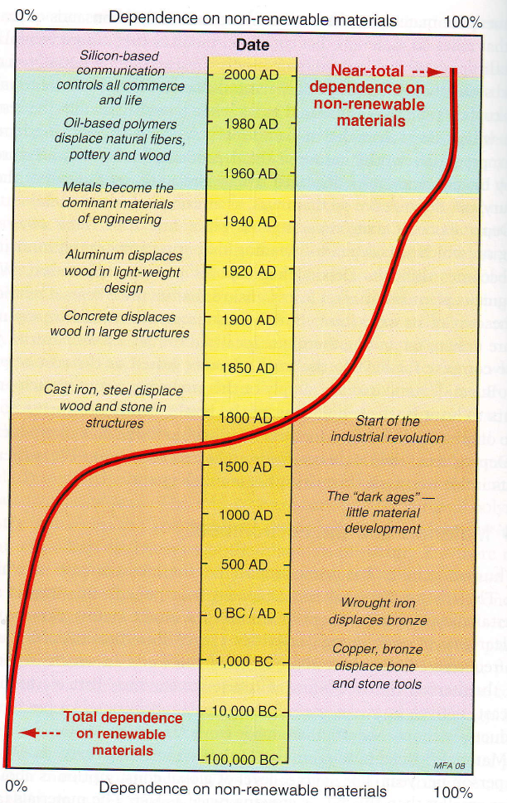
THE AGE OF PLASTICS
The age of plastics has ushered in a heavy reliance on materials that are considered non-renewable. With the growing world population, this places enormous pressure on our natural resources.
Ashby “Materials and the Environment”
Notes:
What did you think of the books?
What is your opinion of the respective writing styles? Organizations?
What did you learn from reading two accounts of the same period? Did you notice differences in emphasis?

Slide 25
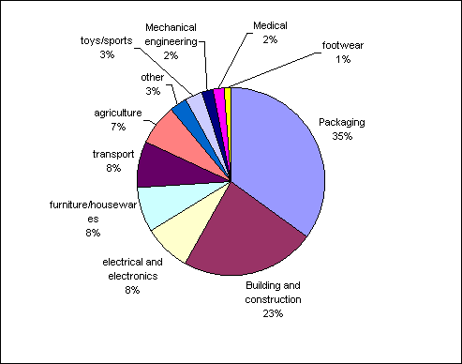
Packaging represents the largest single use of plastics. Use is derived from weight, flexibility and sealing qualities.
http://image.slidesharecdn.com/saynotoplasticswithketa-111120110131-phpapp02/95/say-no-to-plastics-5-728.jpg?cb=1321788877
Notes:
What did you think of the books?
What is your opinion of the respective writing styles? Organizations?
What did you learn from reading two accounts of the same period? Did you notice differences in emphasis?

Slide 26
Production of plastics worldwide from 1950 to 2016 (in million metric tons)*
Global plastic production 1950-2016
2
Note: Worldwide
Further information regarding this statistic can be found on page 8.
Source(s): PlasticsEurope (PEMRG); Consultic; ID 282732

Slide 27
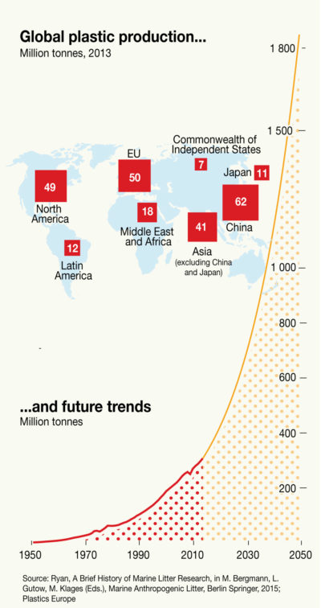
Future Plastic Production
Projected
5X increase over the next 20 years!

Slide 28
PLASTIC Challenges
The world consumes 335 million tons of plastic materials (2015)
The US generated 110M tons of plastic in 2015
Mostly PE, PP, PET and PVC
15% (5M tons) were burned
76% (26M tons) were landfilled
Only 9% (3M tons) of the plastic produced in US is recycled
Only 14% is recycled globally
Why?
http://www.i-sis.org.uk/RFTPW.php
Notes:
What did you think of the books?
What is your opinion of the respective writing styles? Organizations?
What did you learn from reading two accounts of the same period? Did you notice differences in emphasis?

Slide 29
How does one recycle a plastic?
Sort manually or
Shredding and sieving and sort by density
Eliminate impurities like paper
Melt and extrude into pellets
Manufacture new material, So why don’t we recycle more than 9%?

Slide 30
Problems
Cost of transporting sorting, cleaning and processing
Demand
30% of recycled plastic still goes to landfills
China quit taking it in 2018
Cross contamination yields poor polymers
Block co-polymers are being used that stitch together different polymers
Polystyrene (compactors are expensive)
PVC and plasticizers

Slide 31
PVC
PVC is one of the biggest challenges in recycling
Can’t recycle because it typically contains lots of plasticizers (new car smell)
Plasticizers are chemicals that make the plastic softer but the also make it very difficult to recycle because they are hazardous chemicals
Properties vary so too much
The chlorine byproducts make it very toxic to burn

Slide 32
Solutions?
Increase demand for recycled plastic products: Marketing
Build more Recycling Infrastructure
Finding new applications
E.g. roadbeds, straws into fabric
Use more Biodegradable polymers (water footprint)
Decrease dependence?
Examine you own plastic footprint, do you really need that lid?
Example: Ocean Pollution: 10% of the plastics we use wind up there
Most come from 10 rivers
8 in Asia and 2 in South America/Africa
What to do?
Recover plastics in oceans
Stop plastics from entering oceans
Blockchain in Haiti
You can find examples in the news almost daily (Interceptor)
Its going to take creative people and lots of approaches

