Slide 1
John Cougar Mellencamp Paper in Fire
"Paper In Fire" She had a dream And boy it was a good one So she chased after her dream With much desire But when she got too close To her expectations Well the dream burned up Like paper in fire [Chorus:] Paper in fire Stinkin' up the ashtrays Paper in fire Smokin' up the alleyways Who's to say the way A man should spend his days Do you let them smolder Like paper in fire
He wanted love With no involvement So he chased the wind That's all his silly life required And the days of vanity Went on forever And he saw his days burn up Like paper in fire [Chorus] There is a good life Right across the green field And each generation Stares at it from afar But we keep no check On our appetites So the green fields turn to brown Like paper in fire

Slide 2
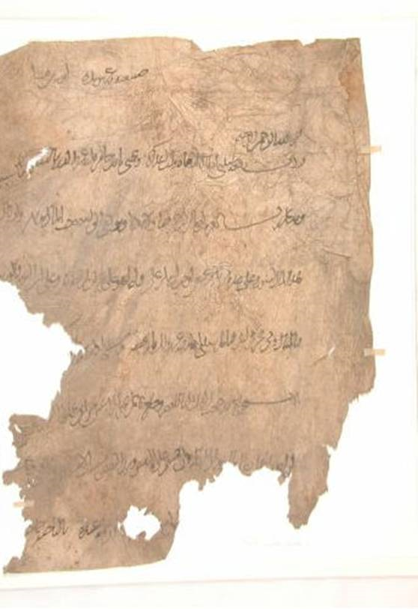
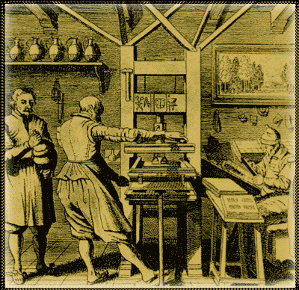
Paper Information Exchange
http://www.osmanlimatbaa.com.tr/history.html
www.history-science-technology.com/
Notes:
What did you think of the books?
What is your opinion of the respective writing styles? Organizations?
What did you learn from reading two accounts of the same period? Did you notice differences in emphasis?

Slide 3
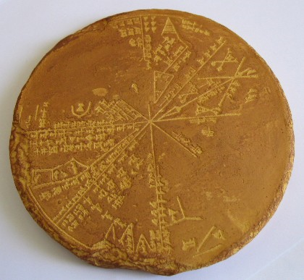
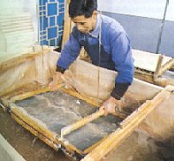
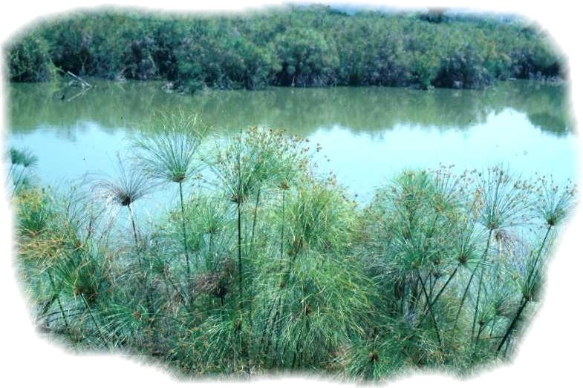
Writing Materials
40,000 BC
4,000 BC
3,000 BC
800 BC
500BC
200 BC
0 AD
1300’s AD
1840’s AD
Lascaux (Cave Walls)
Sumerians (clay tablets)
Egyptians (papyrus)
Greece (Wax tablet)
Greece (lead curse tablets)
Romans, (parchment)
Chinese (paper, bamboo)
Europe (paper flax, cotton, hemp)
Wood Paper
http://www.swordandsorcery.org/images/papyrus%20plant%202.jpg

Slide 4
Clay Tablets
Sumarians started using clay as a means of recording information around 3000BC
Pictographs evolved into wedge produced symbols because it was faster (latin for wedge is cuneus thus cuneiform)
Enabled transmission of knowledge from generation to generation
Gave rise to literature, Epic of Gilgamesh an ancient King of Uruk and adventures
Gave rise to laws requiring all transactions be recorded (2000BC)
Huge libraries that record ancient everyday life still exist thanks to the durability of clay

Slide 5
Papyrus
Papyrus use started around 3000BC
Overlaps significantly with clay
Earliest form of “Paper” Making
Popular until the demand exceeded the supply and the papyrus plants were insufficient
Papyrus Making

Slide 6
Codex
Early writing on papyrus was often done using rolls
The Romans invented the Codex
The modern form of a book
Greatly enhanced the ease of use
Made it possible for multiple scribes to work simultaneously
Started about the same time as the rise of Parchment (animal skins)
Bible was one of the first Codex’s
Allowed one to locate text by page number
Earliest form of Random Access Memory
Rapidly replaced rolls
Paper replaced parchment by 1500’s

Slide 7
Paper
Invented by the Chinese around 200BC
Paper making spread to Iraq by 700AD
Printing spreads to Europe by Mongol invasions of 1200’s
Western mills start around 1300
Scribe becomes more valuable than paper
1458 Gutenberg printing press
Printing Bibles did not open books to average public
Some claim led to telescope?

Slide 8
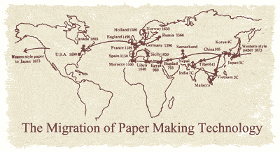
Migration of Paper Making
Reaches Europe
by 1000AD
Starts in 0AD

Slide 9
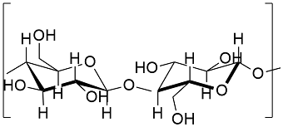
The Science of PAPER
Paper is made from cellulose
Cellulose is part of most plants
Cellulose is a natural polymer
Long chain of sugars (C₆H₁₀O₅) _{n}
n can be as large as 10,000 units
Very organized (crystalline) and hydrophilic

Slide 10
Paper making
Cotton is a major source of cellulose
95% of cotton is cellulose
Early paper was made from cotton and flax
Expensive
1840’s wood started to be used for cellulose
Interesting transition to be discussed more in the next lecture
So what is wood exactly?

Slide 11
WOOD
Wood is a natural composite
Dry Wood is composed of
42-44% cellulose
20-30% hemicellulose (disorganized random sugars)
23-27% lignin
http://upload.wikimedia.org/wikipedia/commons/f/f9/Cellulose-Ibeta-from-xtal-2002-3D-balls.png

Slide 12
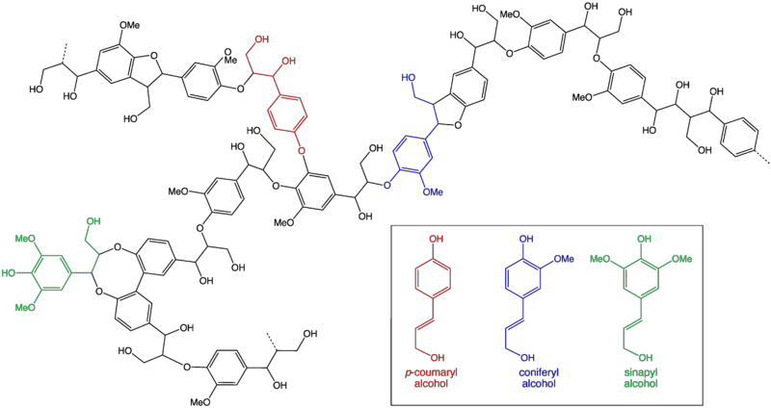
WOOD FOR CELLULOSE
Remember Cellulose is a polymer
Wood is Cellulose bound together by Lignin
Lignin is large molecule
Lots of aromatic rings (usually 6 carbons in a ring)
Makes it hydrophobic (hates water)
Chemically binds cellulose together to give wood much of its properties
Bonds to cellulose must be broken to get cellulose
http://upload.wikimedia.org/wikipedia/commons/thumb/c/c0/Lignin.png/420px-Lignin.png

Slide 13
MAKING PAPER
To make paper first you must break the cellulose lignin bonds in the wood to yield pulp
This process is called maceration
Create individual strands of cellulose
This can be done by two means
Mechanical pulping
Chemical pulping

Slide 14
MECHANICAL PULPING
Wood chips soaked in hot water
Grinding stones or steel discs used to break lignin bonds and free up cellulose
Shorter chains lead to weaker paper
Lignin remains behind
Much higher yield (nearly double)
Lignin can lead to yellowing of paper
Cheaper, less pollution

Slide 15
CHEMICAL PULPING (KRAFT PROCESS)
Use sodium hydroxide and sodium sulfide to break chemical bonds between cellulose and lignin
Reaction produces heat which can be used to power generators
Dissolve the lignin in liquor and wash away from cellulose
Pulp can be bleached to produce white paper
Yield is less because lignin is removed (40-45% of wood weight
Lignin liquor can be burned to also power plant and allow recovery of inorganic chemicals used
Uses lots of water and can pollute (sulfides stink)

Slide 16
Lignin for plastics
Alternative Application
Kraton Polymers use Lignin from pine trees as a source for block co-polymers
Much smaller water footprint compared to other biopolymers
Interesting article

Slide 17
Paper Production Summary
First was mechanical pulping
1867 sulfurous acid chemical pulping process
1879 Kraft Process (sulfate) pulping process
By 1940’s Kraft process dominates because it can accept different wood types and produce stronger fibers

Slide 18
PAPER MAKING
Pulp/paper making (Kraft Process)
Paper making
Paper recycling
Kraft Process
pulp/paper
http://www.youtube.com/watch?v=rZl7KAESsaA
http://www.youtube.com/watch?v=7SdJtYkAzTw
Today we produce 175,000,000 Tons of wood pulp each year
Canada is the worlds largest producer at 21%

Slide 19
Did you know
Pine trees are the largest crop in Florida at $4.5B
Much of the pine tree crop goes to the making of paper

Slide 20
Information Storage and transmission
So this is a classic example of a need and the search for the material to answer this need
The need is to record information
The media has evolved
Clay=>Papyrus=>Parchment=>Paper=>next?
Digital
2002 was the first year when we stored more information digitally than by all analog (paper) means
By 2007 97% of all information was stored digitally (295 exabytes* and it doubles every 3 years)
* Exabyte = 1,000,000,000,000,000,000 bytes

Slide 21
MODERN ALTERNATIVE
Hard Disc Drives
Store information magnetically on a spinning disc
Each number and letter can be represented by a combination of 1’s and 0’s
The magnetic domains can be written to point one way or the other (parallel or perpendicular to the surface) to denote a 1 and a 0
Another read head floats above the spinning surface and can read the direction of the magnetization and thus he information stored

Slide 22
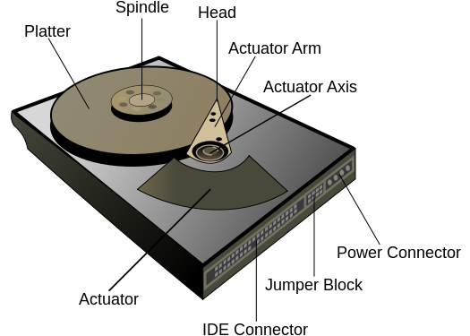
HDD
http://upload.wikimedia.org/wikipedia/commons/thumb/5/52/Hard_drive-en.svg/2000px-Hard_drive-en.svg.png

Slide 23
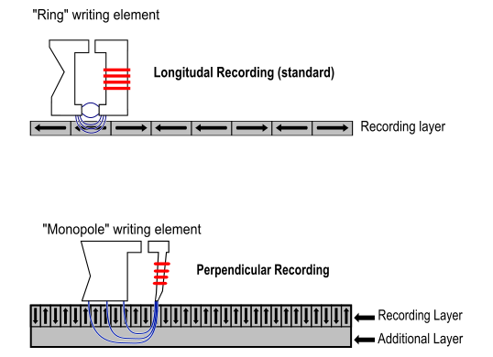
READING MAGNETIC MEMORY
http://thewallstreetwiki.com/_art/ring-v-monopole.jpg

Slide 24
HARD DISC DRIVES
Since Introduction of the HDD in 1955 by IBM
The capacity has increased from 3.75megabytes to 4 terabytes (1,000,000X increase)
The physical volume has decreased from 68 cubic feet to less than 20ml (100,000X decrease)
Weight has decreased from 2,000lbs to 1.7oz (20,000X decrease)
Price per megabyte has decreased from $15,000 to $0.00006 (250,000,000X decrease)
Stunning improvements in all areas

Slide 25
HDD VIDEO
Video explaining the Hard Disk Drive
http://www.youtube.com/watch?v=kdmLvl1n82U

Slide 26
Solid State Drives (SSD)
Replacing Hard Disc Drives
Higher data-transfer rates,
Higher areal storage density,
Better reliability
Much shorter access times
Shock resistant
Applications include Thumb Drives, PC’s, cell phones, cameras, video games, thumb drives etc.
How does it work?
Store the information as a charge in an oxide
Back to clay ☺ (not really)

Slide 27
Flash Memory

Slide 28
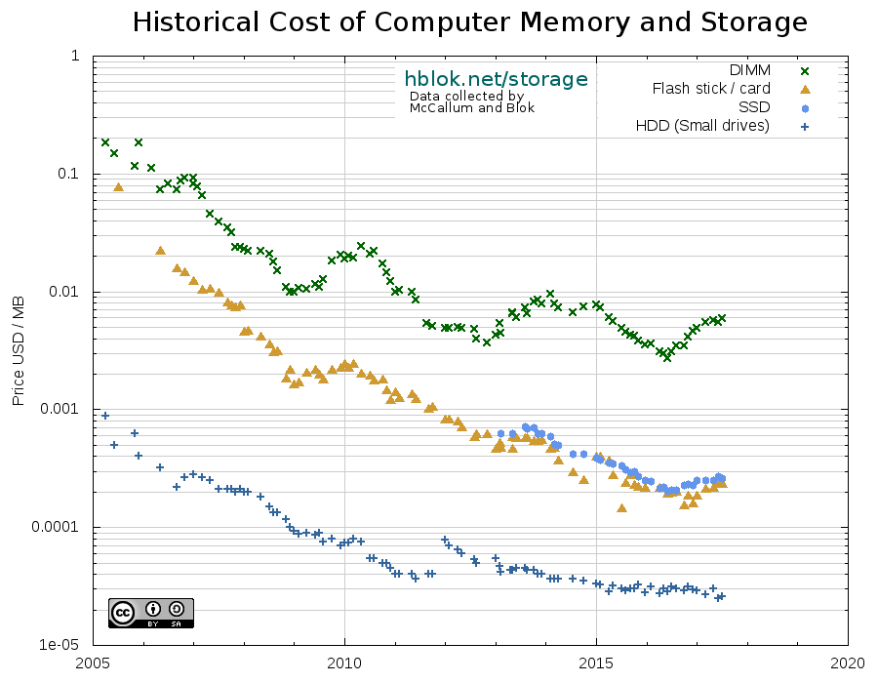
Memory Cost trends
In your lifetime the cost of 1GB of storage has dropped from 10 dollars to less than a penny
DRAM
Flash
Magnetic Disc
https://hblok.net/blog/posts/2017/12/17/historical-cost-of-computer-memory-and-storage-4/

Slide 29
Other Methods?
How else do we store information?
CD’s
Now Flash memory
Hard Drives
Now the Cloud
The future?
Quantum Storage?
What is the appropriate Technology

Slide 30
Social Message
Appropriate Technology
A new materials-based technology has to work in people’s daily lives. It has to be “appropriate” to their needs
Different technologies co-exist based on what is appropriate in a specific situation of use (why paper and SSD’s co-exist)
Part of being appropriate in knowledge recording is preserving the stored information (or not preserving it)

