Slide 1
Silicon
Module 12

Slide 2
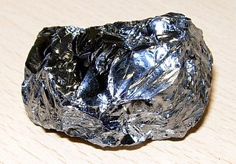
SILICON
Properties
High melting point (1414°C)
Non conducting (if pure) (typically 99.999999%)
Has a bandgap (what’s that?)
Reflects light/shiny
Brittle
Can be doped
Not used for implants
into the body (that’s
silicone, a polymer)
https://upload.wikimedia.org/wikipedia/commons/thumb/e/e9/SiliconCroda.jpg/330px-SiliconCroda.jpg

Slide 3
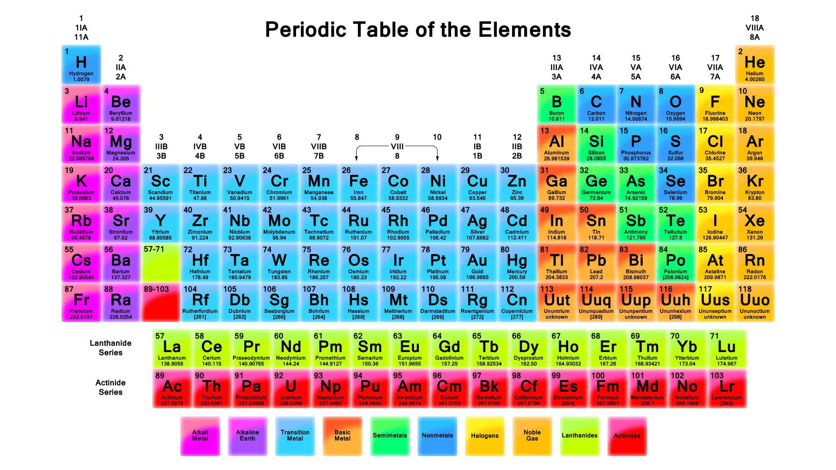
WHAT IS SILICON?
Silicon vs Aluminum

Slide 4
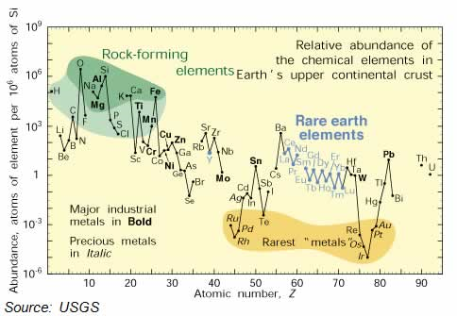
#1

Slide 5
SILICON
1st computer: Eniac Computer 18,000 Vacuum tubes 30,000 tons
"I think there is a world market for maybe five computers." -- Thomas Watson, chairman of IBM, 1943
Why do we refer to this as the Silicon Age?
First need to understand how you can get a material to actually encode and manipulate numbers and letters
Key was binary representation
Switches

Slide 6
SO HOW DO YOU MAKE A SWITCH?
Ge vs Si
SiO₂
Doping
Transistor

Slide 7
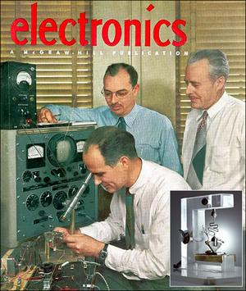
Electronic Materials
“IN DECEMBER 1947, Bells Labs scientists John Bardeen and Walter Brattain first revealed what would come to be known as the transistor. Soon after Bardeen and Brattain made their breakthrough, William Shockley, also at Bell Labs, invented the first semiconductor transistor. All three were awarded the 1956 Nobel prize for their efforts.
Justin Rattner, chief technology officer of Intel, calls the transistor "the fundamental building block of the information age.”
http://www.smh.com.au/news/technology/the-transistor-at-60/2007/11/26/1196036813732.html
Notes:
What did you think of the books?
What is your opinion of the respective writing styles? Organizations?
What did you learn from reading two accounts of the same period? Did you notice differences in emphasis?

Slide 8
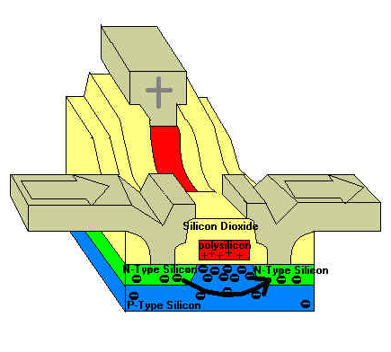
WHAT IS A TRANSISTOR?
Structure
Amplifier
Switch
Store 1’s and 0’s
http://lazarus.developpez.com/cours/eric-thirion/bases-programmation/images/Transistor-1.jpg

Slide 9
WHAT HAPPENED NEXT
1950’s discrete transistors
1960’s Noyce at Fairchild and Kilby at TI figure out how to integrate devices onto a chip with interconnects (awarded 2000 Nobel prize in Physics)
1968 Noyce and Moore leave Fairchild to start new company (Intel)
1965 10devices/chip but by 1969 1000 devices/chip
Doubles every 1 1/2-2 years: Moores Law is born
1971 put multiple functions on a single chip birth of the microprocessor
1975 First PC
"There is no reason anyone would want a computer in their home." -- Ken Olson, president, chairman and founder of Digital Equipment Corp., 1977.

Slide 10
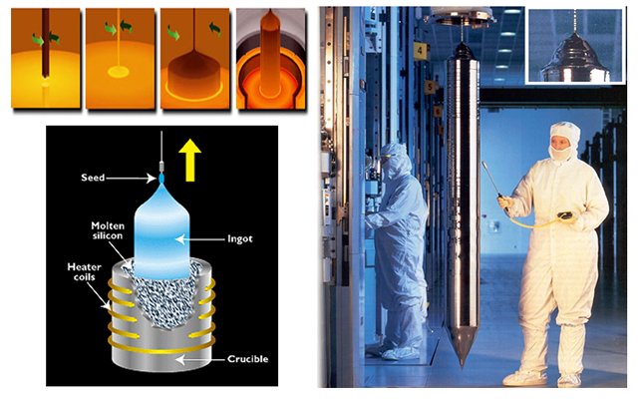
Processing of Silicon
http://cnfolio.com/ELMnotes15
http://cnfolio.com/images/img163ingot.jpg

Slide 11
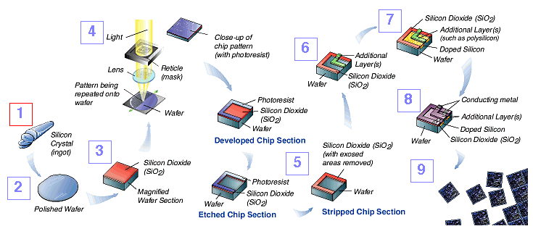
Microelectronics Processing
/www.sematech.org/corporate/news/mfgproc/mfgproc.htm

Slide 12
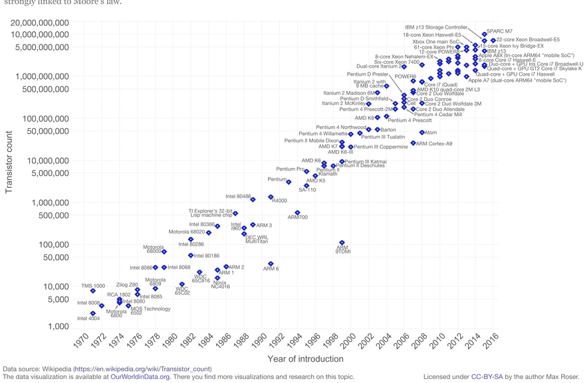
Moore’s Law
www.intel.com

Slide 13
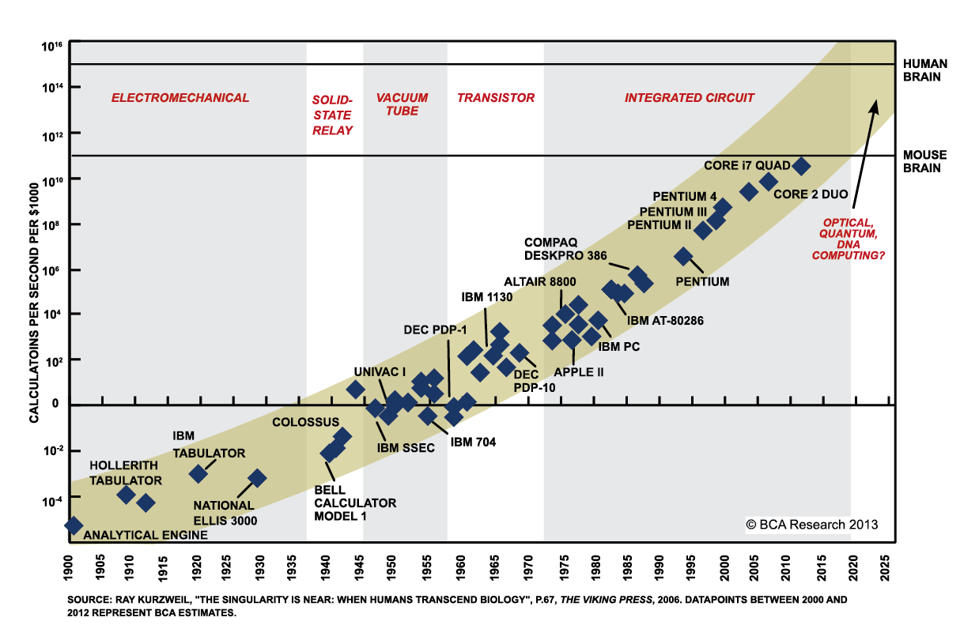
Another way to look at Moore’s law
http://www.bizmanualz.com/wpblog/wp-content/uploads/2005/10/Moores-Law.jpg

Slide 14
Why is this the Silicon Age? Societal Impact
Name Things that would not exist without electronic materials and the digital age that has been derived from them:
http://www.allaboutvision.com/cvs/children-computer-vision-syndrome.htm

Slide 15
Why is this the Silicon Age? Societal Impact
Name Things that would not exist without electronic materials and the digital age that has been derived from them:
iPods/IPads/Personal Computers
Wikipedia
Extended Weather Forecasting
iTunes
Social media
YouTube
Email
Texting
Twitter
SPAM
Blogs
Facebook
Digital Textbooks
Video Games
Dating websites
Fantasy Football
The Cloud
http://www.allaboutvision.com/cvs/children-computer-vision-syndrome.htm

Slide 16
Do cell phones cause nearsightedness?
December 2009 issue of Archives of Ophthalmology found that the prevalence of nearsightedness among Americans has increased from 25 percent to 41.6 percent of the population over the past 30 years — an increase of more than 66 percent.
Also, among people with 12 or more years of formal education, the prevalence of myopia is now as high as 59.8 percent.
What are other potential downsides to the technological advances enabled through electronic materials?
http://www.allaboutvision.com/cvs/children-computer-vision-syndrome.htm

Slide 17
Do Cellphones contribute to Depression?
Jean Twenge, a professor at San Diego State, argues in The Atlantic this week that smartphones may be destroying a generation of teens
Today's teens go out less, date less, and feel more depressed and suicidal, according to Twenge's data.
There's a strong link between the amount of time they spend looking at screens and how sad they feel.
https://www.cnbc.com/2017/08/05/smartphones-ruining-mental-health-teens.html

Slide 18
THE FUTURE
Moores Laws is good down to 5-7nm (6-8 years)
Low Power is the key
3-13% of national energy is consumed by computers
New Materials
Lots of Research needed
Vertical devices
Graphene, MoS₂

Slide 19
Wearable electronics
Organic Semiconductors
Flexible Electronics
CNN Today: Throat Tattoo
Wearable electronics will lead to better health monitoring
Blood pressure, heart rate
Blood glucose
Disease markers
Other advances

Slide 20
Semiconductors are not confined to computing
The LED revolution is the result of inorganic semiconductors like GaN that emit light

Slide 21
How about even shorter wavelengths? DEEP UV?
Semiconductors are used to create LED’s
Wavelength has been getting shorter for the past 30 years from IR down to visible
This has resulted in a lighting revolution
Recent advances are enabling formation of deep UV LED’s (250nm)
What does one use a deep UV LED for?

Slide 22
Future Displays?
Replacing TFT and LCD with organic devices?
What is an OLED?
Look it up, its pretty interesting
How about wearables?

Slide 23
Other Semiconductors
Silicon Carbide and GaN
High bandgap semiconductors
Used primarily for energy applications
Brushless motors
Require SiC to converter DC voltages to AC pulses of current exactly when needed at very high powers
Applications
Electric vehicles, washing machines, AC, Refrigerators etc.
Almost doubles the motor efficiency

