Slide 1
Dripping Diamonds like Marylyn
Song

Slide 2
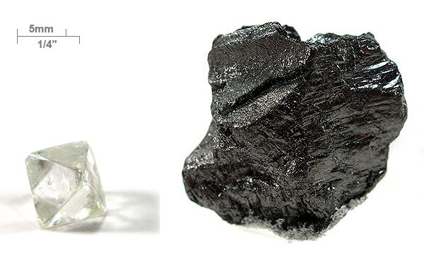
Carbon comes in many forms

Slide 3
What are the properties of Carbon?
Graphite
Diamond
Graphene
CO₂

Slide 4
What are the properties of Carbon?
Graphite
Diamond
Opaque
Soft
Slippery
Conductive
Very Hard
Insulating
Transparent
High refractive index
Graphene
CO₂
Translucent
Strong
Very Conductive
Flexible
Gas
Colorless
Non-toxic
Greenhouse Gas

Slide 5
Allotropes
Multiple structures of a single element
  Carbon properties varies because the structure varies
Allotropes of Carbon include:
  Graphite: bulk SP₂ bonding: 2-D
    Layered structure
  Diamond: Bulk SP₃ bonding: 3-D
    Cubic structure
  Graphene layered SP₂ bonding 2-D
    Single sheet of Graphite

Slide 6
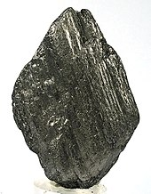
Graphite
Mineral: SP₂ bonded stacks of sheets
Applications
  Lubricant
  Paints
  Molds (first for cannon balls)
    later other metals (very high Tm of 3600°C it actually sublimes)
  Pencils
  Battery Electrodes
  Steel making
  Brake linings etc.

Slide 7
Diamonds
SP3 bonded Cubic
Engineering Applications
  Cutting tools
  Wide Bandgap (5.4eV) Semiconductor
    High temperature, high power, radiation environments
  Highest Thermal Conductivity
    Heat Sinks for electronics
  Optics for Lasers
    Ideal for windows
Gemstones (Natural vs Synthetic)
  Gemesis, Diamond Foundry conflict free diamonds
  DeBeers Answer: Lightbox Diamonds (1/4 the cost)
    Goal: Reduce the perceived value of synthetic Diamonds

Slide 8
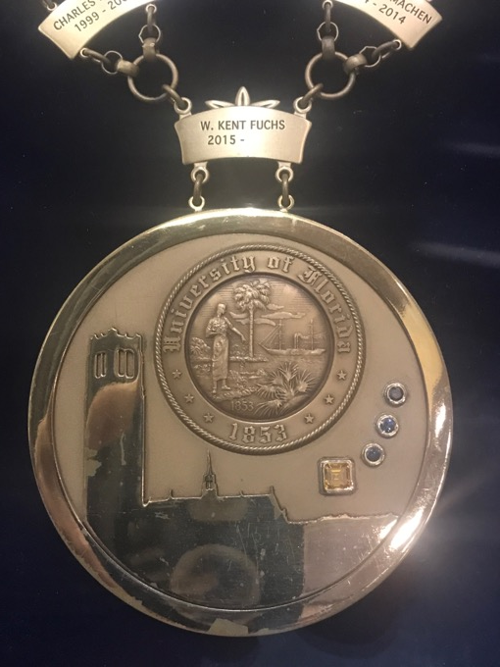
Challenges
Difficult to grow large single crystals
HPHT process, Gemesis (Pure Grown Diamonds)
  Colored diamonds possible
  Process developed partially at
    UF MSE
  Orange and Blue diamonds in Presidential Medallion
  (check them out)

Slide 9
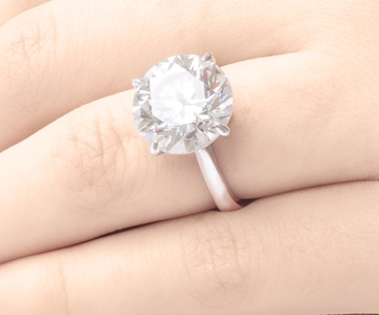
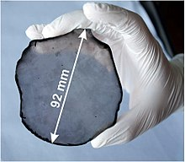
Diamonds
    CVD Process
      Video of Process
      Largest (9 ct)
CVD grown single crystal Diamond
For electronic applications
Jewelry Applications
9 ct colorless
https://upload.wikimedia.org/wikipedia/commons/thumb/3/3d/Single-crystal_CVD_diamond_disc.jpg/220px-Single-crystal_CVD_diamond_disc.jpg
https://mma.prnewswire.com/media/694603/9_04_Carat___WD_Lab_Grown_Diamonds.jpg?p=publish

Slide 10
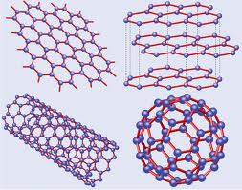
Graphene
    Single 2-D sheet of graphite
    How was it discovered?
      Scotch tape
    Applications (hundreds see website)
      Medicine, Electronics, Sensors, Energy etc.
      Flexible electronics, oxide for water desalination
    Other versions of Graphene
      Rolled up sheet ie carbon nanotubes
      Highest tensile strength ever measured 63GPa (steel is 0.4GPa)
        elevator into space etc.

Slide 11

Vantablack
Graphene (Carbon nanotubes)
Blackest material ever made
Satellites
Paint
BMW painted in Vantablack

Slide 12
CO₂ and the Carbon Cycle
We create 37GT (37 billion tons) of CO2 every year
About half is absorbed and the other half goes into the atmosphere the form of CO₂
wikipedia

Slide 13
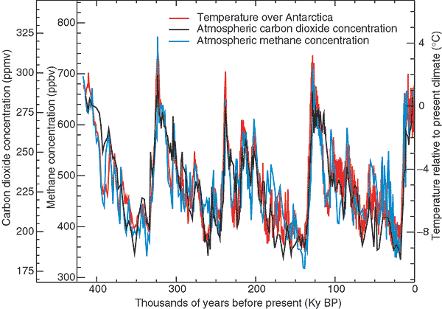
Absolutely Clear Correlation between Global Temperature and CO₂
Note the range of fluctuations 175-325ppm
Nate Lewis Caltech

Slide 14
CO₂ over the last 10,000 years
1600 AD

Slide 15
Where are we today?
CO2 levels hit 415ppm this year (highest in 3.5M years)
Today
Start of the Industrial revolution

Slide 16
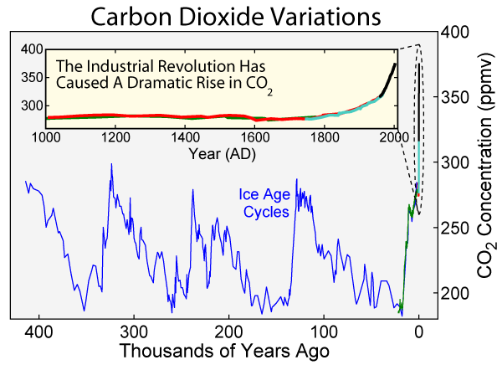
Last 400,000 Years
Red is your lifetime
Last 20,000 years
Started to spike around 1600AD

Slide 17
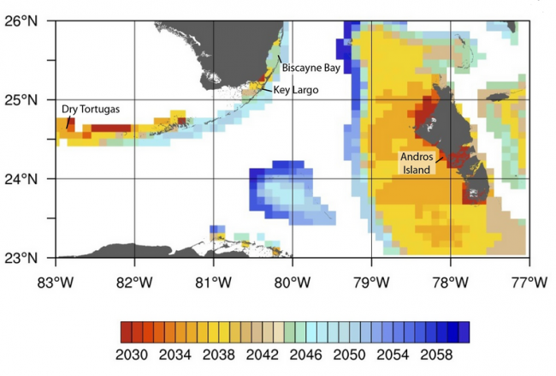
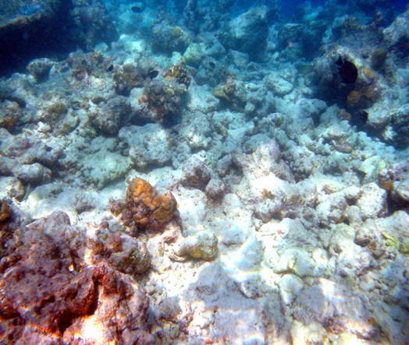
Greenland Ice Sheet
Most of the Reefs off Florida will be gone by 2050
Just 30 years from now
Coral Bleaching
Nov. 2016 Barrier Reef reports
worst Bleaching
Sea level rise
Climate change
Drought etc.
Coral Bleaching
Loss of habitat
Etc.
https://research.noaa.gov/News/ArtMID/451/ArticleID/812/New-high-resolution-projections-of-coral-bleaching-in-the-Gulf-of-Mexico-and-Caribbean-will-help-managers-better-prepare-for-a-more-resilient-future

Slide 18
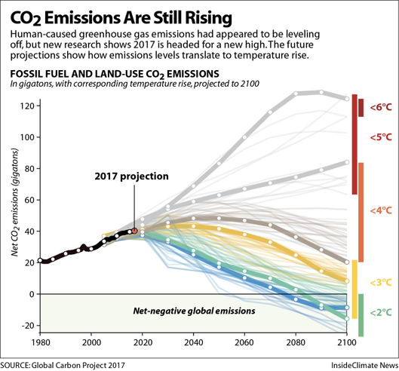

Slide 19
What can be done to address rising CO₂?
Solution is Simple
  Emit less CO₂
  Capture more CO₂

Slide 20
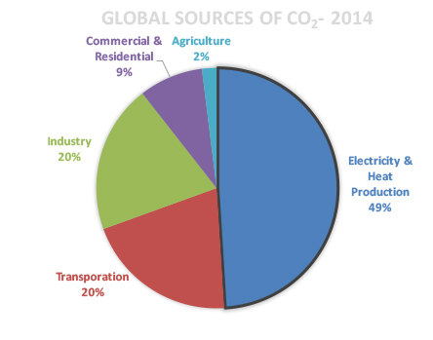
Sources of CO₂
34GT per year
Most of it from Energy Production

Slide 21
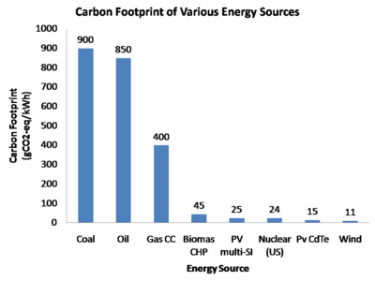
Produce Less CO₂

Slide 22
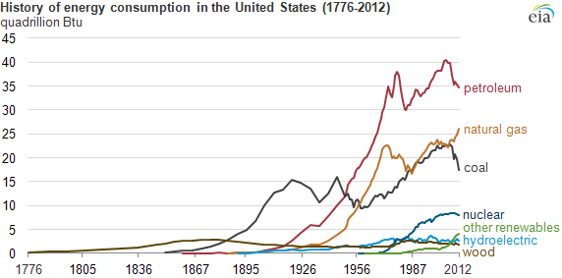
Switch from Coal to Natural Gas

Slide 23
Solar Energy Cost Comparison
Solar and Wind are becoming cheaper than gas or coal

Slide 24
Possible Solutions (entire course)
Electricity from Renewables
Electric Vehicles
Improving Batteries
Hydrogen for Ocean Shipping
DC Brushless motors
Biofuels for Aircraft, Trucking
Smart grids, IOT
Alternative Steel Fabrication (Hydrogen)
CO₂ injection in Concrete
Reforestation
Sequestration and storage
Less Meat

Slide 25
Conclusions
Allan Savory Talk
  TED Talk
Nate Lewis Talk
  Alternative Energy
Other Options:
  Clean Coal challenges?
  Nuclear challenges?
  Solar challenges?
  A material (carbon) Tax?
Lots of work to be done
Hawking Prediction

Slide 26
Conclusions
Carbon comes in many forms
  From some of the softest to the hardest materials
  From very low tensile strength to the highest recorded
It’s the basis for many amazing materials
  Enabled industrial revolution
  New methods of fabrication
    CVD Diamond
  New forms are being discovered
    Graphene, Graphene Oxide, CNT etc.
  Only material with its own tax CO₂
Lots of Opportunities and Demanding Challenges for Future Engineers

