Slide 1
Welcome to iClicker!

Slide 2
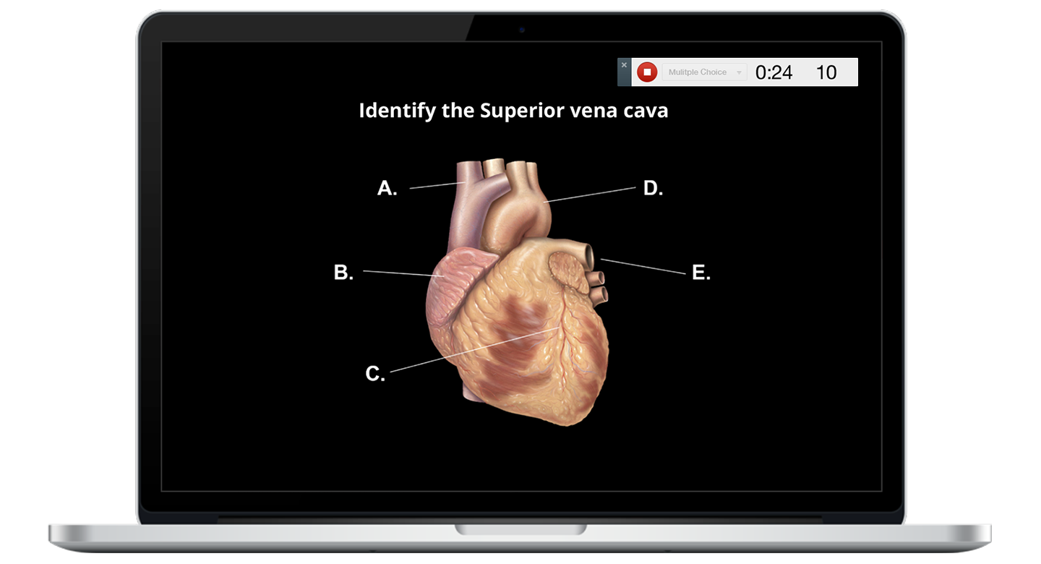
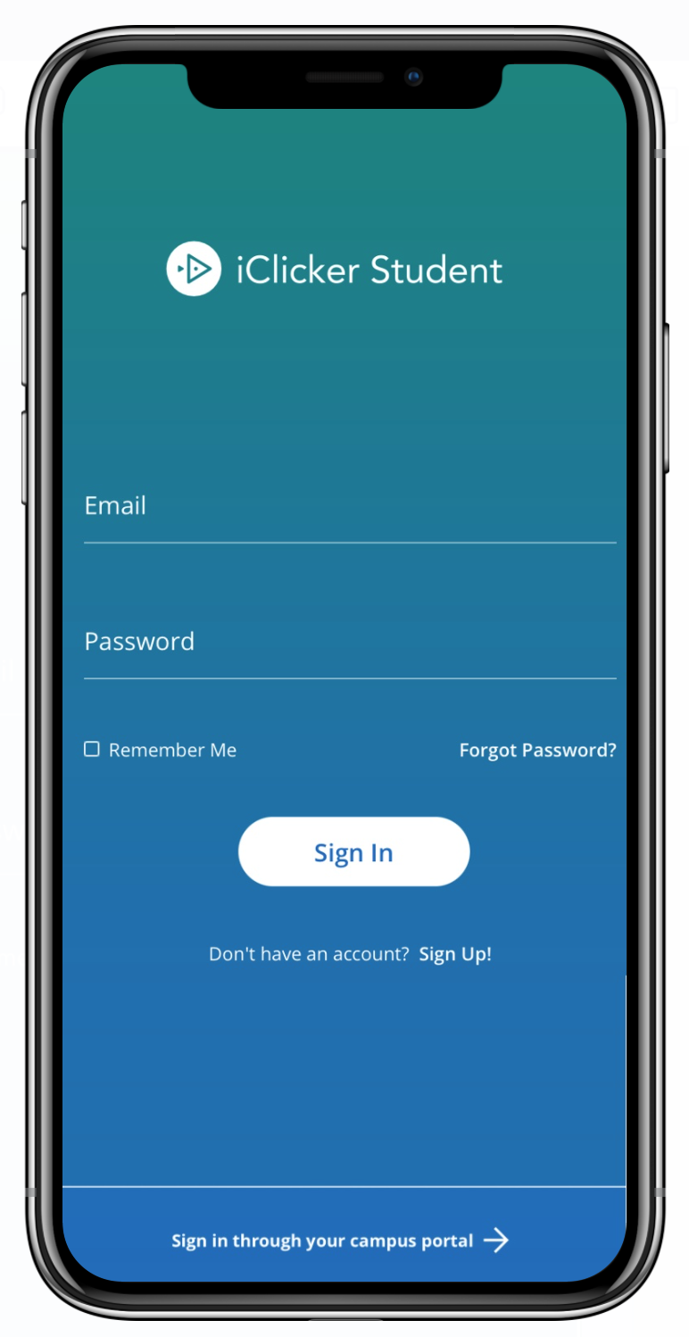
Devices allowed in class
You are required to bring a device to participate in my class sessions.
I will be allowing the use of the iClicker student app (on a smartphone, tablet, or laptop.

Slide 3
Check your email!
I have set up an iClicker integration with our Canvas course, which pulls your names directly into my iClicker roster.
If you have an existing iClicker account that uses an official university email address and/or Student ID, you will automatically be added to our iClicker course. Check your courses list in the iClicker app to make sure!
If the iClicker system does not find a matching iClicker student account, you will receive an email from iClicker Support with instructions to create a new account or update your existing account's profile.
Please note: this email may appear in your Spam or Junk folders.

Slide 4
Create an iClicker account
You must create an iClicker account to ensure your grades are counted
Visit iClicker.com > Create an Account > Student.
Or, download the iClicker Student iOS/Android app.
Select Sign Up! to create your account.
If you already have an iClicker account, just sign in! Do not create and use more than one iClicker account as you will only receive credit from a single account.

Slide 5
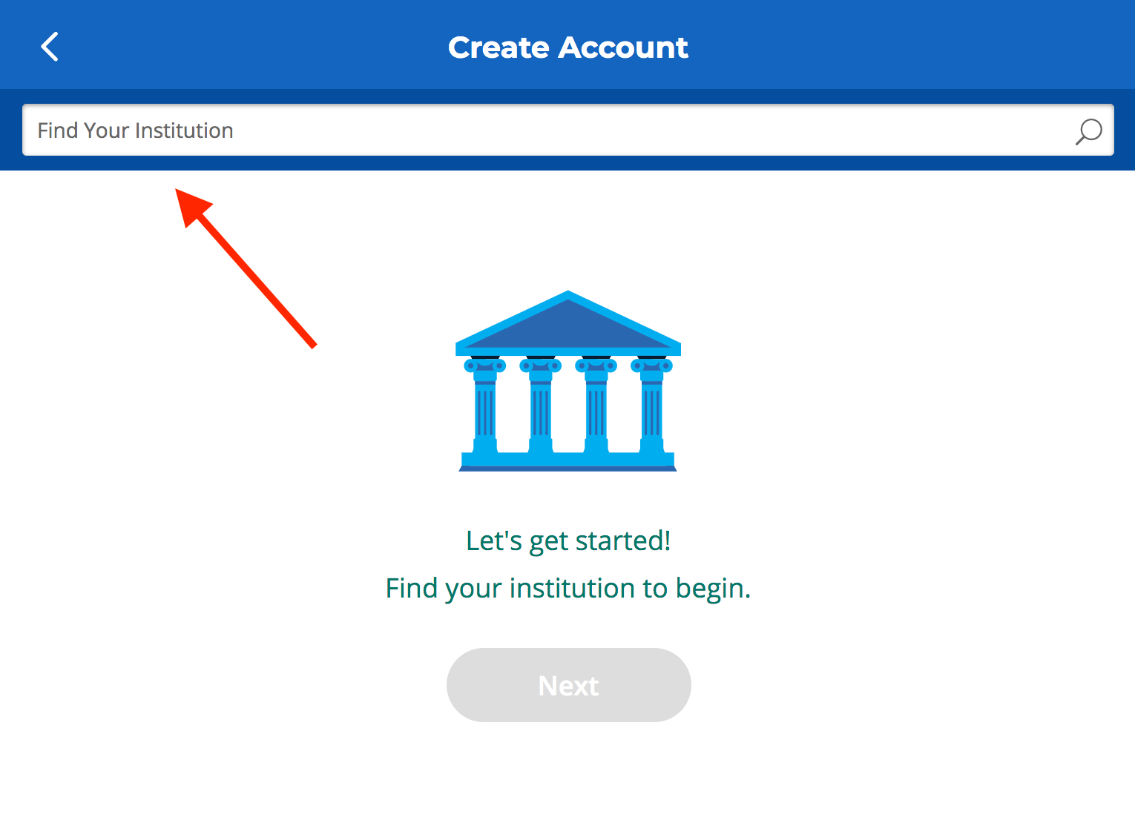
Enter your institution
Enter University of Florida as your institution when creating your account.
Select Next.

Slide 6
Complete your iClicker profile
On the Create Account form, fill out your:
First Name
Last Name
University Email (example@yourinstitution.edu)
Student ID
Create and confirm your password.
Select Create Account.

Slide 7
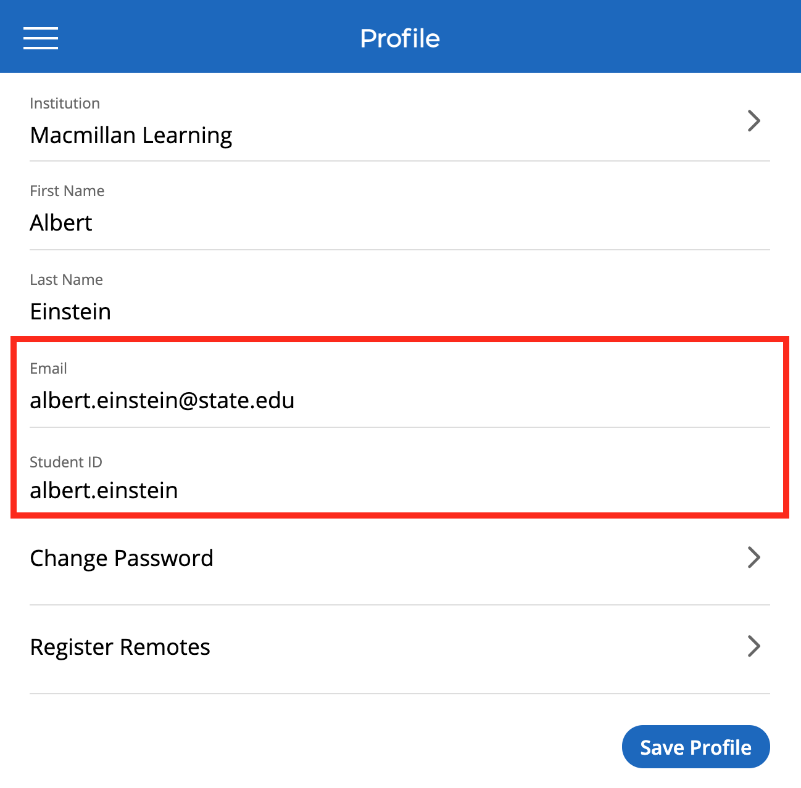
Edit an existing iClicker account
If you already have an iClicker account:
You may need to edit your existing iClicker account so you are using the correct university email (example@yourinstitution.edu) and Student ID
Visit iClicker.com > Sign In > Student
Select Menu > Profile
Click Save Profile before exiting if you are using the iClicker web app.

Slide 8
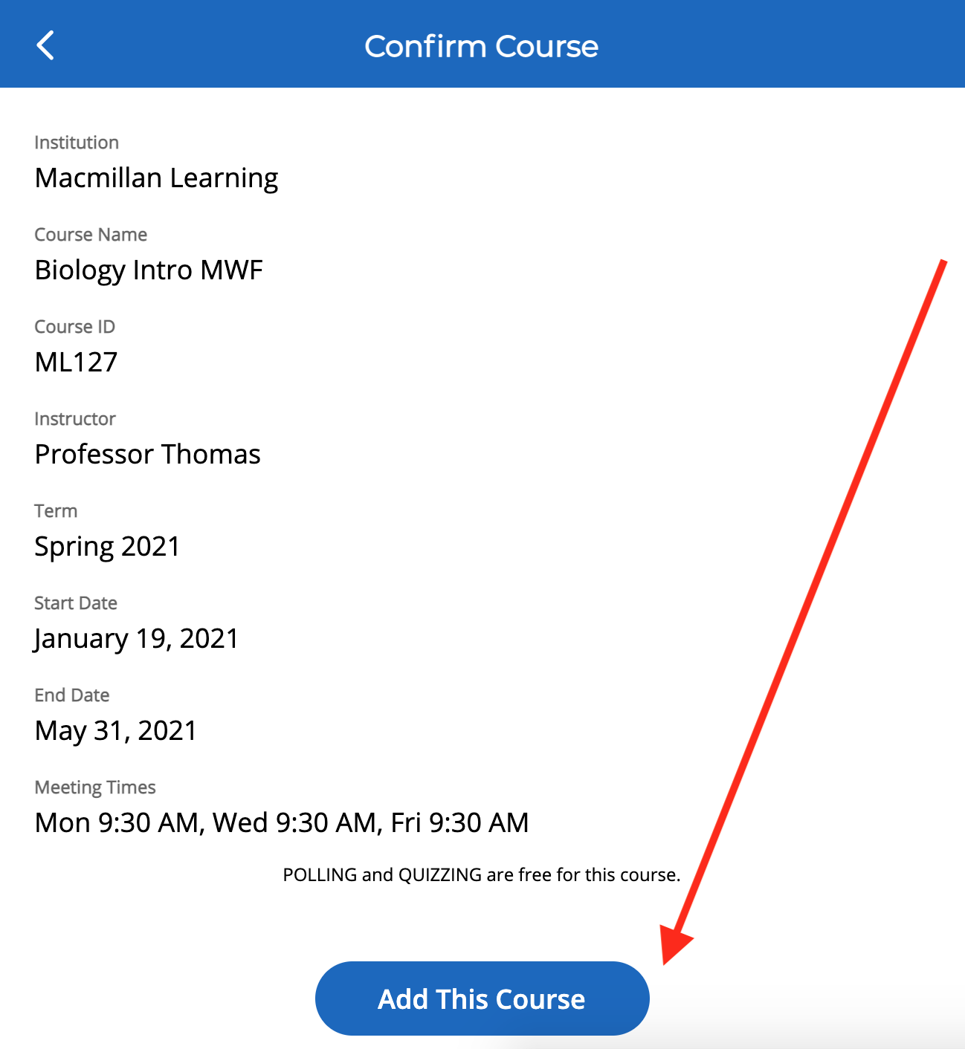
Check your iClicker course list
If you are not seeing this course in iClicker, use the + sign on the main screen to search for my course.
In the “Find Your Institution” field, enter University of Florida
In the “Find Your Course” field, enter PHY2053 Fall 2021
Double-check the details you see to make sure you select this course: You must choose the lecture you have registered for:
P4 PHY2053 Fall 2021
P5 PHY2053 Fall 2021
Select Add This Course and it will be added to the main screen of the iClicker app.

Slide 9
Now you’re ready to go!
I will be running extra credit problem solving sessions in class.
iClicker Student App Users: When I start a session, you will see a button appear on your screen to Join my class. Click this button to start participating in my session for the day.

Slide 10
Questions or Trouble Registering? Visit iclicker.com/support to submit a support ticket and contact the tech support team.
I have also added these steps and links to helpful iClicker troubleshooting guides in the syllabus.

