Slide 1
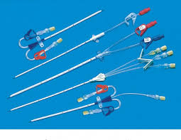
Gwendolyn Ritter-Randolph NUR 3816 /Fall 2016 University of Florida College of Nursing
PREVENTION OF CENTRAL LINE ASSOCIATED BLOODSTREAM INFECTIONS (CLASBI) IN ADULT ICU PATIENTS

Slide 2
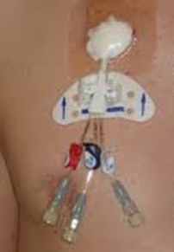
Purpose
To analyze current data in order to identify effective interventions to prevent CLASBI in ADULT ICUs.

Slide 3
Central Line Associated Bloodstream Infection (CLABSI)
A central line-associated bloodstream infection is defined as laboratory confirmed bloodstream infections associated with CVCs when a CVC has been in use 48 hours prior to the onset of an infection with no apparent source except the CVC.
(Basinger, 2014)

Slide 4
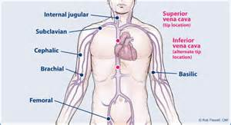
Background
Central venous catheters are used for the administration of:
Fluids
Medications/TPN
Blood Products/Blood sampling
Hemodynamic Monitoring
Hemodialysis
(Chopra,Krein,Olmsted,Safdar. & Saint, 2013; Kim,Holton, & Vigen, 2011)

Slide 5
Background
Central Catheters Disrupt skin integrity, making infection with bacteria and or fungi possible.
This infection can spread to the blood stream causing sepsis with hemodynamic changes, organ dysfunction, and death.

Slide 6
Sources of CVL Contamination*
Extraluminal- Skin organism introduced during catheter insertion or contaminated dressings.
Intraluminal- Contamination of the catheter or hub by hands or devices that deliver bacteria into the catheter lumen.
Hematogenous Spread- Infection originating from another body site and travels through the bloodstream and infects the catheter.
Contaminated Infusate- Fluid or medications contaminated during preparation or manufacture.
*Dumont & Nesselrodt, 2012

Slide 7
Impact of CLASBI
The Center for Disease Control estimated in 2009*
18,000 CLASBI in ICUs in USA
12 – 15% Mortality
Each incidence Increase hospitalization 7 – 21 Days
Adds $37,000 to each hospitalization=.67 – 2.68 Billion Dollars
*Dumont & Nesselrodt, 2012; Chopra et al., 2013; Furuya et al., 2011

Slide 8
METHODS
Literature search conducted using
CINAHL, ProQuest, and Google Scholar databases
Search terms used-CLABSI, prevention, and ICU.
Articles chosen were based on relevance to the topic and nursing practice. From 50 articles reviewed 6 articles were selected for final examination.

Slide 10
FINDINGS
Daily Cholorohexidine baths led to significant reduction in occurrence of CLASBI.
The use of Chlorohexidine impregnated sponges showed a decrease in the frequency of CLASBI occurrences.
Daily Assessments and prompt removal of central lines when no longer needed greatly reduced the occurrences of CLASBI.
Unit based education needed to be implemented for these interventions to be effective.
*Sievert, Armola, Halm, 2011; Dumont & Nesselrodt, 2012; Chopra et al., 2013;

Slide 11
Recommendations for Nursing Practice
Implementation of CVC bundles to include hand hygiene, maximum sterile barrier precautions during insertion
Daily Chlorohexidine baths
Disinfect hubs and needless connectors with appropriate antiseptics before accessing central lines
Daily review of line necessity with prompt removal of unnecessary lines.
Central Line insertion and maintenance checklists
Unit based educational programs

Slide 12
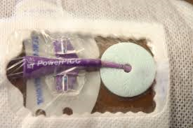
Conclusion
This research study focused on identifying the most effective interventions for the prevention of CLASBI in adult ICUs.
Implementation of CLABSI Prevention interventions led to significant reduction in occurrences of CLABSI in adult ICUs.
This study also showed the importance of unit based education efforts to reduce the occurrence of CLABSI.

Slide 13
Table of Literature Reviewed

Slide 14
References
Basinger, M.A. (2014). The reduction of central line-associated bloodstream infections in intensive care units through the implementation of the comprehensive unit-based safety program (Doctoral Dissertation). Available from ProQuest Dissertations & Theses Global.
(Order number 3631691).
Centers for Disease Control and Prevention (2011). Guidelines for the Prevention of Intravascular Catheter-Related Infections. Retrieved from http://www.cdc.gov/hicpac/pdf/guidelines/bsi-guidelines-2011.pdf
Dumont, C., & Nesselrodt, D. (2012). Preventing central line-associated bloodstream infections CLABSI Nursing2012, 42(6), 41-46. doi: 10.1097/01.NURSE.0000414623.31647.f5
Furuya, E. Y., Dick, A., Perencevich, E. N., Pogorzelska, M., Goldmann, D., & Stone, P. W. (2011).
.

Slide 15
References
Central line bundle implementation in US intensive care units and impact onbloodstream infections. PLoS One, 6(1), e15452. doi:http://dx.doi.org/10.1371/journal.pone.0015452
Kim, J. S., Holtom, P., & Vigen, C. (2011). Reduction of catheter-related bloodstream infections throughthe use of a central venous line bundle: Epidemiologic and economic consequences. AJIC: American Journal of Infection Control, 39(8), 640-646. doi:10.1016/j.ajic.2010.11.005
Zingg W, Cartier V, Walder B, et al. (2014). Hospital-Wide Multidisciplinary, Multimodal Intervention Programme to Reduce Central Venous Catheter-Associated Bloodstream Infection. Plos ONE, 9(4):1-7

